Slide 1
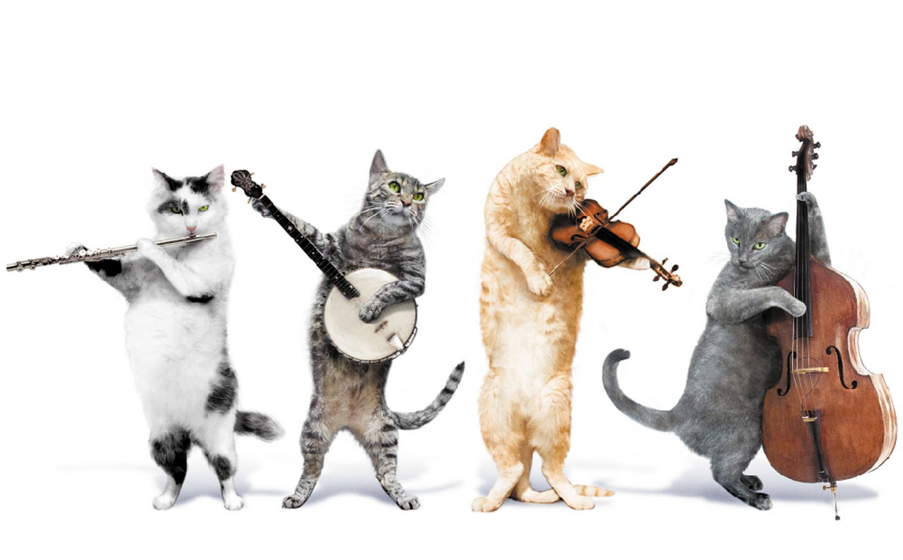

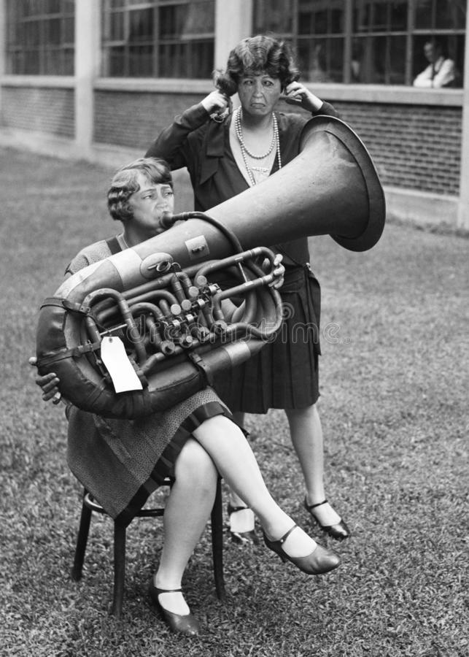

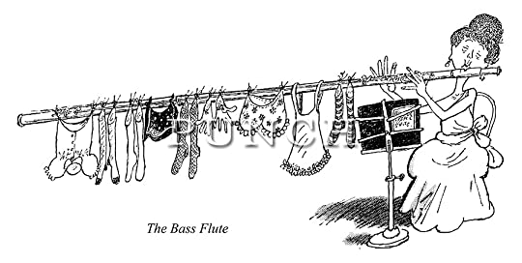
in Music
in Music
Associate Professor Patrick Shepherd
Faculty of Education, University of Canterbury
U3A Timaru 10 August 2026

Slide 2
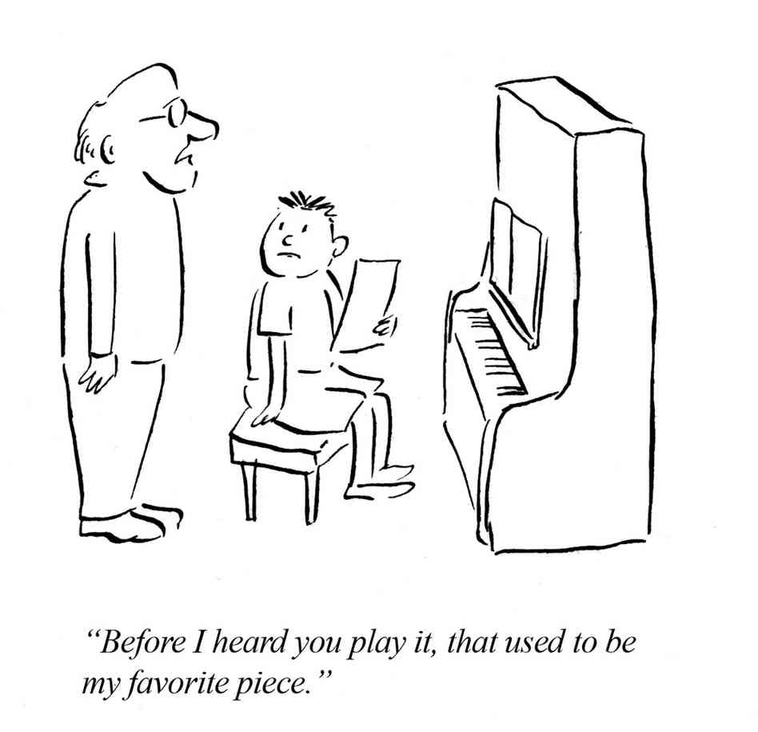

Just to get the party going and to set the tone…
Notes:
Every music teacher has stories about their students.
The music is Ku-ku, best known as Laurel and Hardy’s “signature motif”. We’ll hear more from them later on.

Slide 3
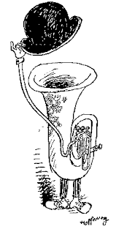
What is “humour in music”?
Like humour itself, it is highly subjective, but what is “humour in music”?
There is a range, from the quirky, thought-provoking wit that tickles the mind to full-blown laugh-out-loud physical humour
Origins of musical humour – how did it start and how did it change?
Musical humour can be loosely around the sub-categories of:
    Humour “about” music, often by musicians themselves and expressed as jokes, cartoons or anecdotes with little or no musical knowledge required to appreciate them
    Humour “in” music i.e. musically-situated humour that can’t easily be translated into another medium, often “intellectual” humour
    Humour “through” music i.e. using music as a comic tool
    Intentional and unintended humour
    “Novelty” items and curiosities
    …and some outliers…
Notes:
Like humour itself, it is highly subjective and that is what you’re going to get today. I hope today’s talk is designed to be as thought-provoking as it is amusing
I aim to cover a range of “humorous music”, from the quirky, intellectual wit that tickles the mind to the full-blown laugh-out-loud physical humour
Origins of musical humour – how did it start and how did it change?
Musical humour can be loosely around the sub-categories of:
Humour “about” music, often by musicians themselves and expressed as jokes, stories or anecdotes with little or no musical knowledge required to appreciate them e.g. what is the difference between a musician and a pizza? A pizza can feed a family of four
Humour “in” music i.e. musically-situated Humour that can’t easily be translated into another medium
Humour “through” music i.e. using music as a comic tool
And the curiosities…

Slide 4
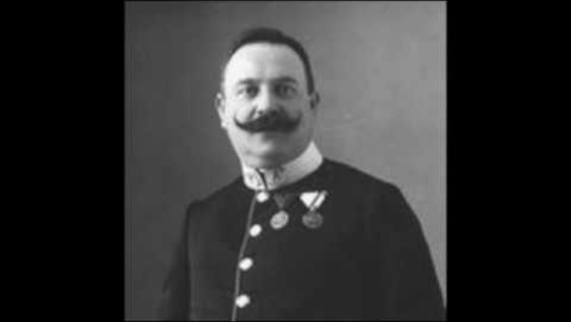
Notes:
Originally not intended as humorous at all, in fact the opposite. But now we simply associate this with clowns.

Slide 5
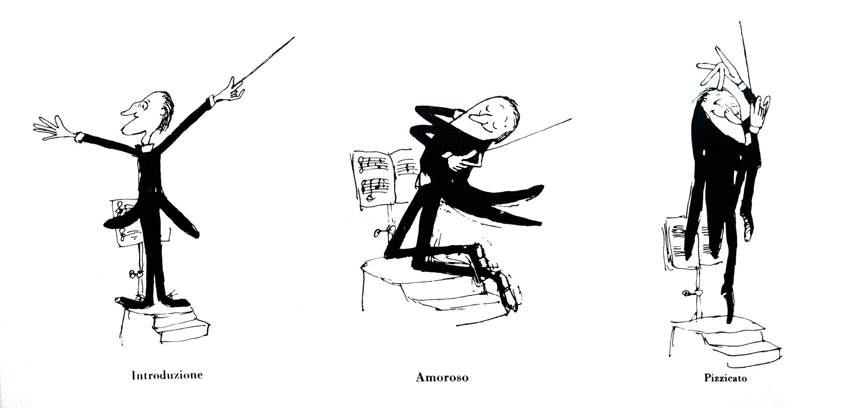
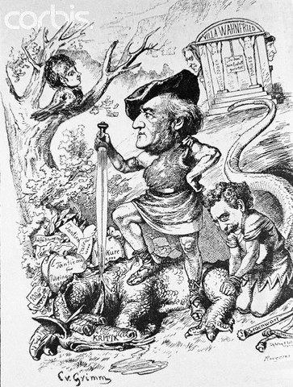
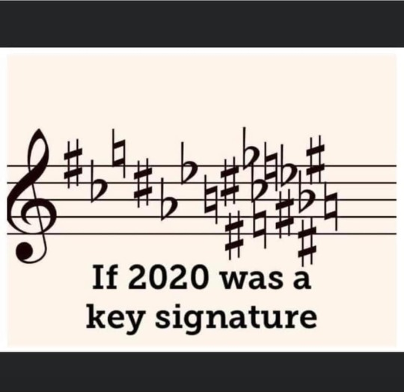

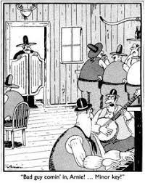
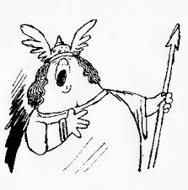
Cartoons

Slide 6
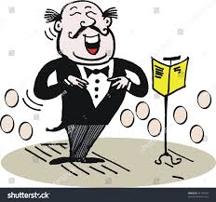
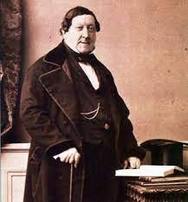
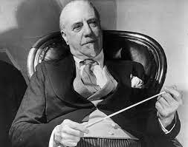
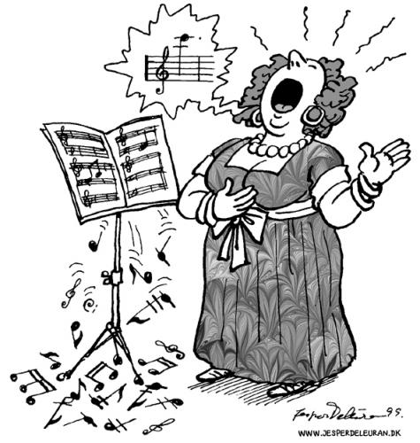
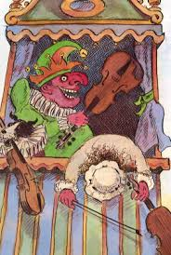
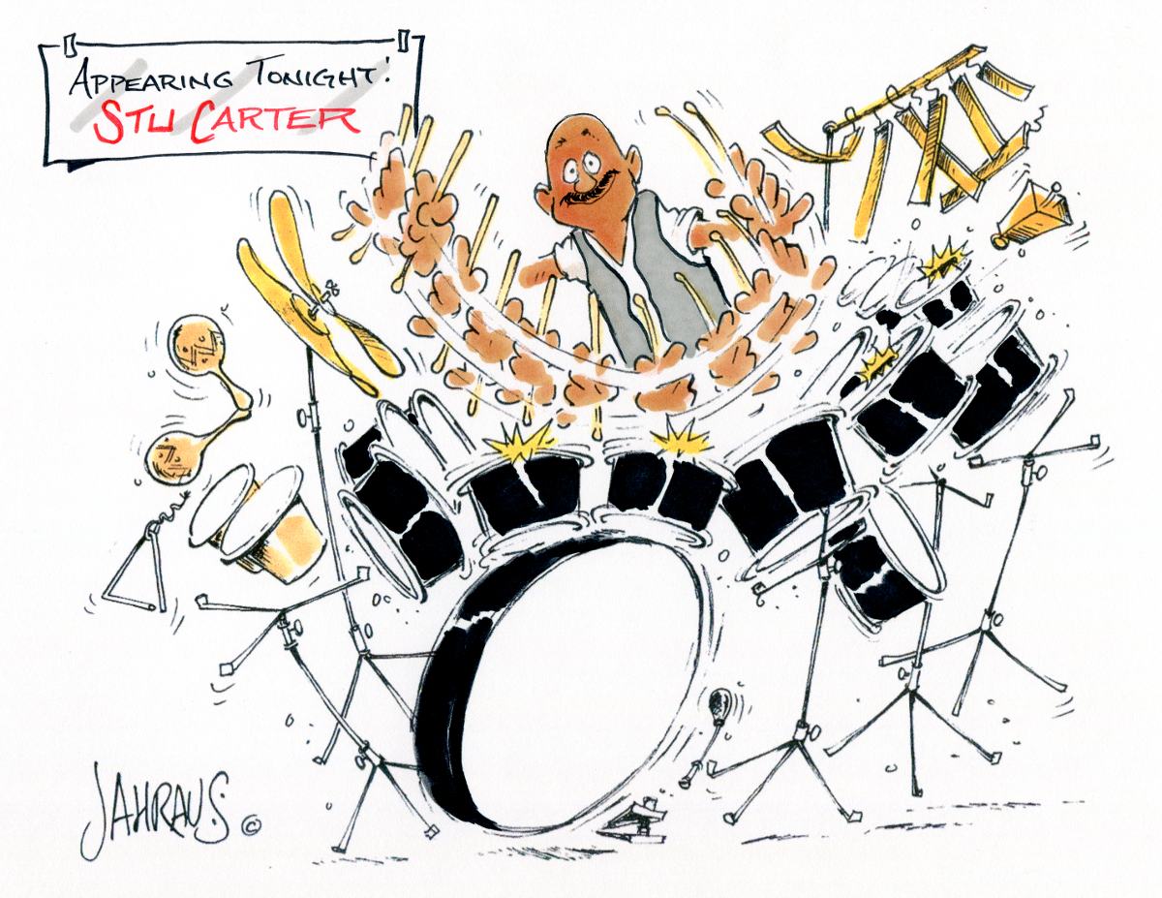
Anecdotes
Opera stories
Hierarchies – drummers, singers, bassonists and viola players
Musicians on musicians
Notes:
Opera stories – Tosca (x2)
the foreign chorus following Tosca over the parapet
The strategically placed trampoline under where Tosca was to land
Hierarchies – drummers, singers and viola players
A drummer went for a job and the boss asked him how many school certificate subjects he had and the drummer said he had 40. “You’re kidding!” exclaimed the boss. The drummer replied, “Well, you started it!” (the premise being that drummers are thick)
Why was the tenor standing outside of his own front door? Because he couldn’t find the right key and he didn’t know when to come in anyway (the premise being that tenors are out of tune and can’t count)
What is the difference between a violin and a viola? A viola takes longer to burn.
Musicians on musicians
Sir Thomas Beecham was infamous for his politically incorrect and often scathing attacks on fellow musicians. He once told a female cellist that she had between her legs an instrument that gave pleasure to millions and all she was doing was sitting there scratching it – in front of the orchestra! He also described the harpsichord as sounding like skeletons copulating on a tin roof. He would not survive today!
Beethoven said of Rossini’s music, “It is not as bad a sit sounds.”

Slide 7
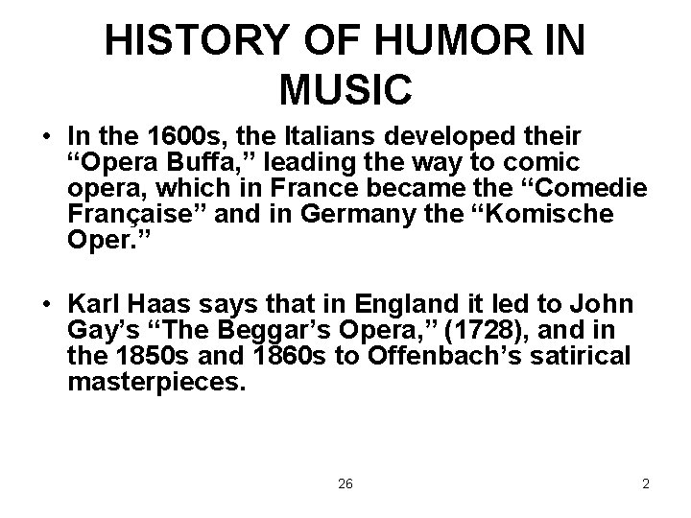

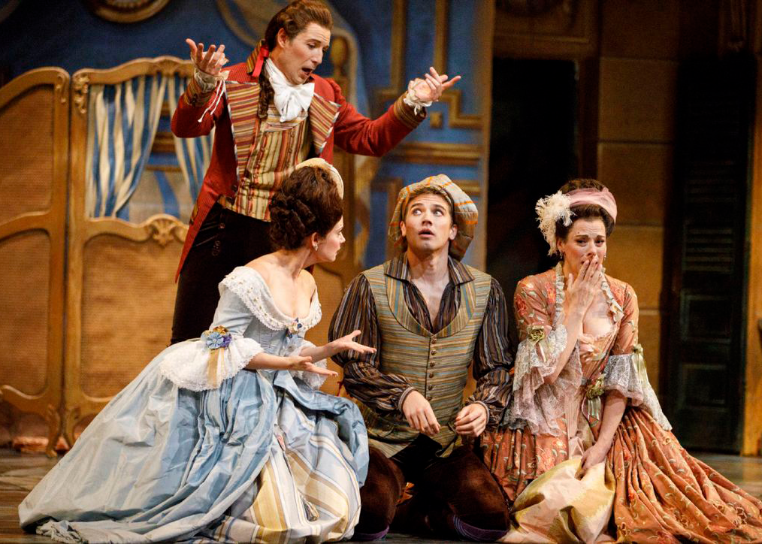
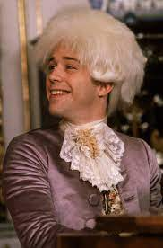
Notes:
Ridiculous story lines, mistaken identity, infidelity, people hiding in cupboards, popular stories of the day e.g. (left to right):
Barber of Seville (Rossini)
Marriage of Figaro (Mozart)
Mozart – story about him playing billiards, being drunk and up all hours
But don’t forget that, in the history of music, we are generally referring to Western music from the last 500-600 years given we know very little actual music from before that period as it wasn’t written down nor recorded. The early examples of Western music that have survived were manuscripts (Gregorian chant, neumes, plainsong scrolls) etc. written for the Church. So, not many laughs there given that “a capella” means “in the chapel” i.e. purely vocal music, no instruments other than the portative organ being allowed because instruments were seen as secular and therefore the instruments of the Devil.
Play opening to 6’22”

Slide 8
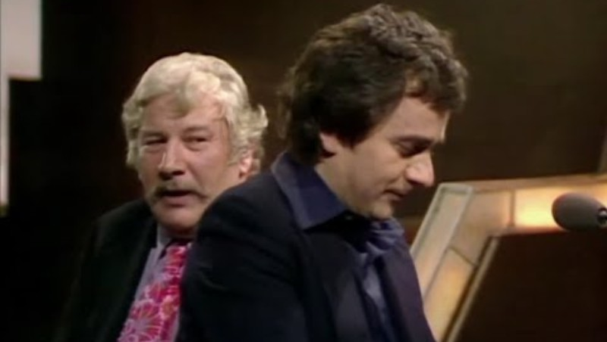
Dudley Moore & Sir Peter Ustinov improvising opera
Notes:
While we’re on the subject of opera, this from a Michael Parkinson interview. Ustinov is a polyglot who speaks many languages fluently but he also has the amazing talent for imitating a language without actually using any of the vocabulary! As for Moore, he was an organ scholar at Oxford University but gravitated towards comedy through the Footlights that spawned so many of the great British comedians in the latter part of the C20th.

Slide 9
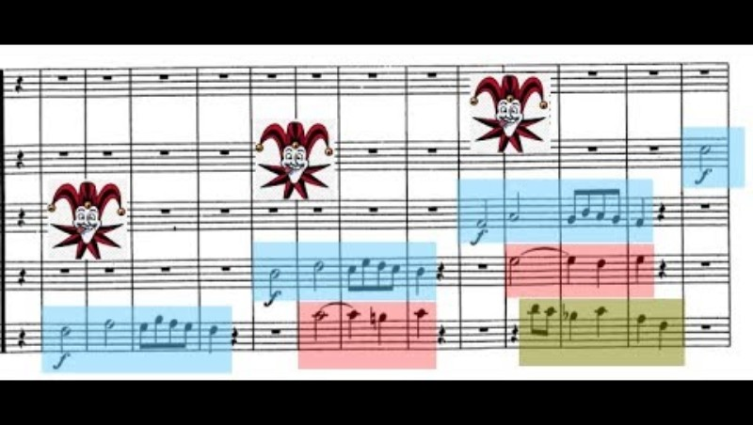
Before we leave Mozart behind, there is, of course, the aptly named “Musical joke”
Notes:
This is a bit academic but stay with it as Richard Atkinson takes us through a very clever piece of musical humour based in challenging the stylistic conventions of the day. This type of thing has way less of an effect in the C21st than it did back in the 1780s. Back then it would have been regarded as less of a joke, probably quite vulgar, in the way it challenges the way music was being presented. We all know that, ultimately, that did not work out so well for the composer, although Hollywood’s portrayal had the usual raft of inaccuracies and dramatic embellishments.
Play opening to 6’22”

Slide 10
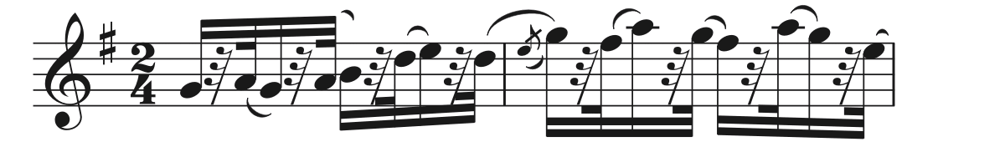
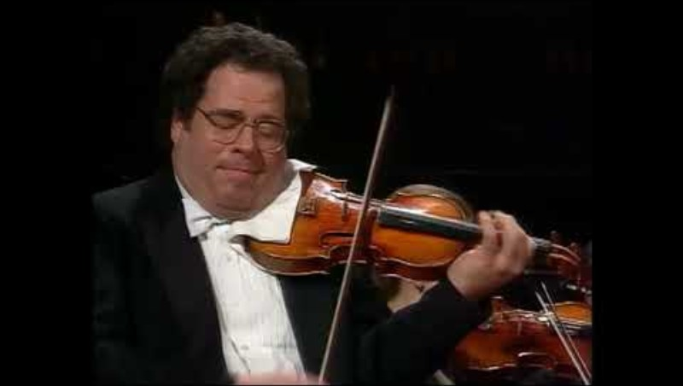
Yes, but is it funny…?
Notes:
This is Dvorak’s Humoresque, so a humorous piece. It needs to be viewed in terms of the conventions of the concert hall, not the tavern. Observant musicians amongst you will note that the YouTube title gave this as Humoresque in G flat major (and Perlman plays it in that key, a hard one for string players) , whereas the music on my slide is in G major, an infinitely more manageable key!

Slide 11
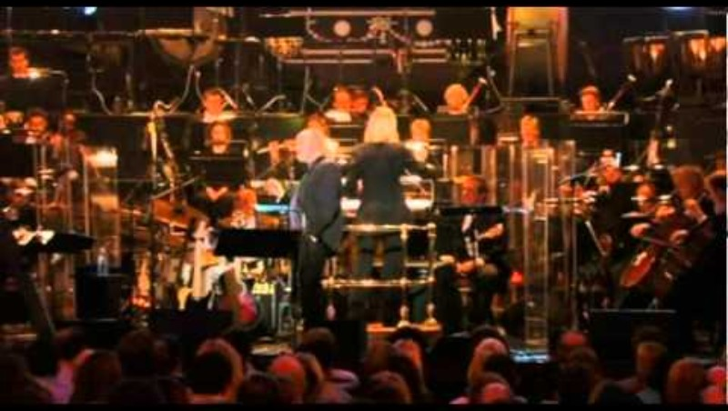
Talking of noticing things….
Notes:
The bassoon is often made of, as in the joke, “Why did the chicken cross the road?” Answer: To avoid the bassoon recital – but here it is the star of the show!

Slide 12
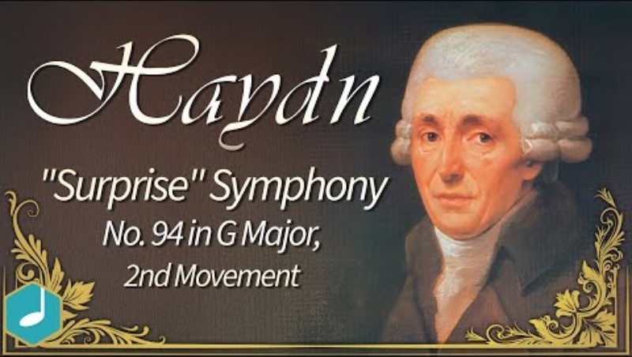
Not the audience participation bit (don’t worry, it isn’t you)… but was it funny at the time?
Notes:
It wasn’t designed to be funny, according to Haydn. Was it to quieten down his audience? Remember that concerts could be rowdy affairs with people eating, talking and even dancing in the minuet movements.
Was it to, indeed, “surprise” them?
No, Haydn maintained that he wanted to “surprise” the public with something new and innovative. It is quite hard not to imagine that the surprise element was part of it, though – he would not be the only composer to lie about how or why he wrote a piece of music. For instance, Kiwi composer Gareth Farr maintains that some of his programme notes are designed to give the audience something to read during the interval. Hm, not so sure….

Slide 13
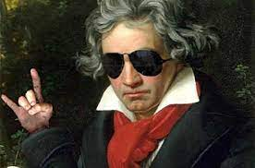
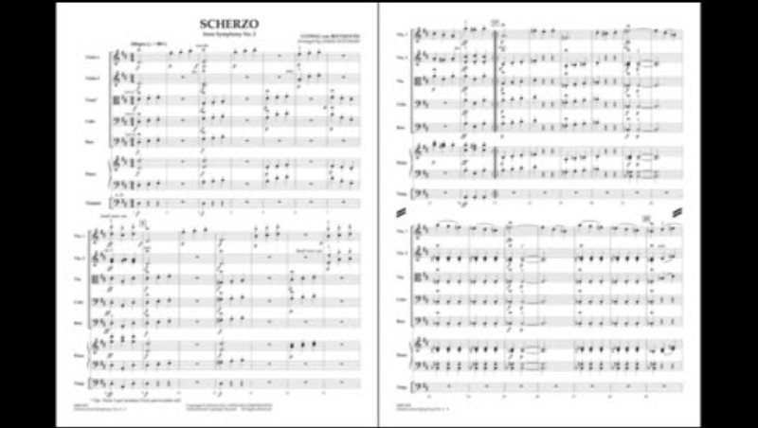
Minuet to Scherzo – adding humour to the dance
Notes:
Similarly, the scherzo should be viewed in context. The minuet was a social dance and became the third movement of the symphony and chamber music, perhaps to lift the mood of the reflective and sometimes sad slow movement preceding it. Gradually it sped up to become the scherzo, or “joke”. Still in a metric 3-beats to a bar it gradually sped up during the Romantic period sothat conductors would beat it in 1)

Slide 14
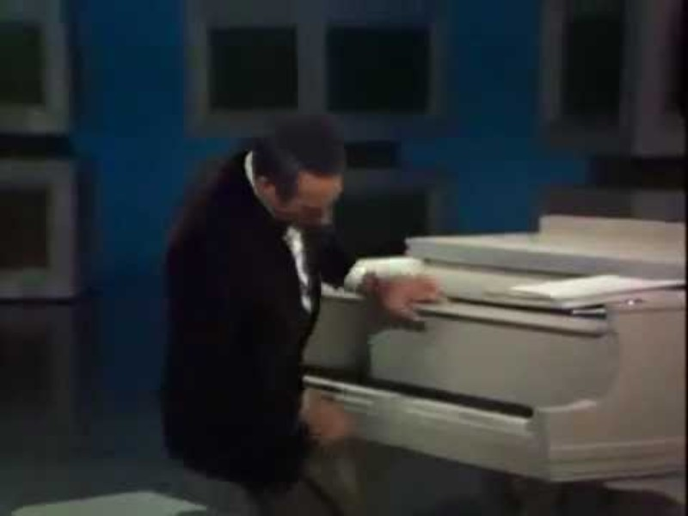
Humour “in” music - Victor Borge
Notes:
The great Victor Borge. Definitely a moment in time with an audience very much clued up on the classical music genre which Borg mercilessly lampoons. In reality, he could play very, very well, and I don’t think this would work if he couldn’t. Same with his modern-day counterpart Bill Bailey.

Slide 15
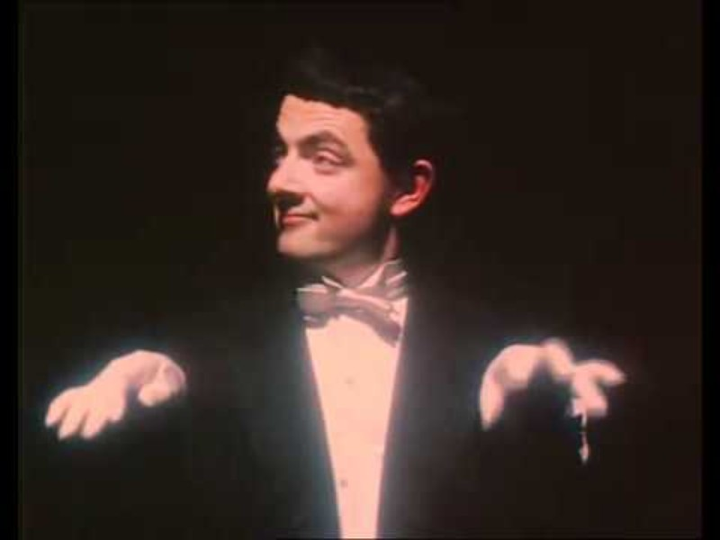
Rowan Atkinson
Notes:
Like Borge, Atkinson takes the pomposity of the performance and shows us its ridiculous side.

Slide 16
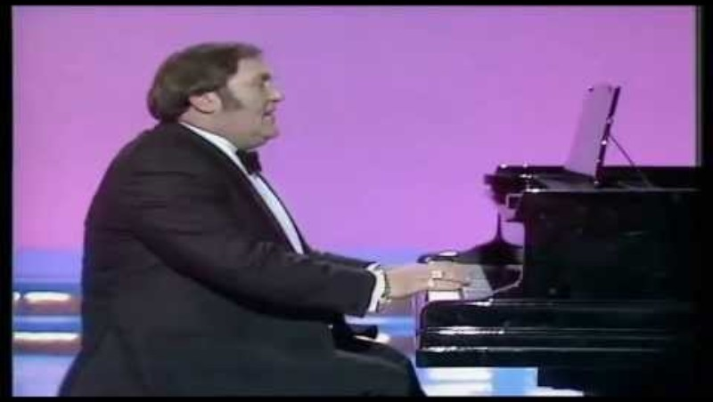
Les Dawson
Notes:
Another good pianist – this is a really difficult thing to do. Talk about the different clefs and now, two different keys!

Slide 17
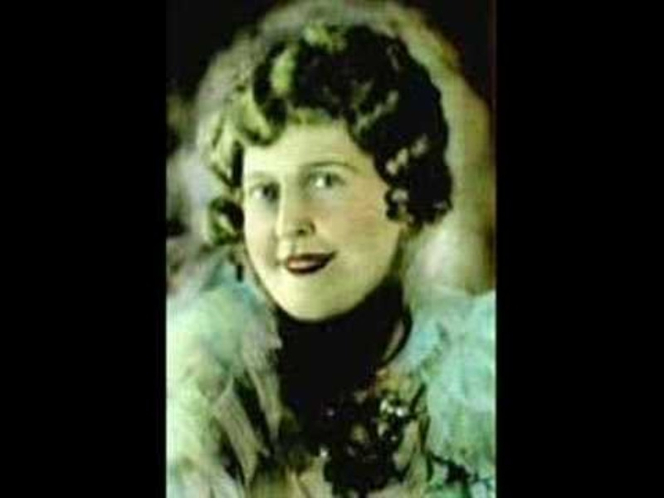
Florence Foster Jenkins
Notes:
But of course, if there is brilliance there is also the other end of the spectrum – ineptitude and Florence foster Jenkins made her name being precisely that. A socialite who even performed for President Rutherford B. Hayes, she truly was awful and didn’t seem to notice, at least not at the start! She was an American socialite and amateur coloratura soprano who became known and mocked for her flamboyant performance costumes and notably poor singing ability. Stephen Pile, in his book The Book of Heroic Failures ranked her (and I quote) "the world's worst opera singer ... No one, before or since, has succeeded in liberating themselves quite so completely from the shackles of musical notation."
Despite – or perhaps because of – her technical incompetence, she became a prominent musical camp cult figure in New York City during the 1920s, 1930s, and 1940s. Cole Porter, Gian Carlo Menotti, Lily Pons, Sir Thomas Beecham, and other celebrities were among her fans. Enrico Caruso reportedly "regarded her with affection and respect”.
Here she is taking on Mozart’s Queen of the Night, one of the trickiest arias in the repertoire, soaring up to a top C (but she doesn’t!)

Slide 18
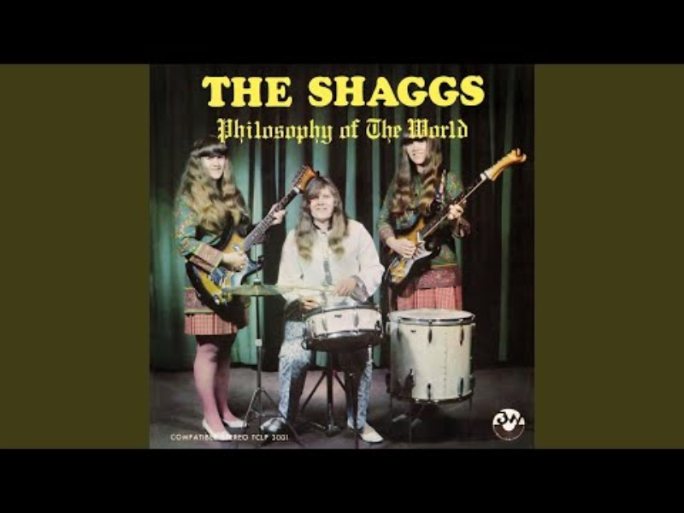
The Shaggs
Notes:
And who can forget The Shaggs’ classic hit “It’s Halloween” – oh, I wish I could! Out of time, out of tune, out of just about everything musical!

Slide 19
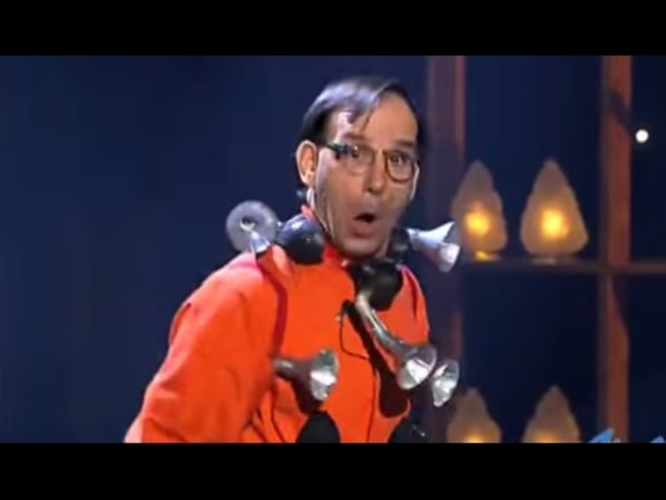
Novelty Items
Michel Lauziere’s extraordinary talents with the “Honking Symphony” and the Klaxofon
Notes:
A type of humour so distinctly “Continental” (Europe)

Slide 20
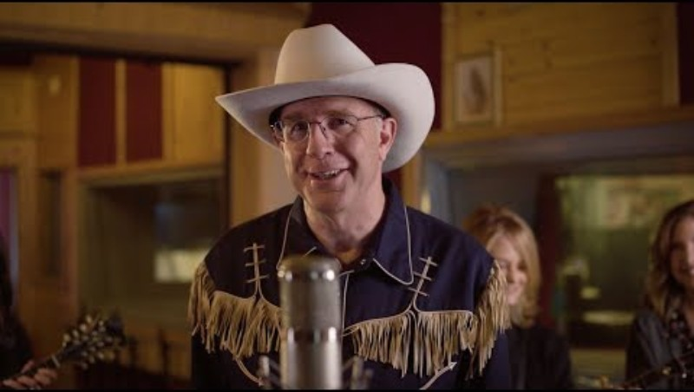
Atonal Country Music – a novelty indeed!
Notes:
You can enjoy this purely for the odd sounds coming from the banjo player’s seeming “wrong notes” in her solo but if you know about atonal music, the wreckage it caused in the early part of the C20th, and the loathing that many still have for it today, it becomes even more amusing, especially when coupled with its most unlikely counterpart, Country music…..
I have not played this to a musician who has not been reduced to tears of laughter. Listen out for the names of atonal music’s most famous exponents – Schoenberg, Webern, and Berg. Incidentally, Webern was shot and killed on 15 September1945 by an American soldier just shortly after the cessation of WWII. The remorse of having killed – albeit mistakenly, although Webern was enjoying a cigar at the time (they say smoking will kill you!) – one of Europe’s greatest composers resulted in the GI committing suicide some time later.

Slide 21
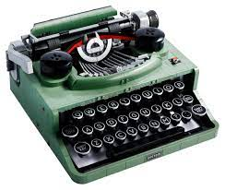
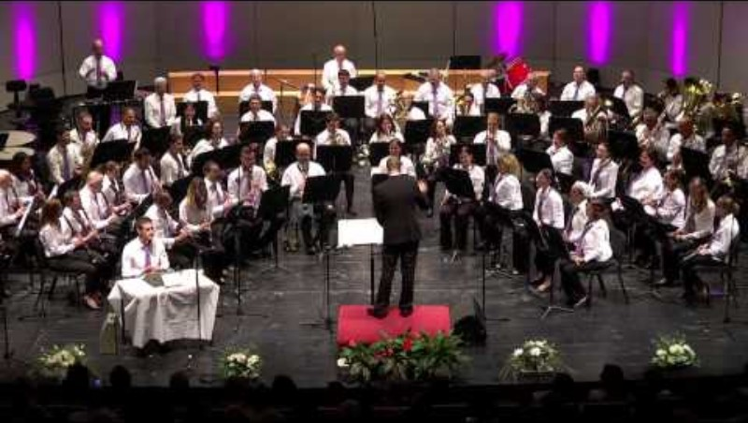
Novelty Items
Leroy Anderson “The Typewriter”
The Typewriter by Leroy Anderson - YouTube
Notes:
And now the turn of the novelty items, often with a nod to the performers who drew on their Music hall or Vaudeville backgrounds.

Slide 22
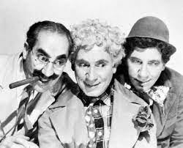
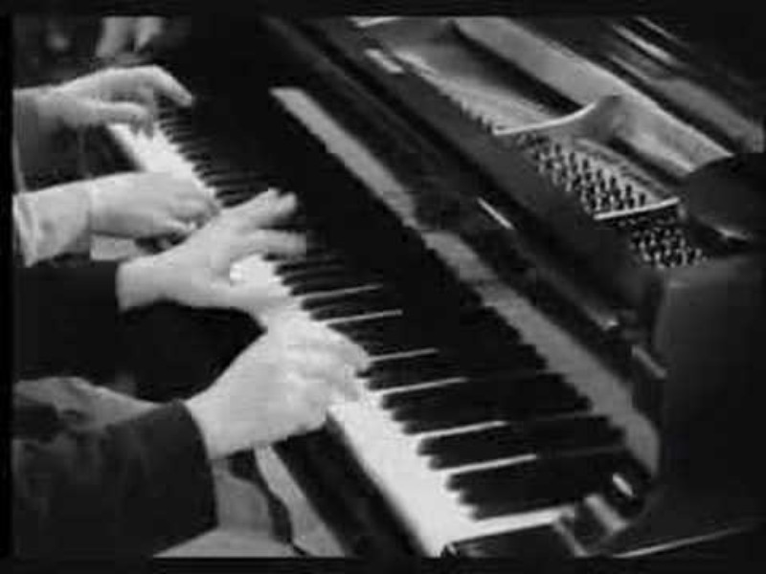
Kings of the “novelty Item”. They were all excellent musicians
The Marx Brothers

Slide 23
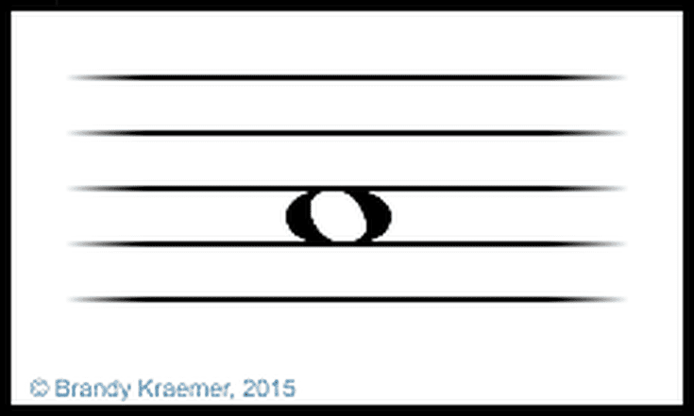
Musical Joke #1:
A joke “in” music requiring some degree of knowledge or explanation
Q: What do you call a musician with a blocked nostril?
A: A semibreve
NB this joke does not work so well in North America…
Notes:
Musical Joke #1

Slide 24
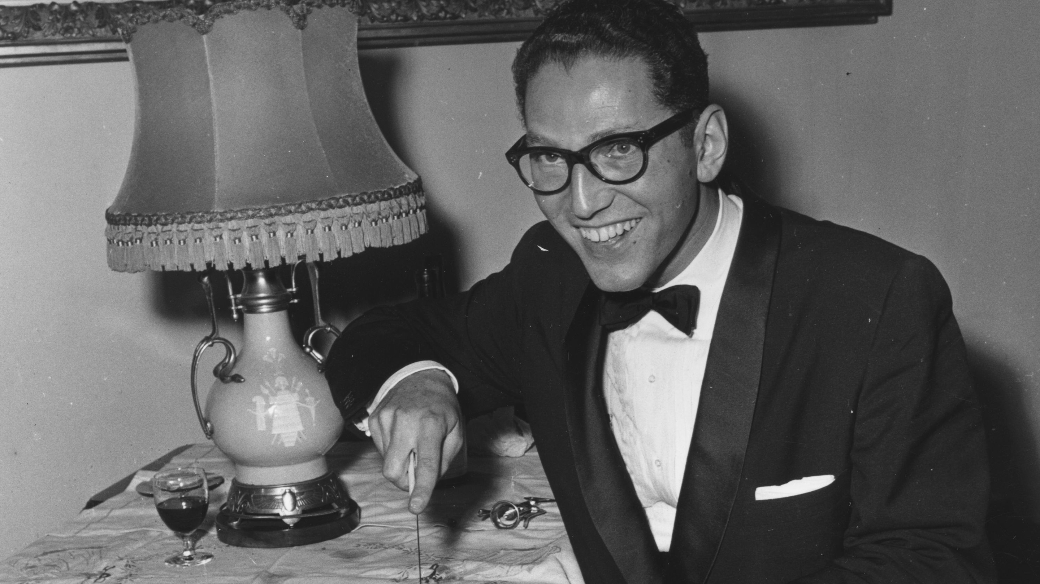


Humour “through” music
Tom Lehrer. He was a graduate of Harvard, and taught Mathematics there and at other prestigious universities across the United States. He is best known for his irreverent and brilliant songs. He is also regarded as one of the first “sick” humorists

Slide 25
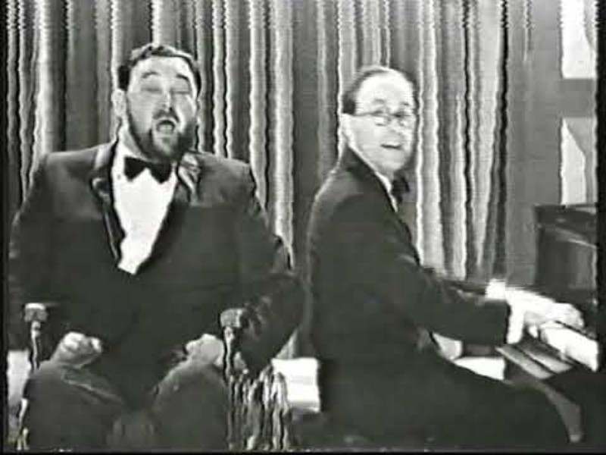
Humour “through” music
Flanders & Swann
Notes:
Of course, humour works especially well when the words also add another level. So, a reminder of a gentle humour from a bygone age.

Slide 26
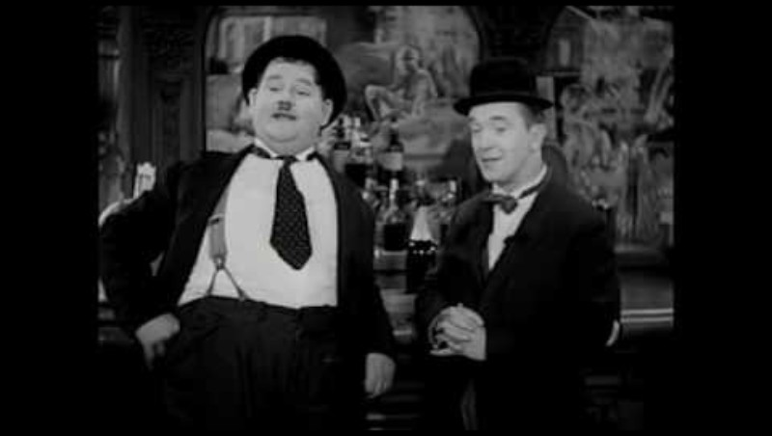
Laurel and Hardy – “Way Out West”
Notes:
Classic Stan and Ollie. Ollie has a lovely voice and can harmonise. Notable for Stan’s voice changing to bass and soprano.
Talk about the different retakes in French, German, Spanish and Italian and what they had to do for the Spanish version.
Alos talk about James Finlayson patenting “Dooooooah!” which predates Homer Simpson by some 50 years!

Slide 27

Bill Bailey

Slide 28
… and the curiosities.
The ultimate was, of course, John Cage with 4’33”
Notes:
Notice the blank slide.
Tell the story of finding a CD recording of this in a second-hand CD store in San Francisco. It was a boxed set of all John Cage’s “greatest hits”. Imagine getting that home and not knowing what it was, so you come back to the shop to complain that the CD suddenly stops playing…..

Slide 29
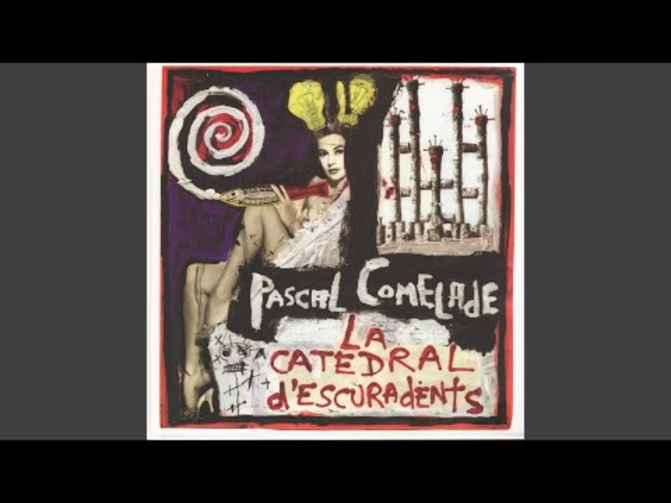
Pascal Comelade
Notes:
Pascal Comelade makes his music using children’s toys.
I’ll end my talk here with this regression to childhood.

Slide 30
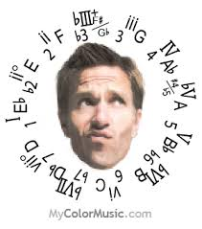
Questions, comments or funny stories?

