Slide 1
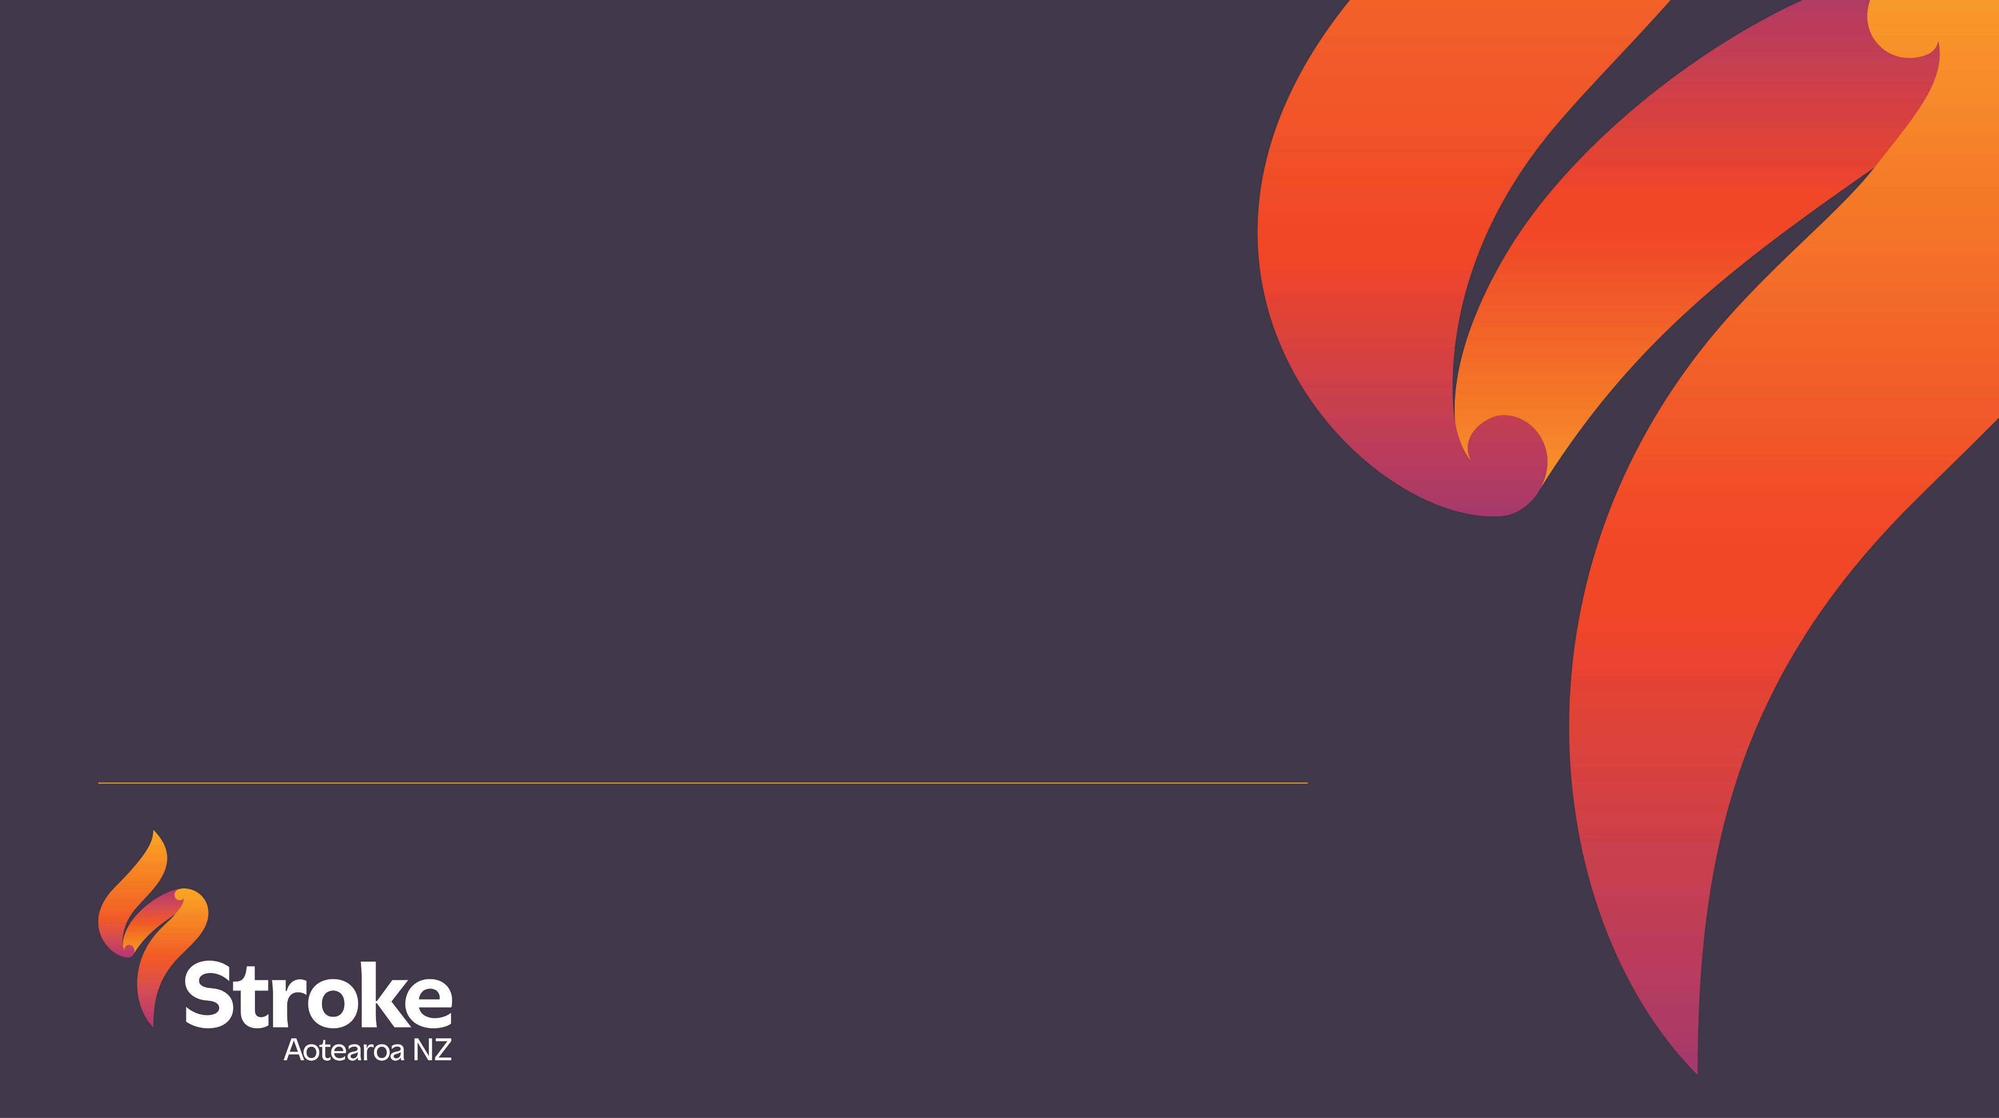
U3A presentation
Jo Lambert, CEO

Slide 2
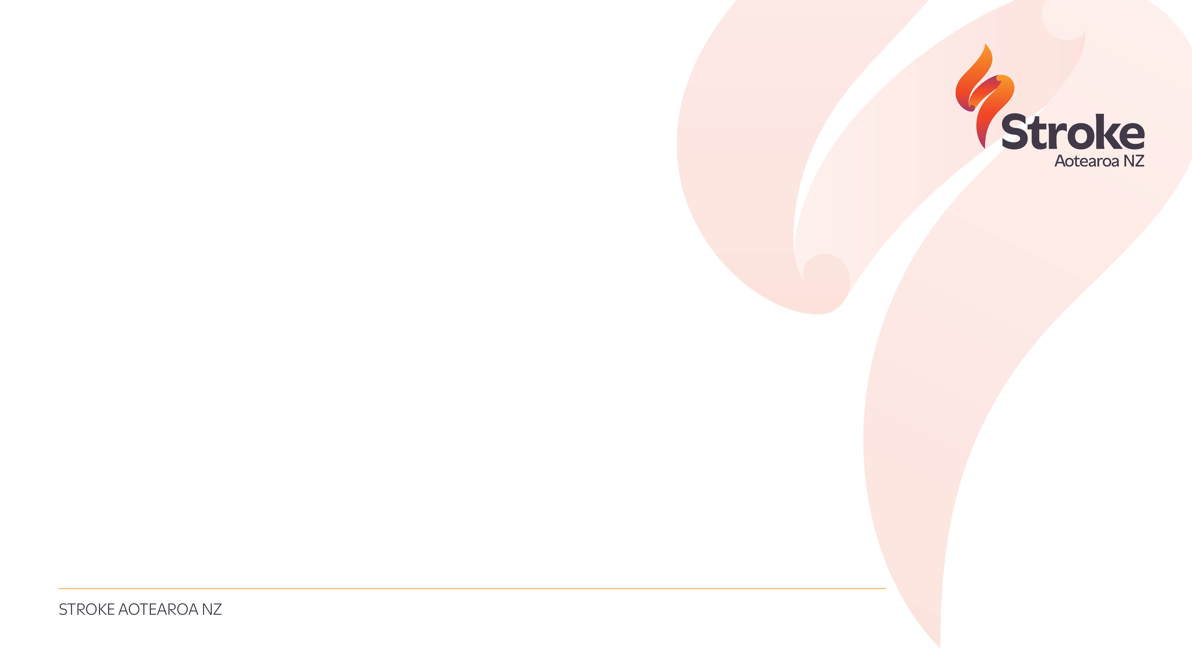
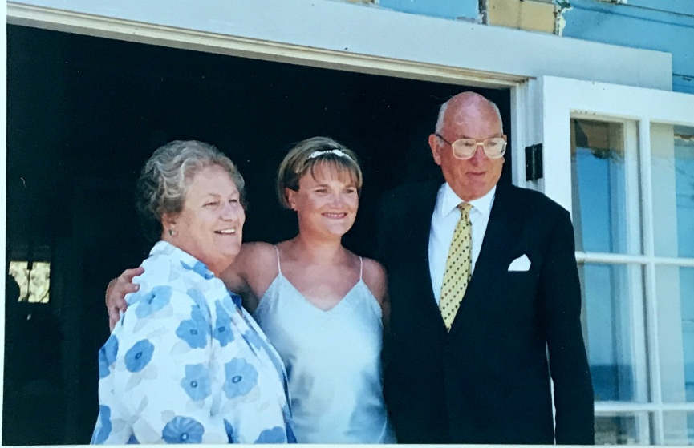
About me
Chief Executive of Stroke Aotearoa New Zealand
Physiotherapy New Zealand Board Member
Prior Board member of Stroke Aotearoa
Co-Chair of the Neurological Alliance
Executive of the Carers Alliance
Community Chapter of HTRHN
Barnardos Aotearoa – New Zealand’s largest children's charity
Commercial background – manufacturing, IT services, Outsourcing, Management Consulting

Slide 3
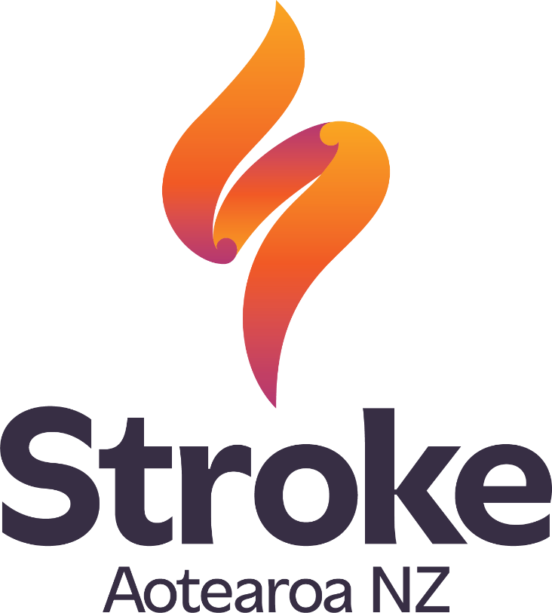
Stroke Aotearoa New Zealand
Te Ahi Tūmanako
(The Flame of Hope)
is at the heart of our brand identity.
Notes:
Our tohu (symbol) features a flame shaped like an ‘S’ for Stroke, incorporating koru. It symbolises a journey of growth through adversity that many stroke survivors experience and the support we provide to those affected by stroke, embodying our commitment to offering hope and support. Our flame serves as a beacon, illuminating the path towards recovery and empowerment.
We are still the same charity you know and love, and if anything our vision is even bigger and more ambitious now than 45 years ago. You are all very special to Stroke Aotearoa and to respect our important relationship I’m going to tell you a little of our plans for the next 5 years...

Slide 4
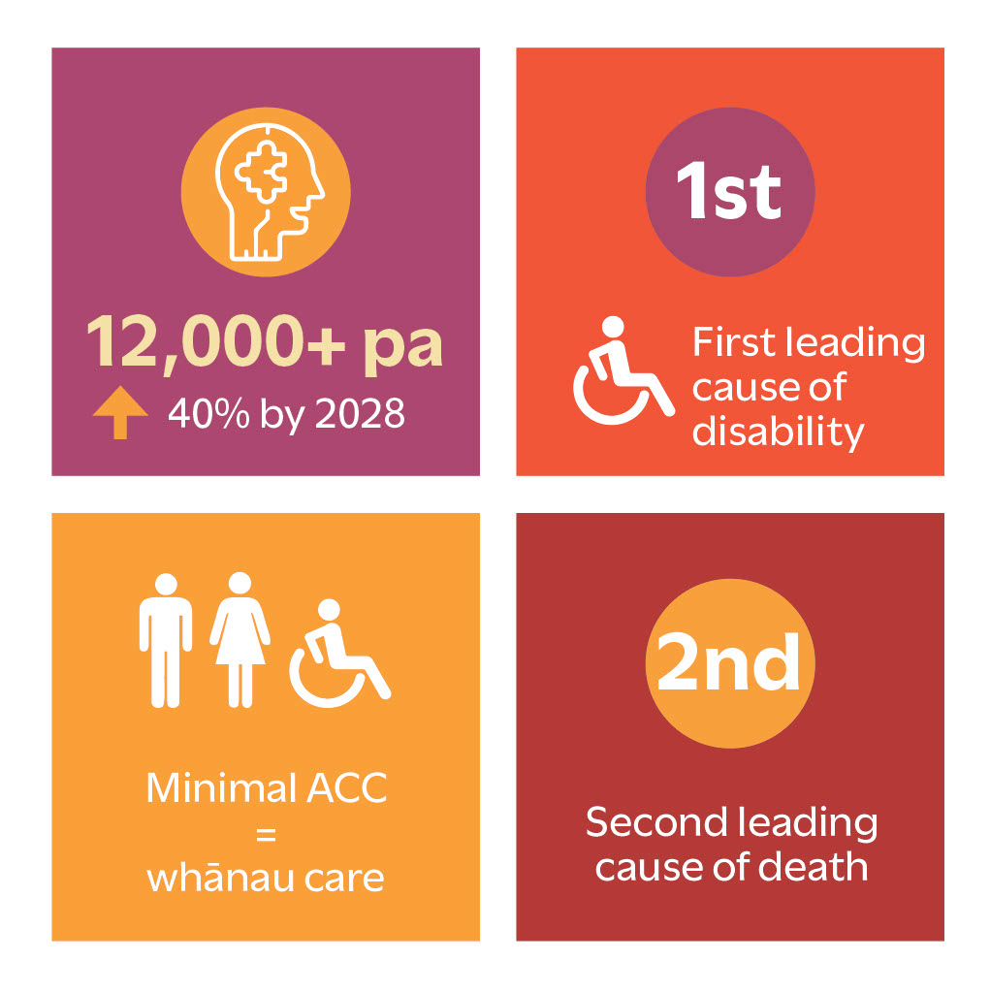
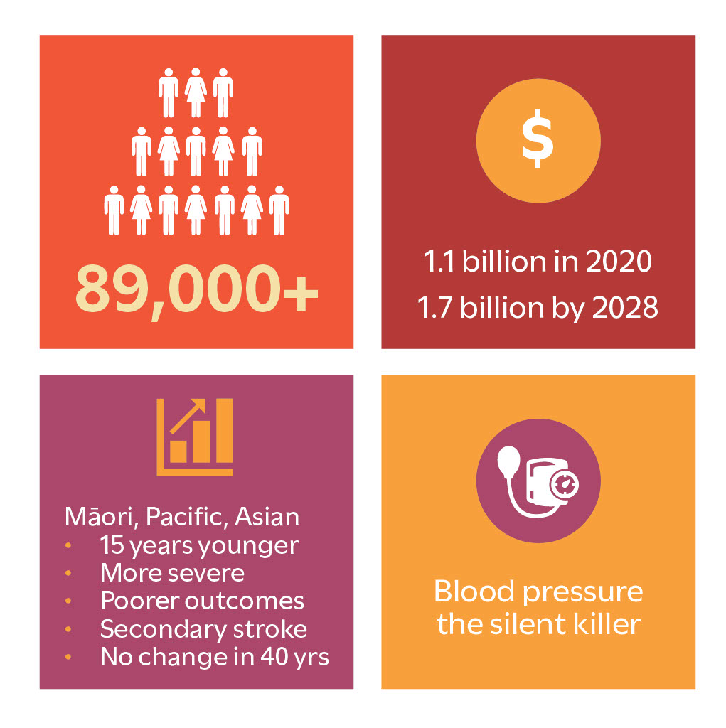
Stroke by numbers

Slide 5
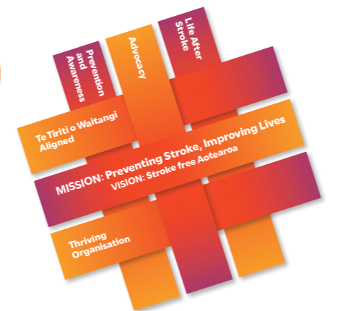
Stroke Aotearoa New Zealand
Our mission is to prevent stroke and improve lives.
Our vision is for a stroke-free Aotearoa.
Our 5 Strategic Priorities:
  Te Tiriti o Waitangi Alignment
  Prevention and Awareness
  Advocacy
  Life After Stroke
  Thriving Organisation

Slide 6
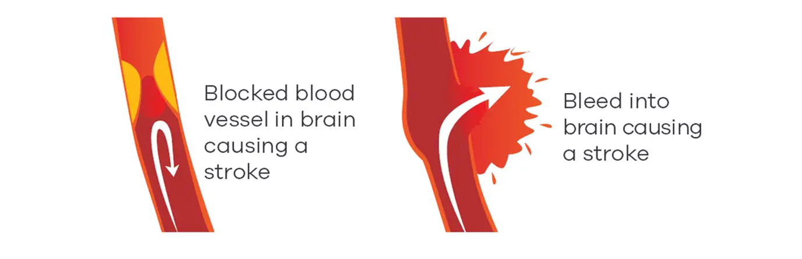
Three main types of stroke
Ischaemic stroke
Haemorrhagic stroke
Transient Ischaemic Attack (TIA)
Notes:
Ischaemic stroke: the most common type of stroke, accounting for about 85% of all strokes each year. They occur when a blockage – usually a blood clot - restricts or cuts off blood flow to brain tissue. Clots can form within the blood vessels of the brain or travel there from other parts of the body, such as the heart. Common risk factors for clot formation include high cholesterol, diabetes, and an irregular heartbeat. Smoking and high blood pressure, over time, damage blood vessels, increasing the likelihood of a clot forming or blocking an artery.
Haemorrhagic stroke: occurs when an artery in the brain bursts, causing blood to leak into the surrounding brain tissue or the surrounding layers. The bleeding can cause irritation to brain tissue and increased pressure within the brain or skull, and result in significant damage and loss of function. The most important risk factor for haemorrhagic stroke is high blood pressure.
Transient Ischaemic Attack (TIA): A TIA is like a stroke, except that the signs last for a short amount of time and no longer than 24 hours, and show no damage on brain imaging. Although the signs do not last long, a TIA is very serious. If untreated, up to 18% of people with TIA will have a full-blown stroke within 3 months, 12% within 7 days, and 8% within 48 hours after a TIA. Because of this, a TIA is often called a warning stroke or mini-stroke and requires very urgent treatment.

Slide 7
The most significant impacts on outcomes
F.A.S.T. diagnosis and treatment
Specialised stroke unit care - multi-disciplinary care team
Rehabilitation and recovery
Long-term care and support
Ongoing management of underlying health conditions
Notes:
Prompt treatment greatly increases the chances of surviving a stroke and enhances the likelihood of a successful recovery. The initial focus of treatment is to limit the extent of brain damage and prevent additional strokes. This almost always requires medications and, in some cases, surgical interventions to repair a ruptured blood vessel or remove a clot. Every 15-minute delay in treatment reduces the chance of being able to live independently. After initial treatment is begun, people are cared for in a specialised stroke unit by a multi-disciplinary care team to reduce the risk of complications, further strokes, and begin the recovery process.
Long-term care aims to support brain recovery by helping healthy brain cells compensate for the functions of those that have been damaged. This process requires the brain to adapt and relearn skills. Recovery is typically guided by personalised rehabilitation plans developed in collaboration with the patient, their whānau, and their healthcare team. These plans may include physiotherapy, speech therapy, and occupational therapy to address specific needs. Additionally, managing underlying health conditions, such as high blood pressure, heart rhythm disorders, or lifestyle factors, is crucial to reduce the risk of future strokes.

Slide 8
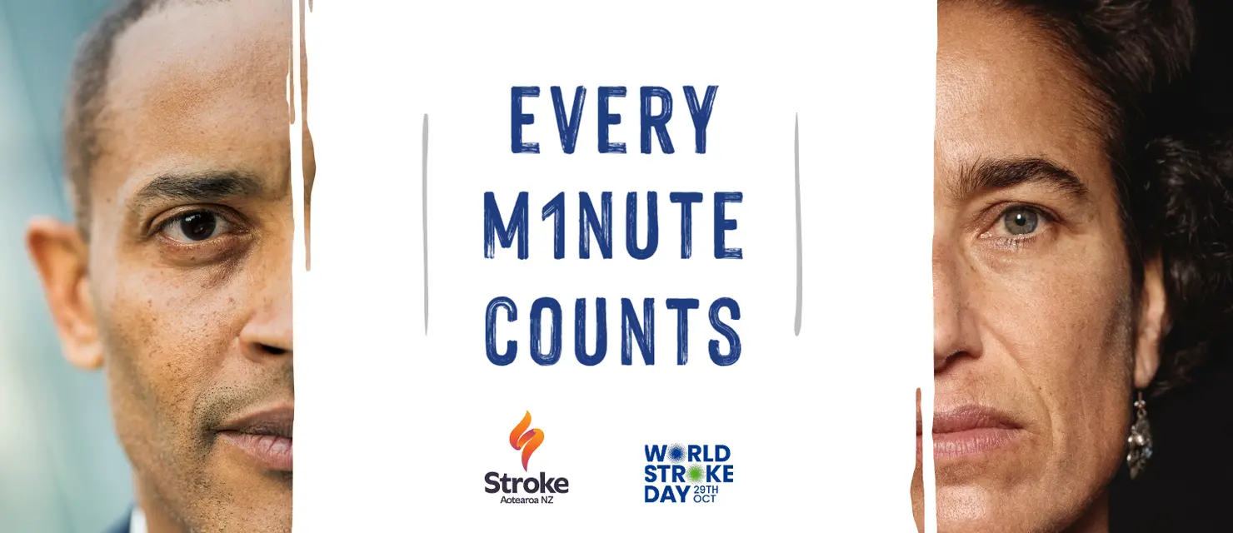
Every minute = the death of 1.9m neurons
Notes:
Prompt treatment greatly increases the chances of surviving a stroke and enhances the likelihood of a successful recovery. The initial focus of treatment is to limit the extent of brain damage and prevent additional strokes. This almost always requires medications and, in some cases, surgical interventions to repair a ruptured blood vessel or remove a clot. Every 15-minute delay in treatment reduces the chance of being able to live independently. After initial treatment is begun, people are cared for in a specialised stroke unit by a multi-disciplinary care team to reduce the risk of complications, further strokes, and begin the recovery process.
Long-term care aims to support brain recovery by helping healthy brain cells compensate for the functions of those that have been damaged. This process requires the brain to adapt and relearn skills. Recovery is typically guided by personalised rehabilitation plans developed in collaboration with the patient, their whānau, and their healthcare team. These plans may include physiotherapy, speech therapy, and occupational therapy to address specific needs. Additionally, managing underlying health conditions, such as high blood pressure, heart rhythm disorders, or lifestyle factors, is crucial to reduce the risk of future strokes.

Slide 9
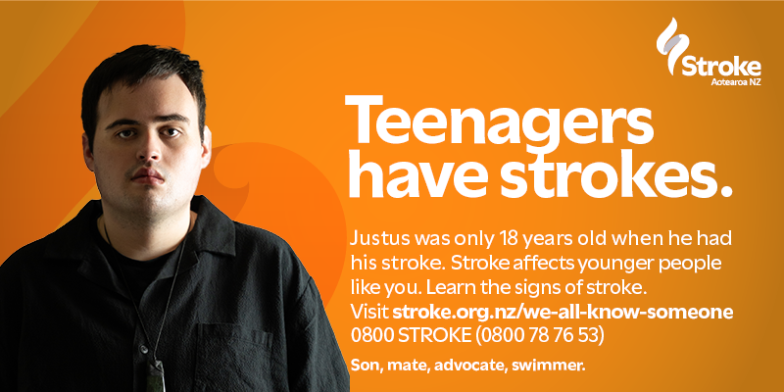
We All Know Someone
Notes:
Strokes don't just happen to 'other people'. They happen to people we love — our mums, our mates, our cousins, our kids, and our koro.As you’ll know, stroke doesn’t discriminate. It doesn’t care who you are, how old you are, what you do, or where you are. It can affect any of us.
Our national campaign (funded by donors) portrays everyday individuals whose lives have been impacted by stroke, challenging common myths like "stroke only affects older people." Justus, pictured here, was just 18 when he had his stroke. He was in his first year of university, out with friends on the evening it happened. His stroke was not diagnosed until 7 hours after it had happened partly because of his age and partly because it was assumed he was drunk. Because of the delay in receiving treatment, Justus was left with significant disability. He hadn't had a drop of alcohol that night.

Slide 10
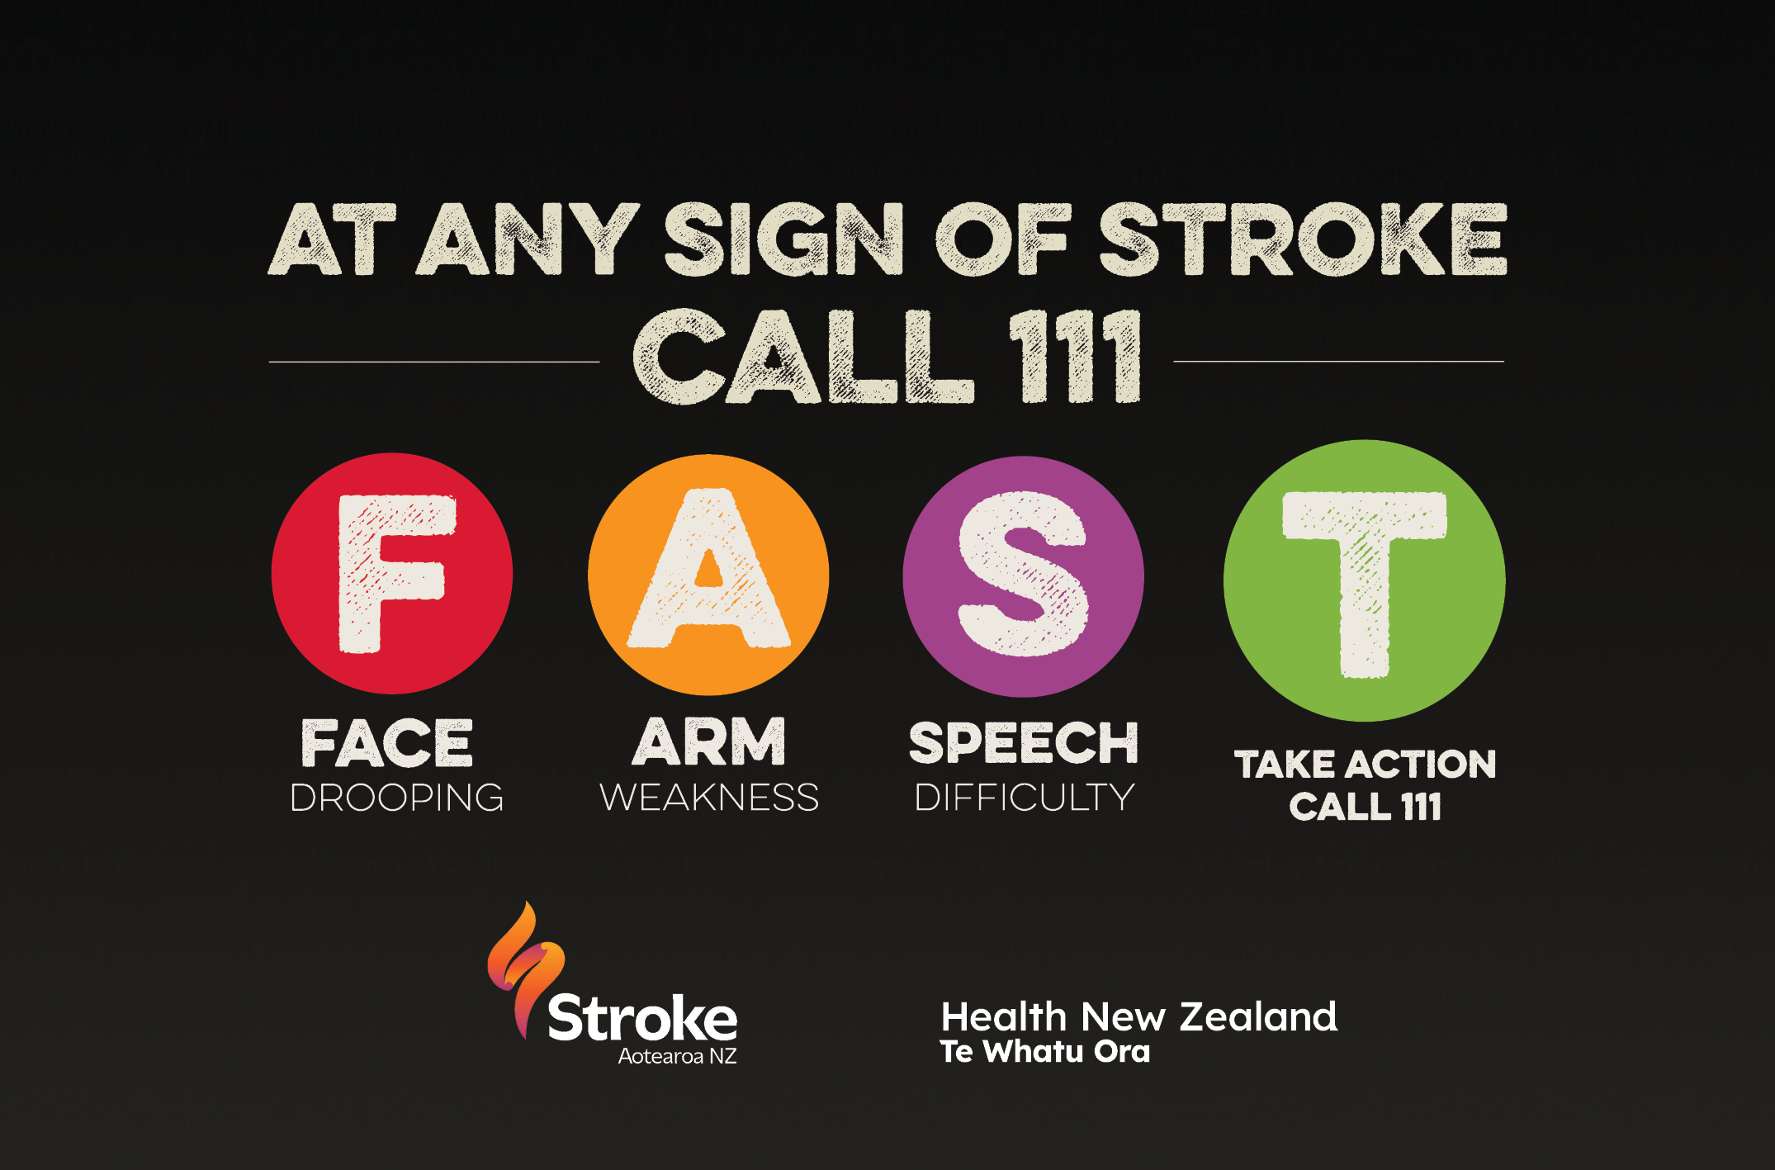
F.A.S.T
Notes:
It is stories like Justus' that remind us why campaigns like F.A.S.T are so critical, giving people the ability to recognise the signs of a stroke, to help get treatment as quickly as possible, and potentially to save a life. [Go through the F.A.S.T signs]. Every minute a stroke is left untreated, millions of brain cells are destroyed, and there is only a relatively small window where clot-busting drugs or clot retrieval can safely and effectively be used. The F.A.S.T campaign is partially funded by Health New Zealand, but the activity and resources you see on social media which reaches thousands of people every year, is made possible thanks to donors like you.

Slide 11
Strategic Priority 1: Te Tiriti o Waitangi Aligned
Incidence
Outcomes
Cultural capability and responsiveness
Partnership and protection
Notes:
Prevention education, training, and awareness of stroke
F.A.S.T. Awareness to improve outcomes
Life after stroke support, and secondary prevention
Collaboration with health services, NGOs and communities to make stroke their priority too
0800 helpline – for survivors, carers, clinicians
Advocacy – tackling systemic issues including access, funding, and excellence in care, through the voice of lived experience

Slide 12
Strategic Priority 2: Prevention and Awareness
1 in 4 New Zealanders will be impacted by a stroke
90% of strokes are preventable and linked to controllable risk factors
  high blood pressure
  physical inactivity
  poor diet, especially salt intake
  smoking – many of which can be controlled.
Notes:
Most strokes are preventable. Up to 90% of strokes are linked to ten risk factors, including high blood pressure, physical inactivity, poor diet, and smoking – many of which can be controlled.
High blood pressure is the number one controllable risk factor for stroke, and can be managed through regular checks, healthy living, and medication if needed.
Atrial fibrillation (irregular heartbeat) increases stroke risk.
Some risk factors, such as high salt levels in processed food and labelling policies, should be managed at government and policy level.

Slide 13
Prevention and Awareness
Free BP and AF testing
Education seminars and workshops in the community
Targeted prevention programmes for employers
Community events and collaborations
Educating our rangatahi
Promoting healthy lifestyles, salt awareness week
Advocating for law change, and submissions
Website and social media channels
May = Stroke Awareness Month
29th October = World Stroke Day

Slide 14
Blood Pressure: the silent killer
Notes:
The Future of Stroke Aotearoa and Health-15

Slide 15
Tips to manage your blood pressure
Be smoke and vape-free
Eat less salt and processed food
Be active
Take medication as prescribed
Check your blood pressure regularly
Keep alcohol intake low
Check and manage cholesterol levels
Maintain a healthy weight
Manage other long term conditions / co-morbidities well
Notes:
Maintaining healthy blood pressure is one of the most important and effective ways to stay well and reduce your stroke risk. High blood pressure (BP) is a leading cause of stroke. Healthy blood pressure not only protects your brain, it helps protect your heart, eyes, and kidneys.
To keep you well and living life to the fullest here are some suggestions:

Slide 16
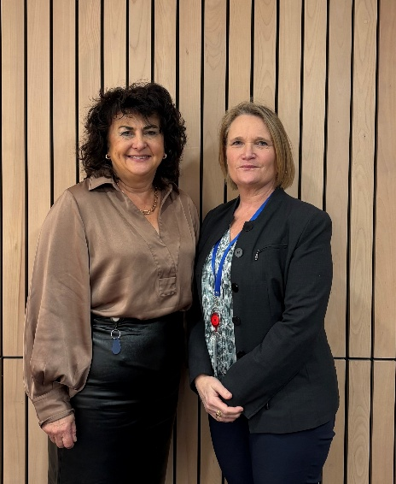
Strategic Priority 3: Advocacy – at two levels
At a system level – exerting influence through:
  Meetings with Ministers and Officials
  Responding to submissions
  Partnering with NGOs
  Advisory Committees
  Holding the funders to account for quality care
At an individual level:
  Supporting stroke survivors and whanau to navigate the complex services to which they’re entitled

Slide 17
Strategic Priority 4: Life After Stroke
Individual support through 0800 STROKE
Referrals from hospitals
Education and support to Stroke Groups
Monthly Online Café, to create connection
Information and resources – The Life After Stroke book
Collaboration with Barnardos What’sUp
Return to Work support
101 Education for clinical and non-clinical staff
Funding in some areas for individual grants
Website

Slide 18
Life After Stroke Support

Slide 19
Strategic Priority 5: Thriving Organisation
People and culture by living our values
Being financially sustainable
  17% government funding
  Multi-faceted fundraising programmes, supported by campaigns, fundraising events, regular giving, appeals, bequests, grants …..
Environmental impact, social responsibilities, and governance practices
Fundamental principles of partnership through all our work

Slide 20
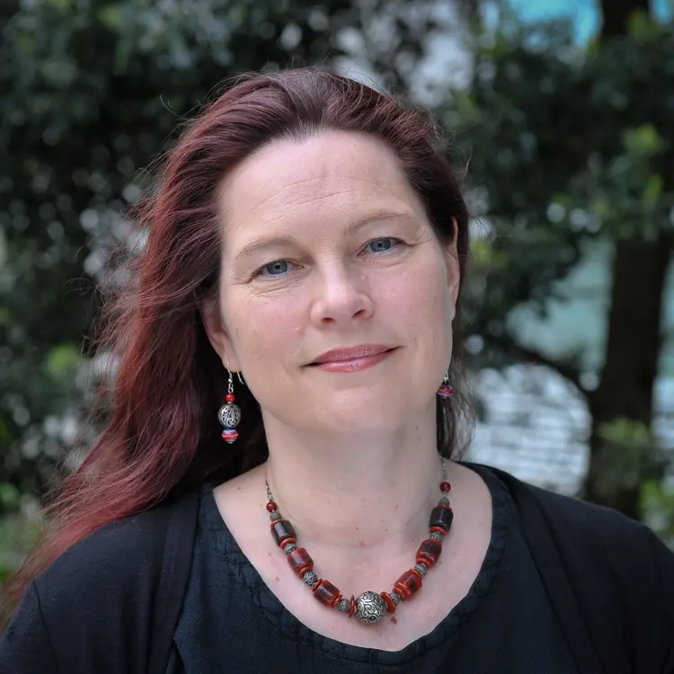
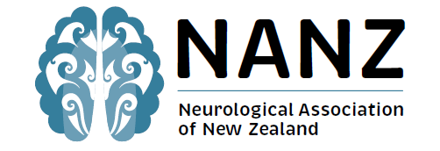
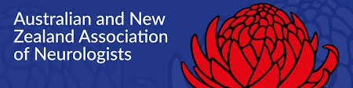


Neurological workforce research 2024
Prof Anna Ranta, MD, PhD, FRACP, FAHA, FAAN, FWSO
University of Otago, Wellington and Health NZ Capital, Coast and Hutt Valley
Stroke Aotearoa Board Director
Co-Chair of the National Stroke Network
Notes:
What is the current Neurology workforce supply?
How does supply match demand?
How do we compare with others?
What does modelling suggest about the future?
Implications
Solutions

Slide 21
The size of the problem
22% of hospitalisations are neurological
Neurological diseases are the leading cause of ill health and disability & second leading cause of death globally

Slide 22
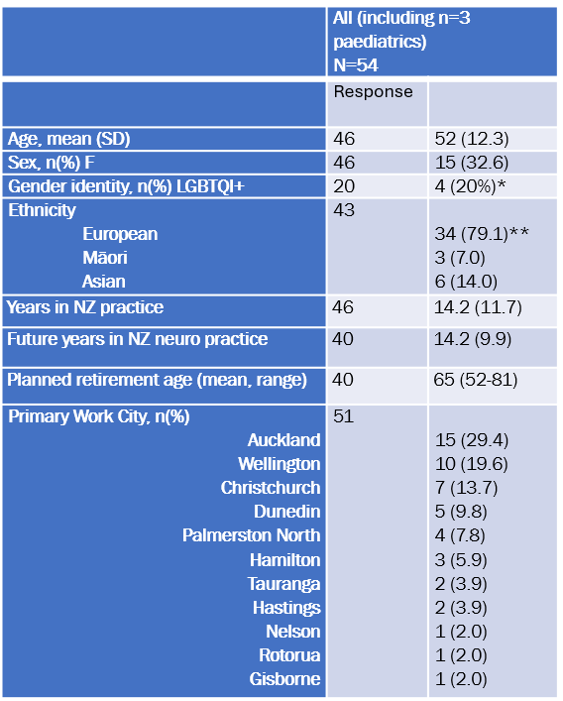
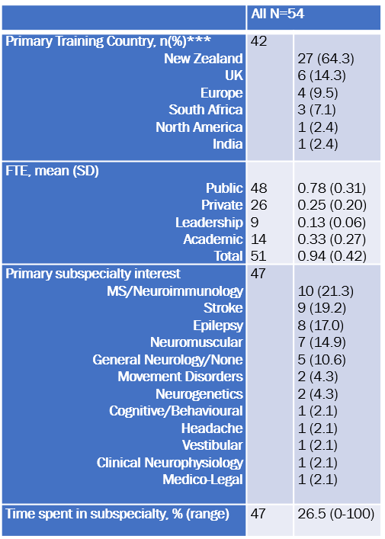
NZ Neurologist Demographics
Individual Workforce Surveys
In 2014 Female: 23.3%
(48.3% in USA)
Notes:
Things to note:
32% of the workforce is now female in comparison to 2014
79% of the workforce is European
64% Trained in NZ, 10 in Europe and the UK
29% are based in Auckland, 19% in Wellington and 13% in Chch.
Primary Subspecialites: 21% specialise in MS / Neuroimmunology, 19% in Stroke, 17% in epilepsy, 14% neromuscular
26% of each person’s time is spent in their subspecialty

Slide 23
Current NZ Neurological Workforce
Notes:
1 neurologist to every 77,563 people (adult and paediatric)
1 neurologist to every 88,469 adults (14% fewer)
1 neurologist to every 99,227 people in the public system
1 neurologist to every 70,000 in metro NZ in comparison to 104,859 living rurally.

Slide 24
Comparison

Slide 25
Demand vs supply

Slide 26
Why would NZ need fewer Neurologists?
Generalist models of care
  Most hospitalised patients managed by general physicians
  Key conditions like headache managed in primary care
  Stroke, Alzheimer’s, Parkinson’s, Motor Neurone disease managed by geriatricians
Focus on first specialist assessment vs follow-up
  Neurology in NZ focusses on making a diagnosis
  Aus estimate for every initial assessment we need 6 follow-ups needed
  NZ we see for every initial there is one follow-up
  Long-term care for conditions like epilepsy managed by GPs

Slide 27
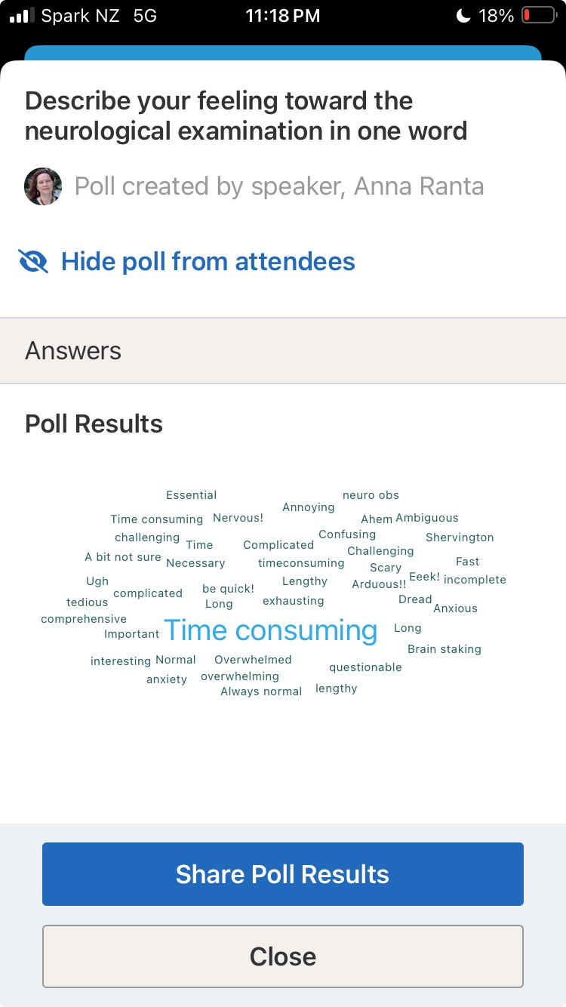
Why would NZ need fewer Neurologists?
Potentially more cost-effective
Often closer to home
Neurological disease is complex
Clear evidence that generalists feel overwhelmed
People with neurological diseases are at high risk of sub-optimal management

Slide 28
What the research found?
NZ Neurology workforce is increasing in diversity – but still ≠ society; clinical need
NZ neurologist rate very unfavourable c/w Australia, Europe, and cardiology
Projections suggest maintaining status quo will result in worsening outcomes
Current practice patterns do not meet population need
Productivity is reducing - impact of ↑complexity/Rx, acuity, work patterns

Slide 29
The solutions
To meet current NZ demand we need to at least triple if not increase by 8-fold
↑ hospital neurology consultant positions
Retain current trainees – more jobs, more attractive jobs
↑ trainee posts & attract more medical students to neurology
↑ medical students (we do not just need more GPs)
Prioritise workflow tools (e.g. AI) to improve efficiency & reduce clinician burden
Reconsider NZ neuro models of care – is the generalist model still fit for purpose?

Slide 30
Next Steps and Action
We need a national neurology workforce strategy
Neurological Alliance of Neurologists & Neurology NGOs like Stroke Aotearoa support collaborating
Government support to develop or at least consider strategy
National Neurology Clinical Network

Slide 31
It’s not all doom and gloom
Two innovative initiatives led by Stroke Aotearoa to
  Take prevention direct to the most vulnerable
  Educate the non-clinical workforce

Slide 32
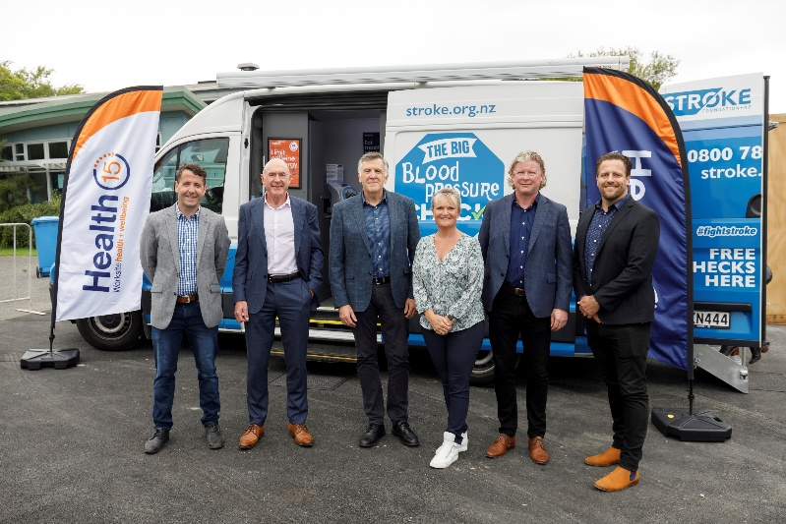
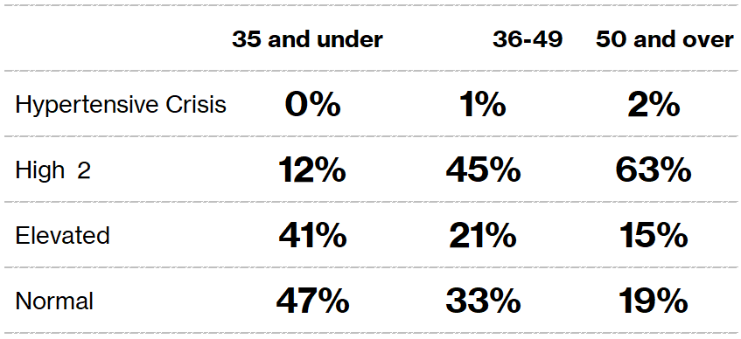
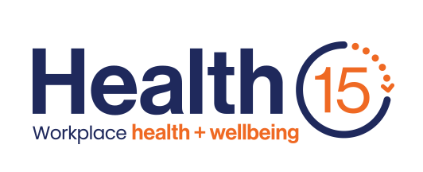
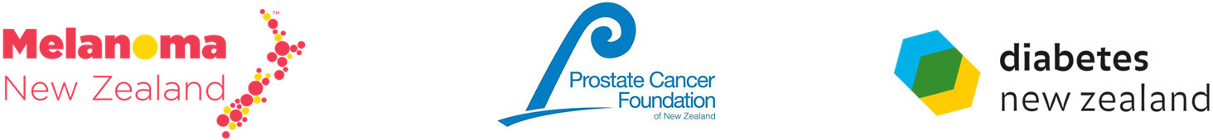
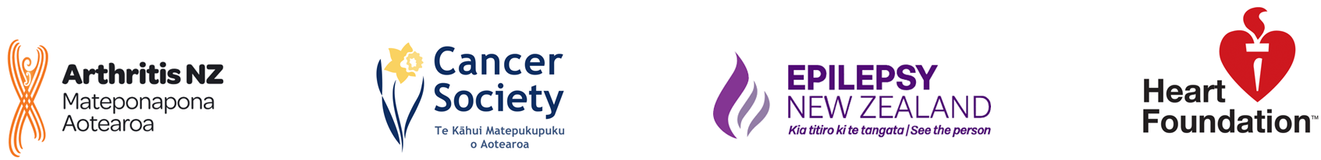

Innovation in the community
Total Health15 BP’s taken
since launch
Total partner businesses
Total sites
visited since launch
2995
24
81
BP Category breakdown for all Health15 sites
Age breakdown by category for all Health15 sites
29%
.
Normal
19%
.
Elevated
50%
.
High
1%
.
HT Crisis

Slide 33
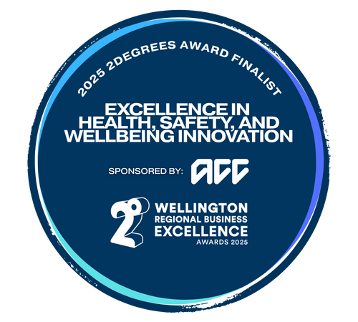
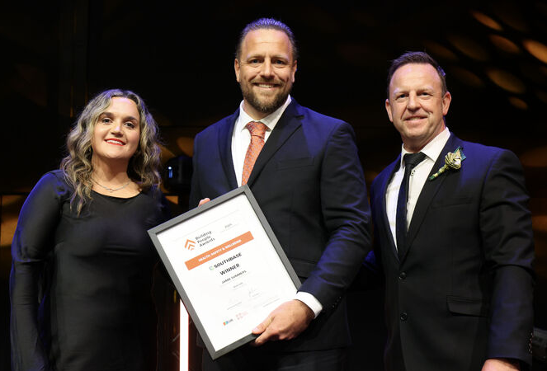
Winner – 2degrees Wellington Regional Business Awards 2025
NZIOB Award

Slide 34
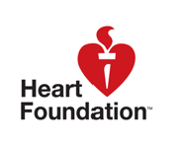
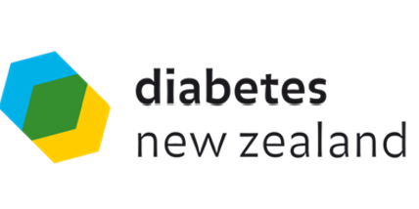
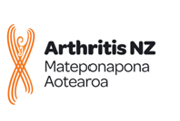

Educating the non-clinical workforce
Level 3 NZQA Certificate in Long Term Conditions, with micro-credentials in Stroke, Cardiac, Diabetes and Arthritis care
100,000+ unskilled workers caring in the community, plus whanau
NGO collaboration with The Open Polytechnic
NGOs provided the condition specific expertise
Courses currently under construction
Launch in August 2026
Outcome: Trained workforce, communities of interest, learning framework to grow sector skills and capability
.

Slide 35
Your support, your way
R
A
M
Regular Donors
Appeal Donors
Gift in Memory
Ongoing monthly giving
Responding to campaigns
Honouring loved ones
W
D
Gift in Will
Major Donors
Keeping the flame of hope alight. Talk to us today about how you can make a difference.
Legacy giving
Heartfelt gifts that transform lives

Slide 36
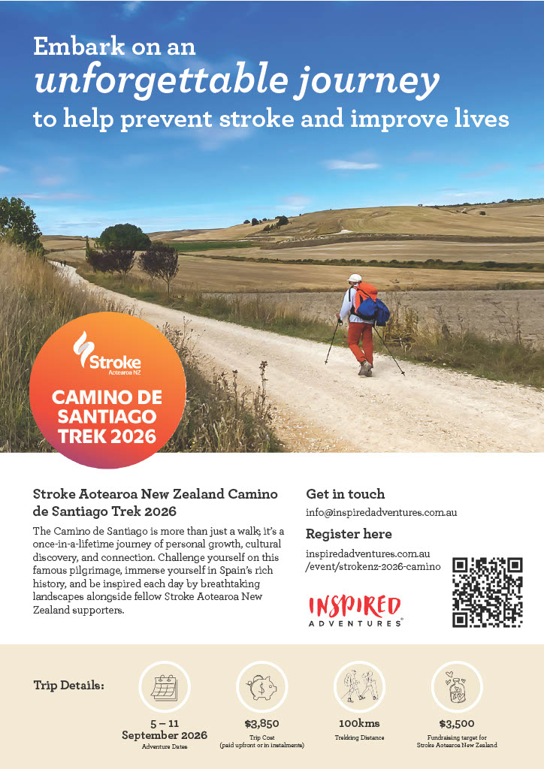
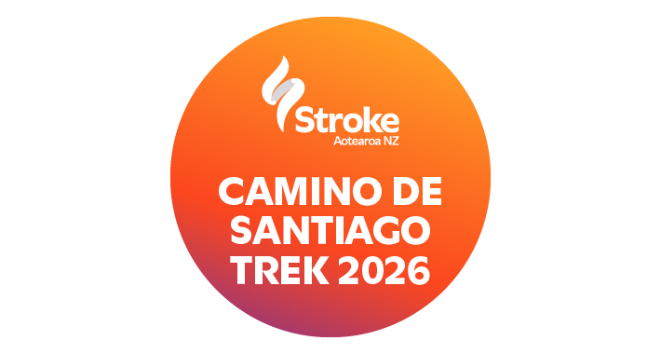
Camino de Santiago 2026
Notes:
Jamie and Sarah going on the Camino

Slide 37
Camino de Santiago 2026
Dates: 5-11 September 2026
Distance: 100km over 5 days.
Challenge grade: 3.5/5 (even tougher than the Great Wall of China)
The most famous pilgrimage route in the world.
From peaceful villages to rolling hills, medieval towns, historic churches, and awe-inspiring landscapes that have been shaped over centuries.
Notes:
Details about the Camino

Slide 38
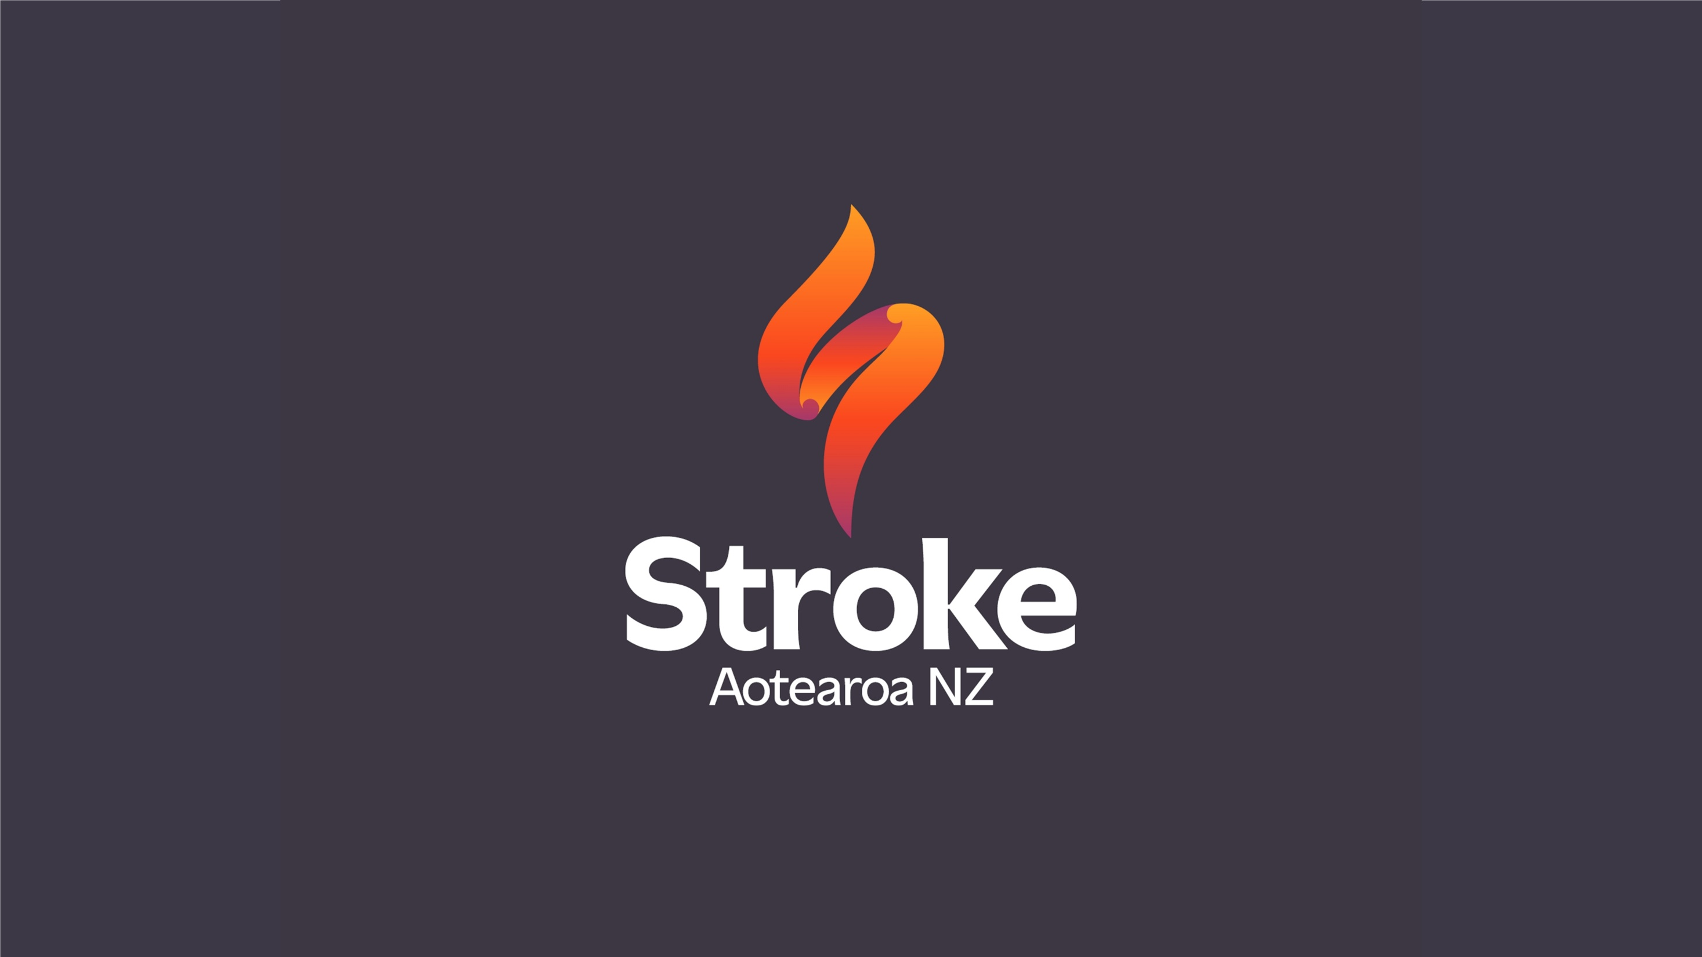
Notes:
Jo Lambert Slides Next

