Slide 1
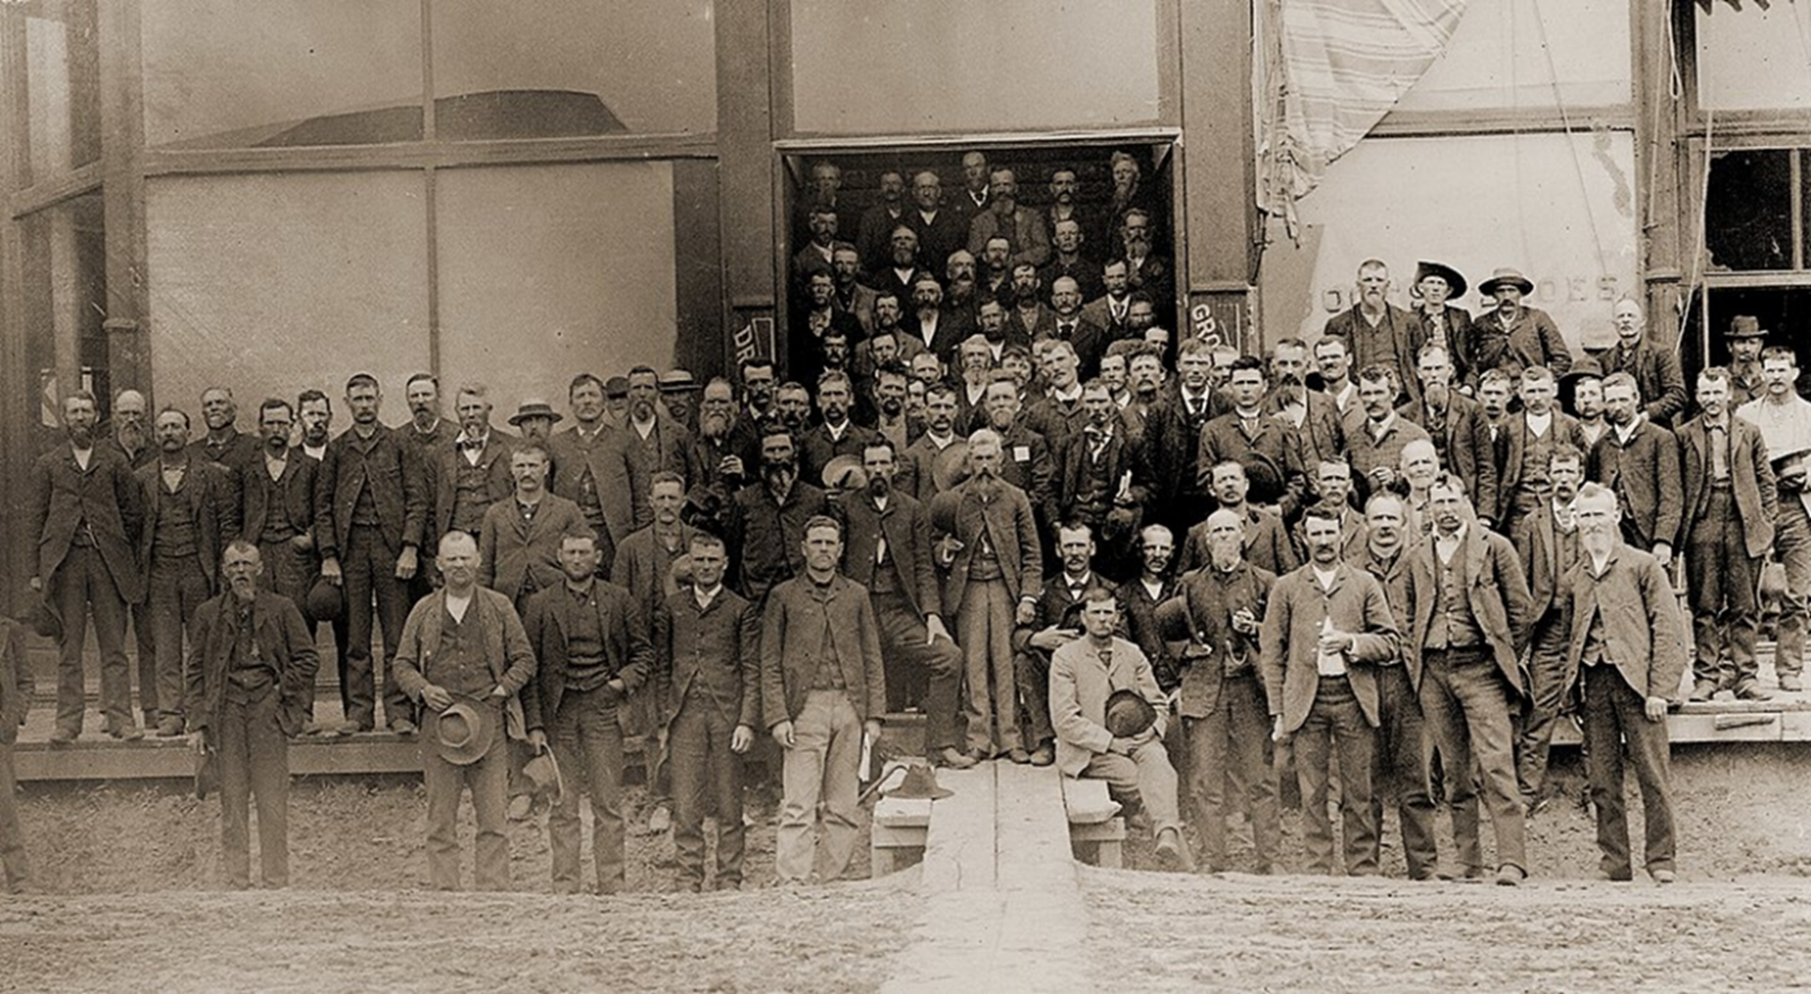
Understanding Populism u3a _ Timaru
15.6.2026
Notes:
Shout out to students for feedback - Aaron Kwak

Slide 2
Today’s lecture
Populism: A potted history
  Russia/USA… Ancient Rome/India/Cuba
Anti-Populism
  What it gets wrong…
A thinner version of populism
  Taking seriously the charge of Elite Failure
Perilous Politics …
  What follows? What is to be done?

Slide 3
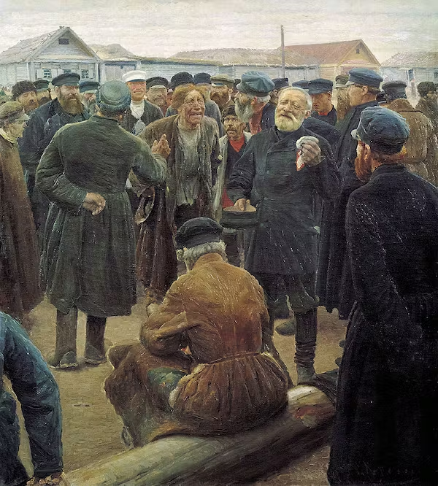

Historical origins
Born in places “two hundred and fifty miles to the nearest post office, one hundred miles to wood, twenty miles to water, six inches to Hell”.

Slide 4
Historical origins
1860s
Russian
American
1890s
Narodniks – “friends of the people”
Intention was to help emancipate the masses and increase their welfare.
Zemlya i Volya (Land and Liberty)
Peasantry = the revolutionary subject capable of bypassing capitalist development and moving directly to communism through communal land ownership, based on the traditional mir.
Dissolved into two major factions:
Narodnaya Volya (People's Will)
Chernyi Peredel (Black Repartition)
… Gave way to Leninist-Marxism.
The People’s Party (est. 1891)
An electoral coalition of the protest movements of the Southern Farmers‘ Alliance, the Colored Farmers' National Alliance, and the Knights of Labor.
  A coalition across racial and gender lines.
Endorsed William Jennings Bryan for Democratic Presidential Candidate, who lost (in 1896) to McKinley.
  Terroristic violence and fraud characterised that election;
  Movement became increasingly riven by racial conflict and eventually collapsed.
Notes:
Intellectual movement; grassroots movement
Chernyi Peredel – land distribution…

Slide 5
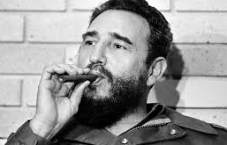
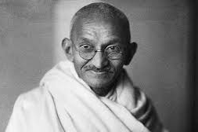
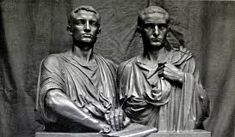
Mahatma Gandhi
Fidel Castro
Populists
Tiberius Gracchus and Gaius Gracchus.
Notes:
Long historical lineage…

Slide 6
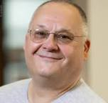
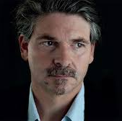
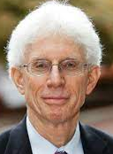
Understanding populism
“An ideology that considers society to be ultimately separated into two homogeneous and antagonistic groups, ‘the pure people’ versus ‘the corrupt elite’, and which argues that politics should be an expression of the volonté générale (general will) of the people”.
Cas Mudde
“The danger to democracies today is not some comprehensive ideology that systematically denies democratic ideals. The danger is populism—a degraded form of democracy that promises to make good on democracy’s highest ideals.
Jan Werner-Muller
“The assumption of (popular) homogeneity is always false, it leads first to denial and then to suppression. The inevitable culmination of denial and suppression is a populist declaration of enmity on behalf of a non-existent people against an undeserving scapegoat.”
In Sum: Populism is illiberal, anti-pluralist, dangerously exclusionary, insufficiently cognizant of the demands of a complex reality.
William Galston
Notes:
Populist ideology

Slide 7
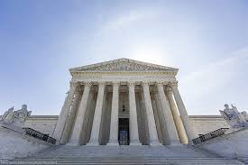
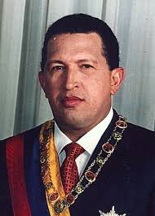
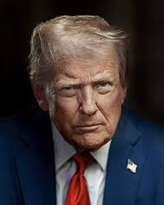
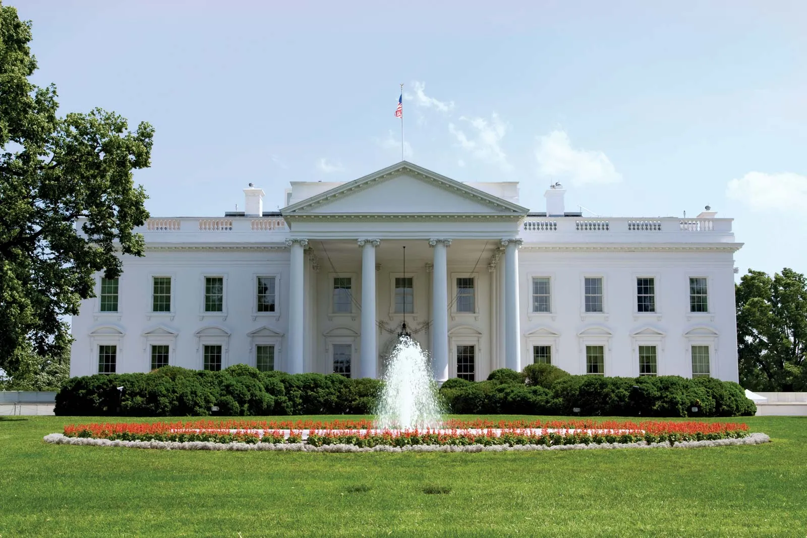
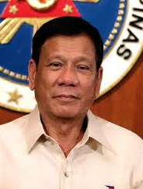
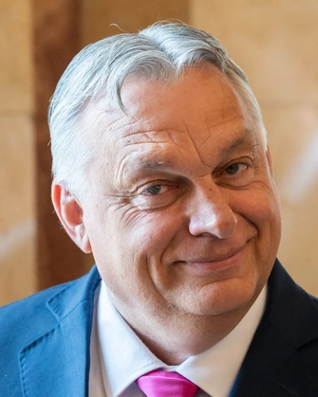
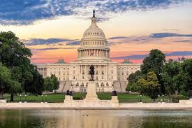
Ideology of Demagogues
Possessive
Approach to…
power
Notes:
What populists do

Slide 8
Anti-populism
In sum, populism is understood as a...
A ‘Thin-centred’ ideology
Committed to…
Anti-pluralism
Which issues in strategies characterized by...
Unorganized, amorphous and fickle masses;
Antagonistic forms of rhetoric;
Illiberal and undemocratic consequences.

Slide 9

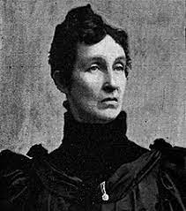
The original populists
These people are removed from Muller’s definition of populism.
The original populists are not, it turns out, populist!!!
‘Raise less corn and more hell’
Mary Lease
Notes:
Is this not a populist? ---
” Wall Street owns the country. It is no longer a government of the people, by the people, and for the people, but a government of Wall Street, by Wall Street, and for Wall Street. The great common people of this country are slaves, and monopoly is the master.”

Slide 10
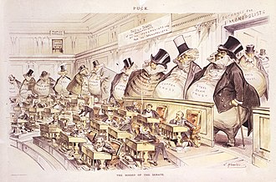
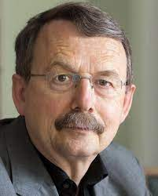
Populist critique of democracy involves two central parties...
Democracy
“Democracy”
The Elites
The People
Often articulated at both national and international levels
An ambivalent evaluation of the democratic credentials of the situation
Usually articulated at a national level
It is at the national level where democracy has – until recently – been most effective…
We live in “façade democracies”, where legitimacy is based on acquiescence…
How do different populists differently decontest....
Democracy, People, Elite?
All populists provide answers to the following questions:
‘How have the elite damaged democracy’
and
‘How has this harmed the people’?
Wolfgang Streeck
Notes:
Appealing to pluralism in this context of a corrupt or captured democracy that does not work effectively is to miss the fact that pluralism is not what is directing the political process….
Façade democracies

Slide 11
Definitions...
Thinner still
Ridding definitions of their moral baggage
Three parts
Positing the centrality of popular-elite hostility to political life
  But that need not be the only important division
    Nor do we need to assert anything like the ‘moral purity of the people’
Ambivalence with respect to claims that our democracies are best described as having been constrained by liberal commitments
  … as opposed, instead, to having been constrained/’corrupted’ by elite agency
An expectation that elites will react against populist interventions
  Elites are incorrigible, well-resourced and competent political actors.
Notes:
This helps us encompass the original populists…

Slide 12
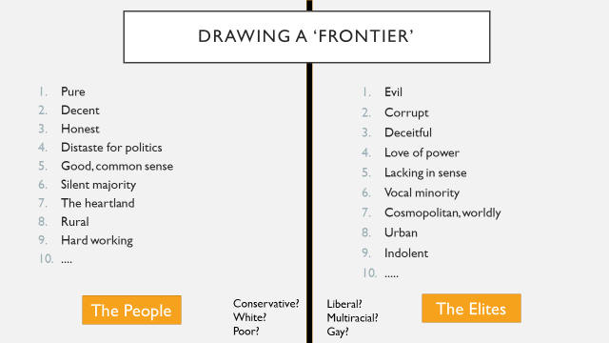
The basic political division
Again…
Although populists always posit the centrality and basic salience of the elite/popular division this need not mean
  It is not the only relevant constituency;
    People who are with us, those who must be convinced; those who must be ignored; those who must be defeated...
  Nor does it spell out what populists are destined to do about their orientations.
  And, most crucially of all, it does not tell us how we must articulate the people.
‘The people’ is a radically open category
Notes:
Mosca claimed with great relish that the major political philosophers, from Aristotle to Machiavelli and Montesquieu, had only focused on superficial characteristics of political regimes when they made those hoary distinctions between diverse forms of government, such as monarchies and republics or aristocracies and democracies. All of these forms were shown to be subject to the far more fundamental dichotomy of ruled and ruled.
To build up at last a true science of politics, one needed to understand how the “political class” recruits itself, maintains itself in power, and legitimates itself through ideologies which Mosca called “political formulas,” such as “Divine Will,” “the People’s Mandate,” and similar transparent maneuvers.

Slide 13
A Structural understanding of the people
Who should ‘the people’ be?
Put simply:
Those ill-served by the elites.
This is an understanding that can extend beyond... race, gender, class and even nationality.
The people are diverse – and there need be no sense of unity based on a notion of anything as substantial as ‘moral purity’...
They are united simply by their being victims of elite failings, and who have the right to expect a lot more from their representatives ...
But, the divisions persist...
Inside/outside....
Us/them.
And so, dangers (of the kind critics identify) remain
Notes:
Trump – an elite who cannot be corrupted – the people are just those people who support him, however much that dwindles
Even as that dwindles, he remains a populist…
Populist are also those political actors who offer themselves up as representative of this kind of constituency as well.

Slide 14
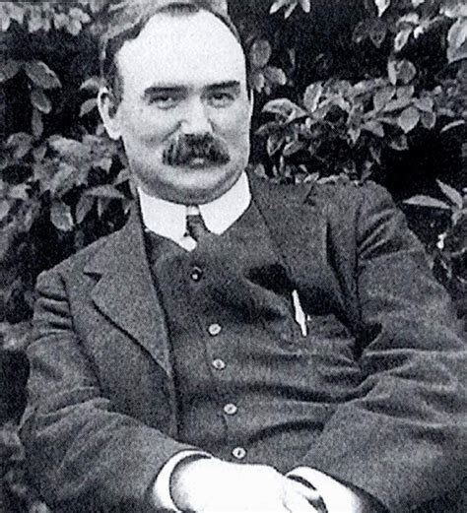
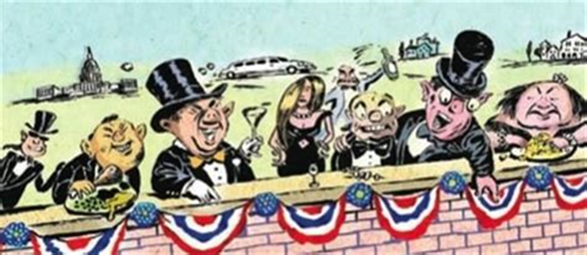
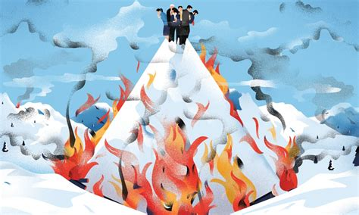
Naming the Enemy
“O, yes! The ruling class are worthy of study. The natural history of the ruling class is of fascinating interest. You begin with interest, you proceed with awe and admiration, you deepen into hatred, and you wind up with contempt for the nature of the beast. You realise that – The Capitalist Class is the Meanest Class that ever grasped the Reins of Power.”
James Connolly
Davos
Notes:
Value of designating blame for people with power who have misused it…

Slide 15
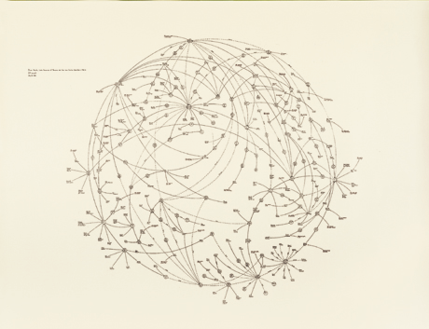
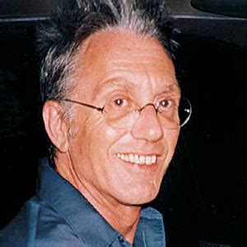
Networks of elite power
Mark Lombardi
Deranged conspiracy?
Well researched map of elite power?
Oliver North, Lake Resources of Panama, and the Iran-Contra Operation, ca. 1984–86 (4th Version), 1999.
Notes:
Suicide

Slide 16
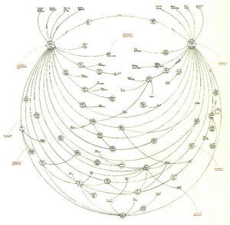
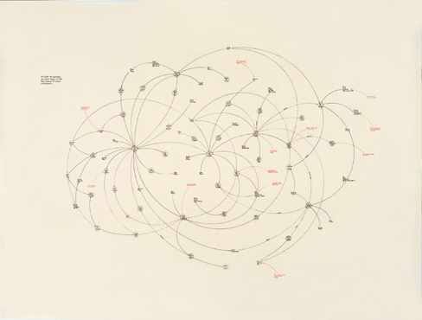
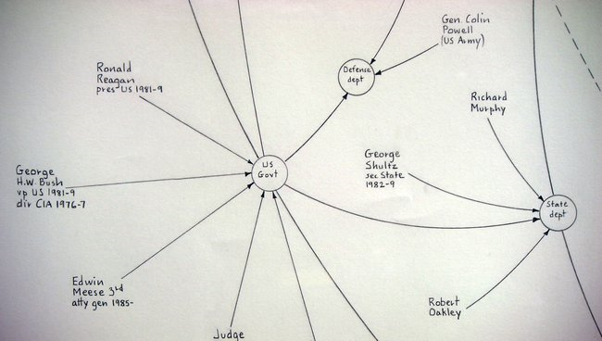
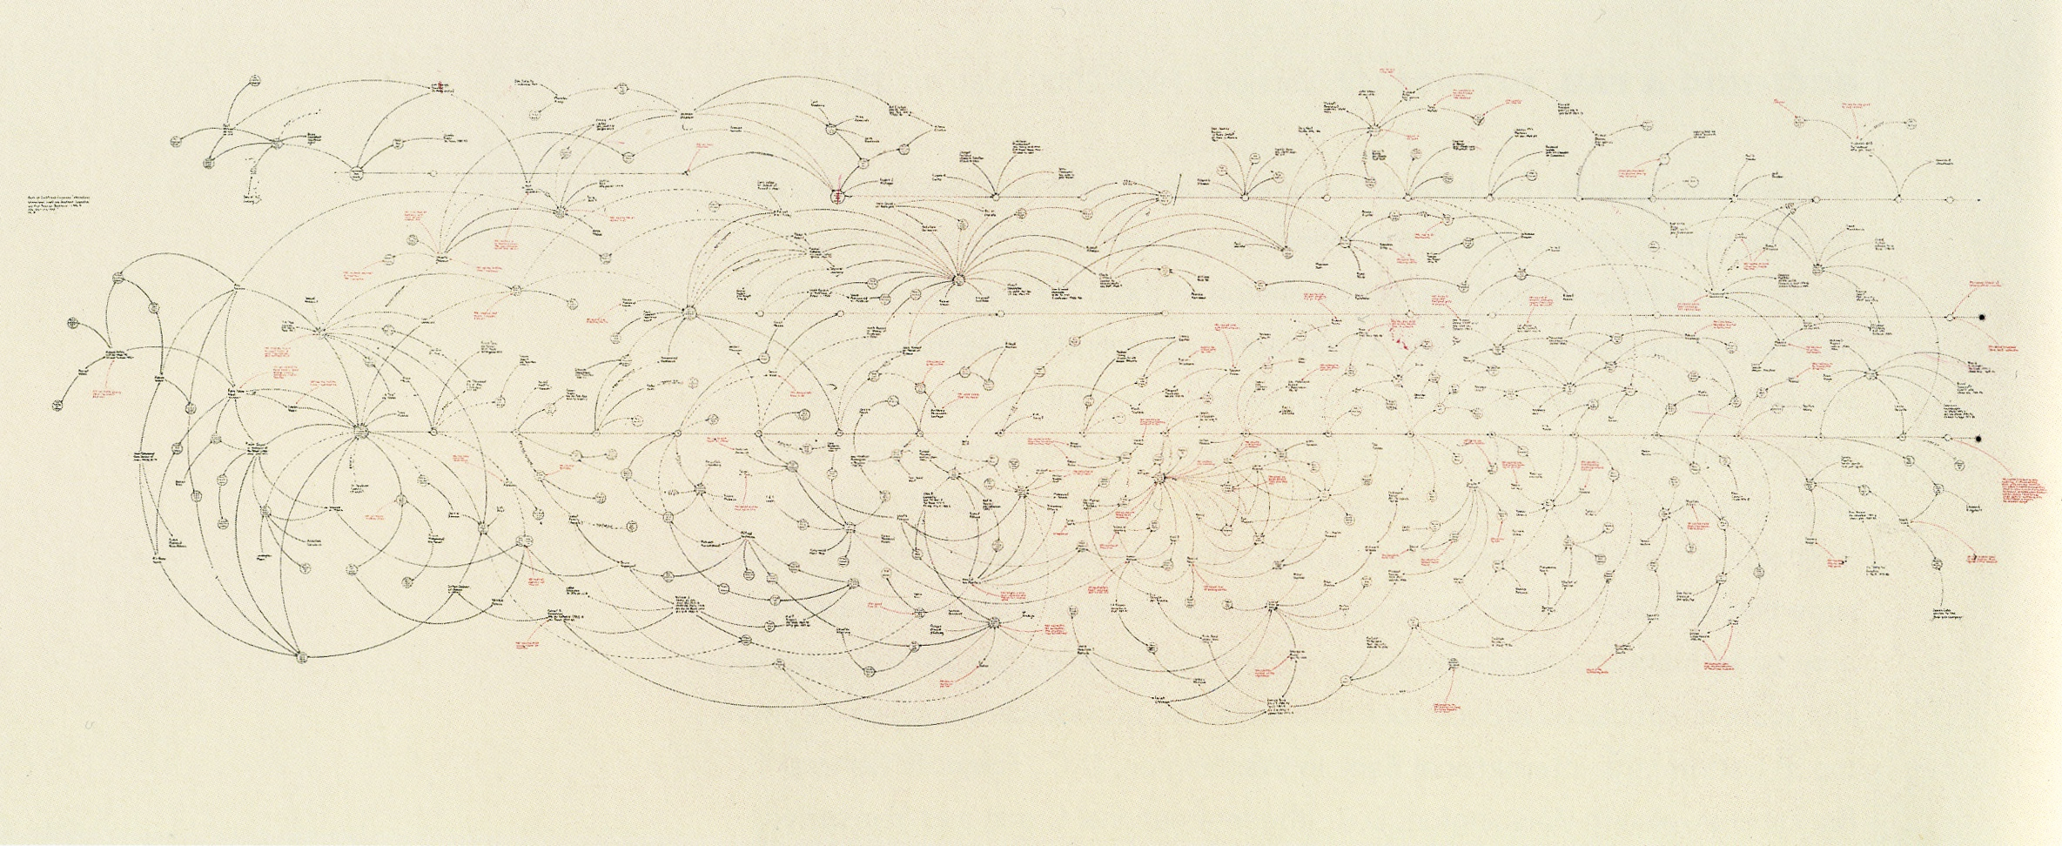
Art that documented ‘the uses and abuses of power’.

Slide 17
A basic Question…
Why assume that populists’ contempt for (at least some) elites is wrong?

Slide 18
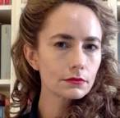
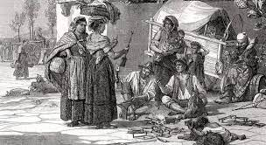
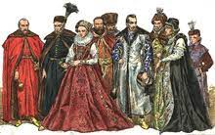
Oligarchic overreach
In modern, liberal democratic nations ‘the elites’ are also citizens...
Citizenship is egalitarian and unranked...
In previous epochs, there were formal divisions between
The Plebeians and the Nobles... People are marked out into definitive classes.
However,
‘Even though the theory of popular sovereignty that underpins liberal representative governments has obscured the fundamental division between the ruling elite and the common people, this split is factual and unavoidable’.
Specifically,
‘In times of crisis—in which common people are impoverished and disempowered to the point of oppression -... the veil of legal equality thins out’.
Camila Vergara
Popolo/Grandi
Vergara is here making an empirical claim...
Against which populism is best regarded as ‘the politicization of wealth in reaction to systemic corruption and the immiseration of the masses, an attempt to balance the scales of social and political power between the ruling elite and the popular sectors.’
Notes:
Oligarchic overreach refers to a situation where a small group of powerful individuals, known as oligarchs, overstep their bounds of authority and influence to the detriment of the broader society. In an oligarchic system, power is concentrated in the hands of a few individuals or entities, often based on wealth, and they exercise a disproportionate amount of control over political and economic institutions.
Oligarchic overreach occurs when these powerful individuals or groups abuse their power by engaging in activities that serve their own interests at the expense of the common good. This can take many forms, such as monopolizing industries, manipulating the political system to their advantage, and stifling competition.
Oligarchic overreach can have a number of negative consequences for society. It can lead to the concentration of wealth and power in the hands of a few, limiting opportunities for others to participate in the economy and politics. It can also stifle innovation and economic growth by preventing competition and innovation from emerging. Furthermore, it can undermine democracy by giving disproportionate power to a small group of individuals and limiting the ability of the broader population to have a voice in decision-making.
In order to address oligarchic overreach, it is important to promote greater transparency and accountability in political and economic systems. This can include measures such as stronger antitrust laws to prevent monopolies, greater campaign finance reform to limit the influence of money in politics, and greater public oversight of government and business activities. By promoting greater equality and democratic participation, we can help to prevent oligarchic overreach and build a more just and equitable society.

Slide 19
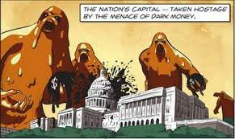
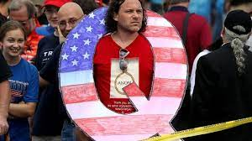
The Ruling class reality or conspiratorial fiction?
Some questions to ask yourself.... And that can have answers.
No... Murderous Satanic and blood drinking paedophiles are running things with the help of ‘woke’ anti-patriots who are funded by foreign powers and a “cultural Marxist” agenda.
***
No.... A ruling class of people operate to limit the demands people can make of their institutions in order to guarantee that the growth required for ever expanding capitalist production is sustained, even as ordinary folk suffer, many quite considerably, as a result
Do we live in ‘real’ democracies?
  What are the conditions that need to be satisfied for real democracy to function?
What do the relevant elites do?
  What are the kinds of things elites do the pursue their interests?
Are elites connected to the needs and interests and rights of ‘ordinary people’?
  How do/should ordinary people hold their elected representatives (and others) to account?
Notes:
In the American context, Doug Henwood describes an active ruling class, understood as a ‘politically engaged capitalist class, operating through lobbying groups, financial support for politicians, think tanks, and publicity, that meshes with a senior political class that directs the machinery of the state’ (Henwood 2021, 51). Most recently, this active ‘ruling class’ has developed a ‘production chain’ of political ideas to educate, develop and further the careers of ‘right-wing candidates up and down the ballot’, from ‘the Oval Office all the way down to places like Schoharie County, New York’ (ibid.). This class has also funded professors, think tanks, publications, and advocacy organizations... as part of a coherent, long-term, and ideologically rigorous strategy’ (Ibid, 68; Mirowski and Plehwe 2009). Charles Koch – as Henwood describes him, a ‘rare case of a serious capitalist organising independently on his class’s behalf’ – is explicit about this political project: “libertarians need an integrated strategy, vertically and horizontally integrated, to bring about social change, from idea creation to policy development to education to grassroots organizations to lobbying to litigation to political action’ (Koch cited in Henwood 2021, 69).

Slide 20
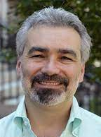
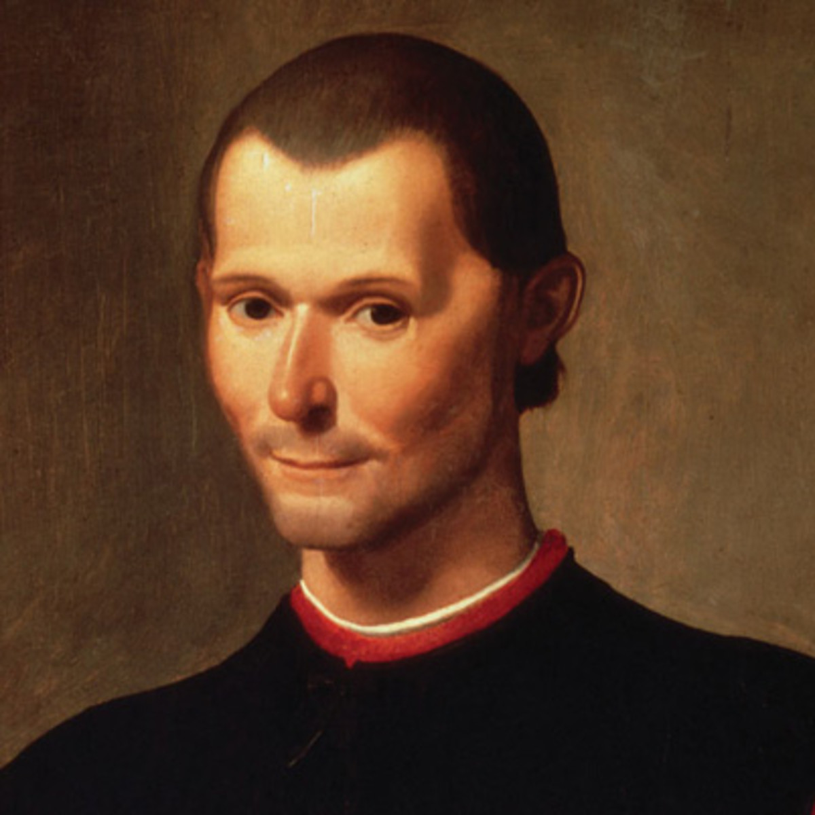
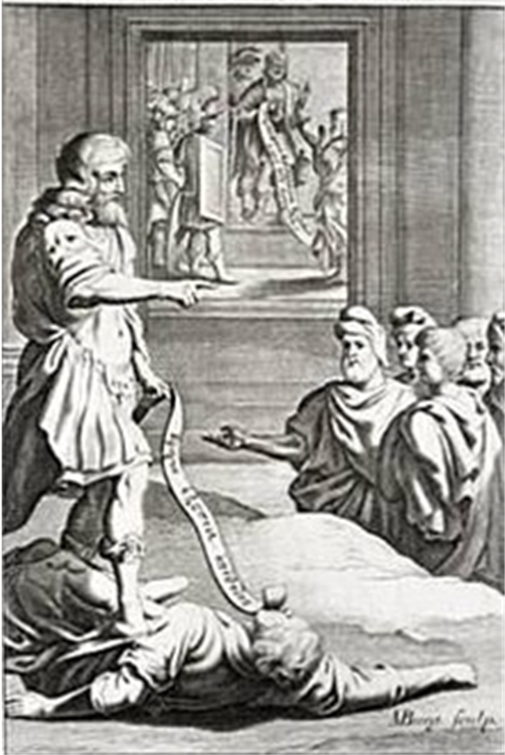

Dealing with elites...
An instance of ‘ferocious populism’
John P. McCormick
‘... He [Cleomenes] perceived that he could not confer this benefit on his country unless he obtained sole power. For he saw that the ambition of others made it impossible for him to do what was useful for many against the will of a few. Wherefore, finding fit occasion, he murdered the Ephori and all others likely to oppose him; after which, he completely renewed the laws of Lycurgus.’
Notes:
‘Ferocious populism’… Cleomenes Spartan (200 BC) (used the character of Lycurgus the lawgiver, which allowed him to legitimize this violence…)

Slide 21
Populist strategy
Even if populists convince us of their correct reading of our failed/failing democracies, it does not mean that “anything goes”...

Slide 22
Populist strategy
Populists can draw on a range of approaches to advance their agendas
‘Shortcuts to power’: the possessive approach
  Including ‘dismembering’ and ‘unmembering’ one’s rivals;
  Pack the courts with one’s chosen personnel
  Changing of constitutions to keep populist leader in power
  Gerrymandering electoral districts
Use constitutional provisions to...
  Expand the courts (as pursued by FDR and Abraham Lincoln).
  Change electoral process in ways that will favour populist agenda
Try and achieve a degree of cultural hegemony outside formal arenas of power
  Cultural products (cinema, art, theatre, literature) can be produced with populist messages.
‘Take over’ a political party... by getting one’s candidates elected!
  Self-declared (left-)populists in the US are trying to swerve Dems in broadly populist directions.
Use/Avoid divisive rhetoric and keep under the radar
  Perfectly possible and sensible for populists to avoid using populist rhetoric in an effort to stay under the radar.
Even if populists convince us of their correct reading of our failed/failing democracies, it does not mean that “anything goes”...

