Slide 1
Happiness Differences between Countries
Simon Kemp

Slide 2
Happiness is important
“Better an ounce of happiness than a pound of gold.”
… and governments are important:
“The happiness of society is the end of government.”

Slide 3
Cantril Ladder
A single item in the World Happiness Report is used for the measurement
The Cantril Ladder asks respondents to think of a ladder, with the best possible life for them being a 10 and the worst possible life being a 0. They then rate their own current lives on that 0 to 10 scale.

Slide 4
Basic Method of the World Happiness Report
Usually 1000 participants per country per year questioned by Gallup World Poll.
Averaged over the last 3 years: 2026 results from 2023-2025.
Results put together by the Sustainable Development Solutions Network based at the University of Oxford: Wellbeing Research Centre.
147 countries in 2026. 140+ languages.

Slide 5
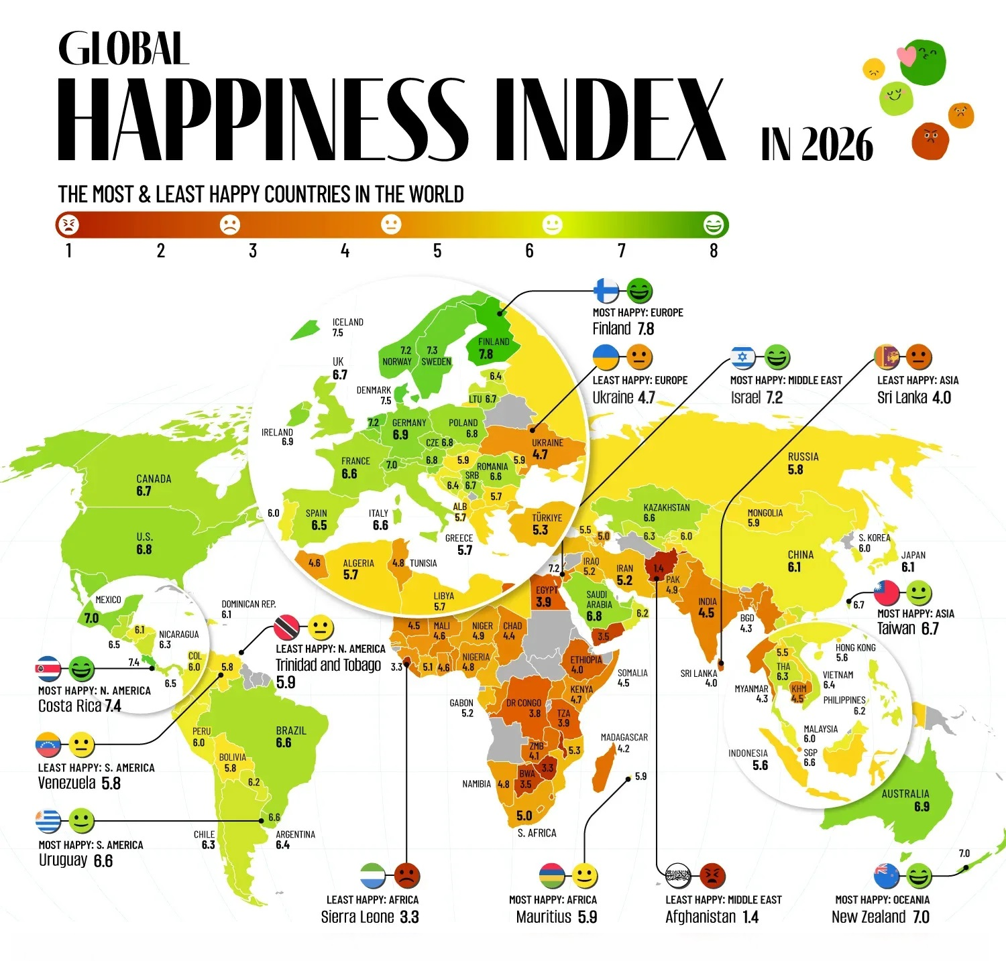

Slide 6
Overall results
Richer, safer, more democratic countries do better.
The differences are huge. As a very rough estimate, the results indicate that about half the variation of in people’s happiness is due to what country they live in. This seems odd.
Oddities: Japan. Botswana. Costa Rica.

Slide 7
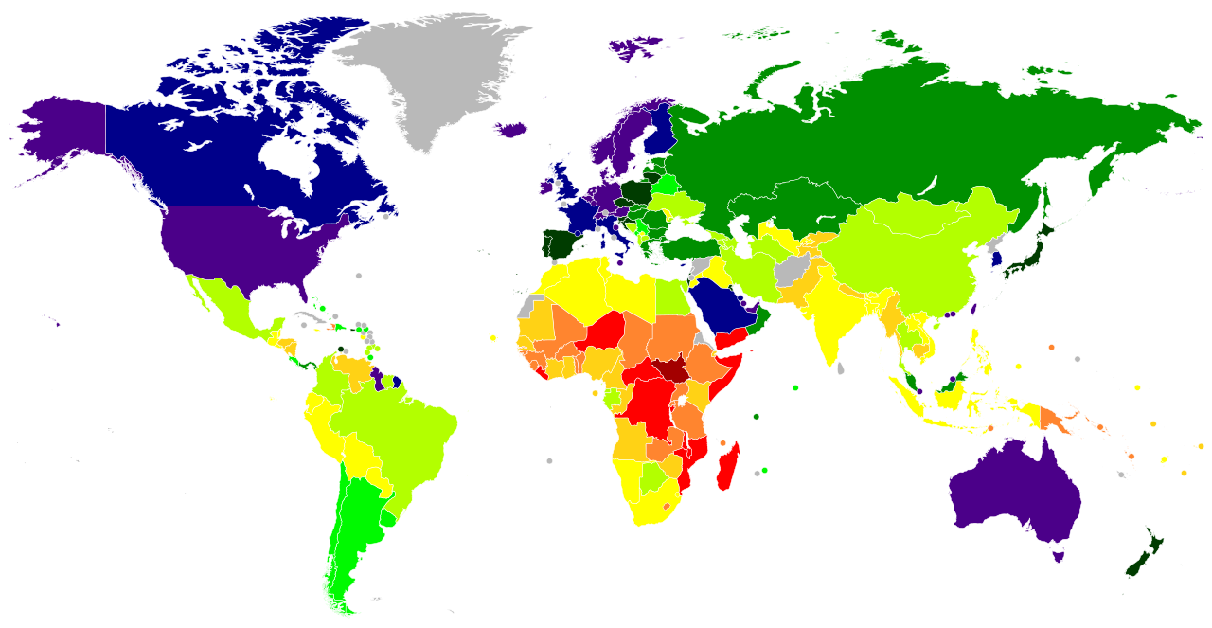
GDP per capita (adjusted for cost of living)

Slide 8
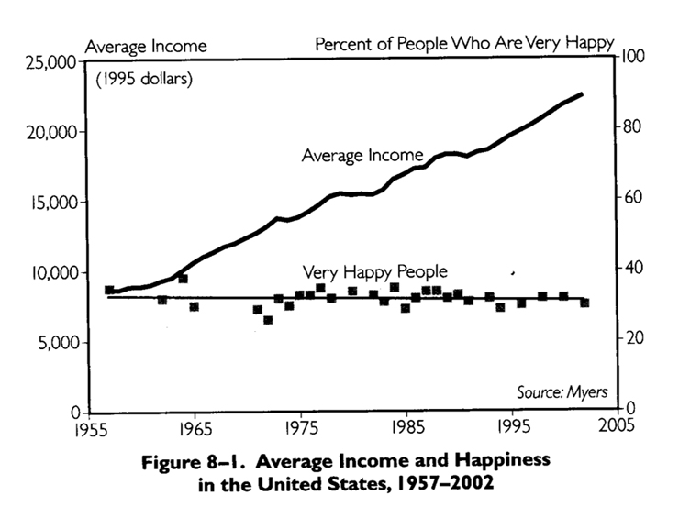

Slide 9
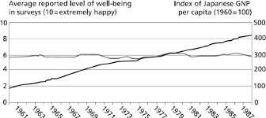

Slide 10
Income
Income doesn’t explain all of the country differences, although it is probably part of the answer.
So how about income inequality (which is a very fashionable explanation)

Slide 11
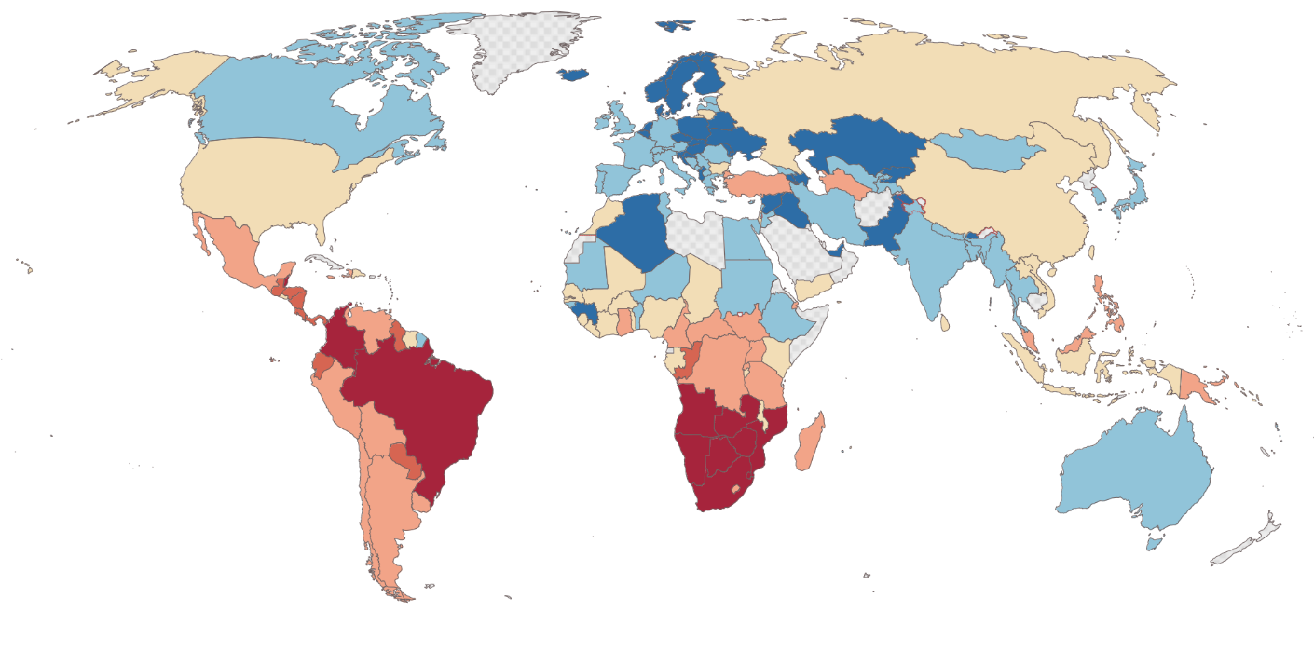
Gini coefficents (Inequality) in 2022

Slide 12
Other explanations
Lots of these, for example, life expectancy and health; crime. (Climate clearly doesn’t matter.)
The WHR report in 2026 thought the three most important explanations were (in order): average income; lack of corruption; social support. Other authors find other explanations more important (e.g. personal freedom).
Trouble is that “good” things – income, decent health services, good government, low crime rate – tend to cluster together and it is not easy to pick them apart.
Implication: Hard to know what to improve.

Slide 13
2026 focus on social media
Social media and smartphones make people miserable.
Especially younger people in the USA, UK, NZ, Australia, Canada.
(This fits with quite a lot of other evidence.)

Slide 14
Are the happiness results real?
If they are real, then what country you are born is responsible for about half your happiness. (Oddly this is about what people say.) Issues:
How does the “best possible life for you” translate?
Are there cultural differences in how happy people say they are?
Do different cultures have different ideas of what happiness is?
How does WHR sampling work?
How free are people to reply?

Slide 15
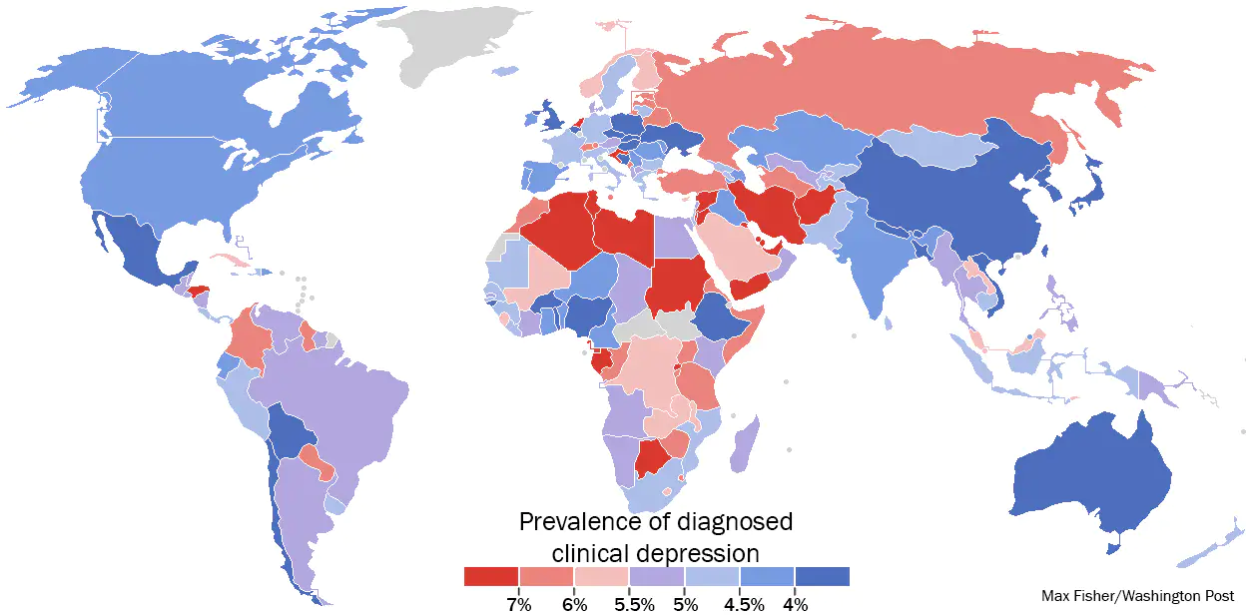
Depression round the world

Slide 16
… one way to check
Bolle & Kemp (2009) compared student groups where on group is known to be unhappy (Asians in NZ; Poles in East Germany; Hungarians vs Danes).
Describe an imaginary student who has either a great life or a very poor life, and ask for happiness ratings.
Found no difference between the groups in how they rated, indicating perhaps a common “shopping list” for happiness.
Suggests that culture mightn’t bias the results much.

Slide 17
Conclusion
There are happiness differences between countries.
They are big.
We don’t really know why they exist, or if they are real.
Implication.
Beyond the obvious – avoid war! – it is not easy to fix miserable societies.

