Slide 1

Either You Control Social Media
or Social Media Controls You
by Kseniia Zahrai, Ekant Veer, Paul Ballantine, Herb de Vries and Girish Prayag
U3A, 17 Nov, 2025

Slide 2
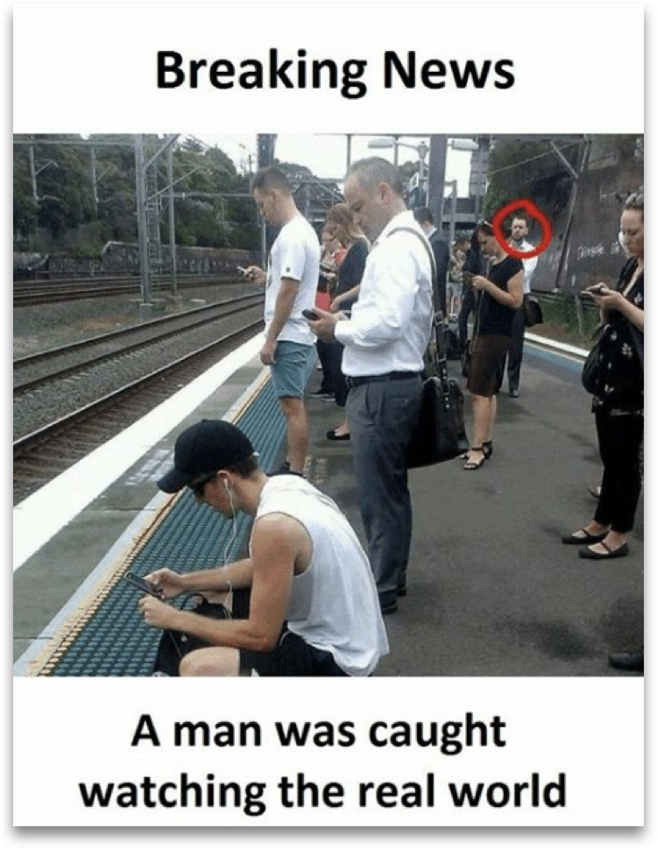

Social Media Users
65% of Earth
2.5 hours daily
7 full years of life
79% of NZ population

Slide 3

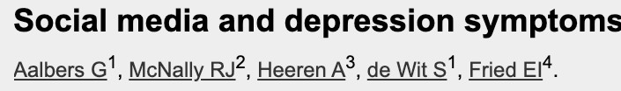

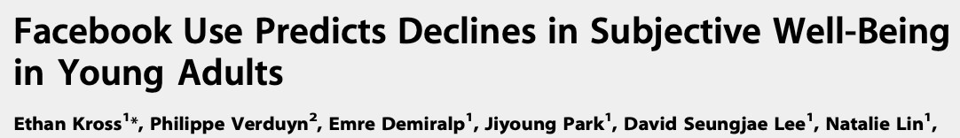
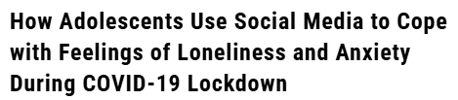

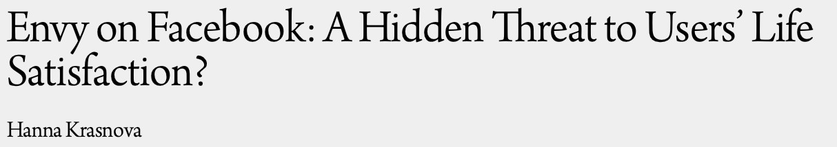



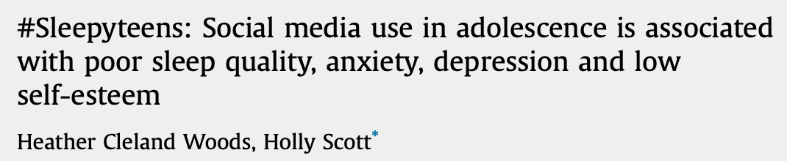
Is it Good or Bad?
#Sleepyteens: Social media use in adolescence is associated with poor sleep quality, anxiety, depression and low self-esteem

Slide 4

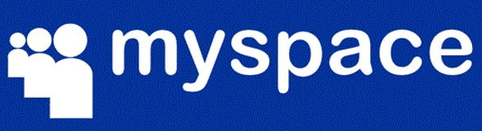

What Counts as Social Media

Slide 5
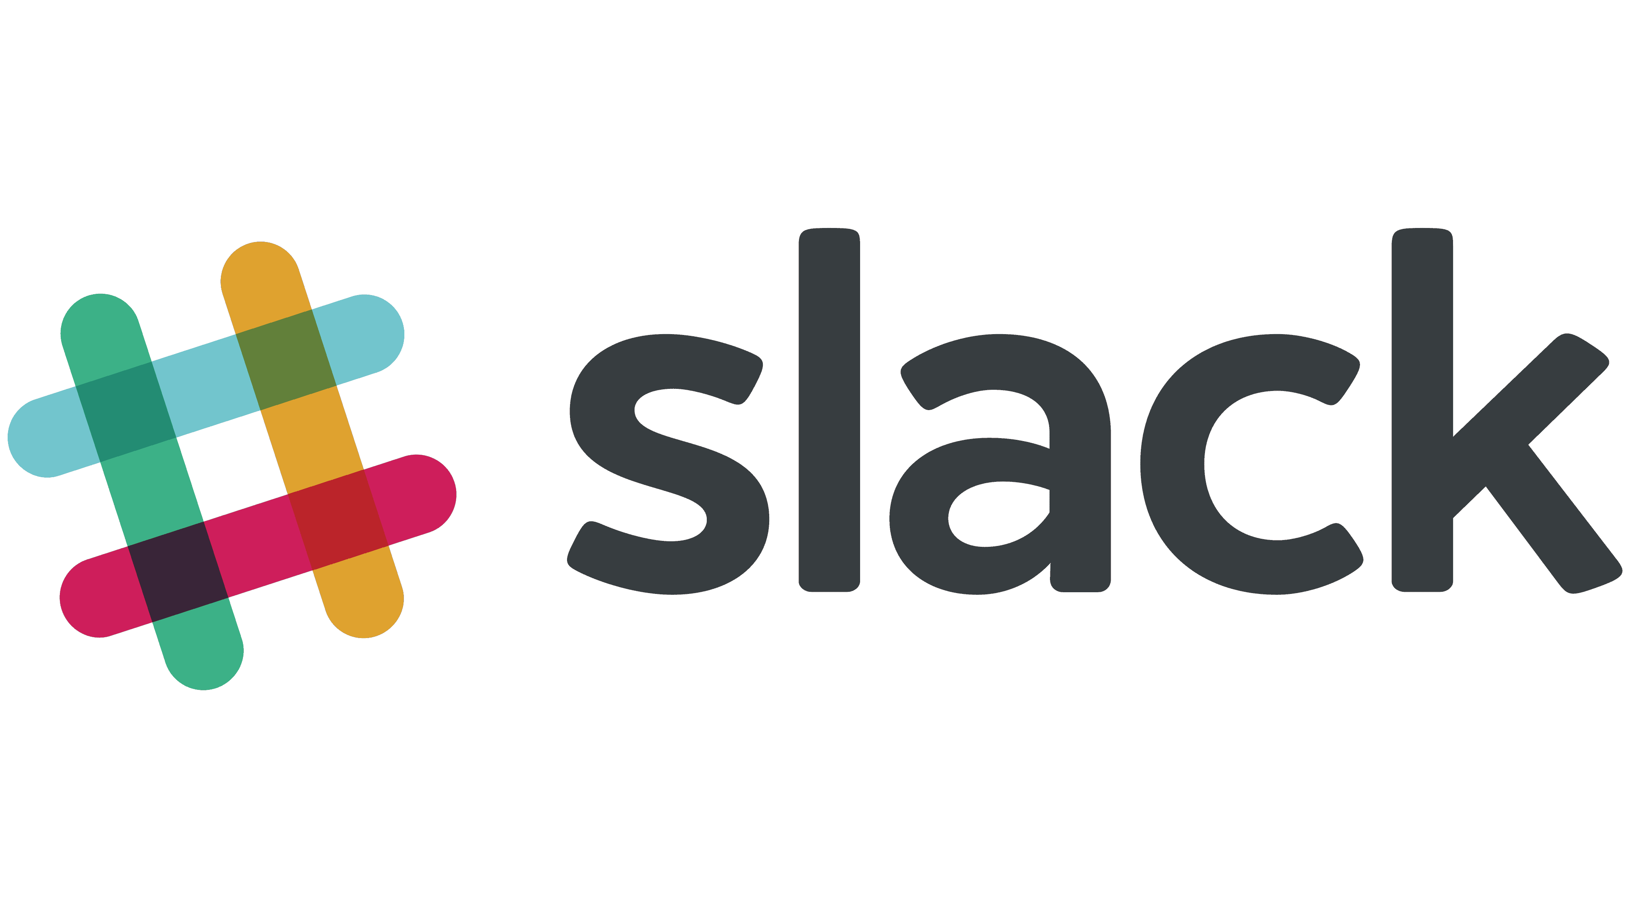






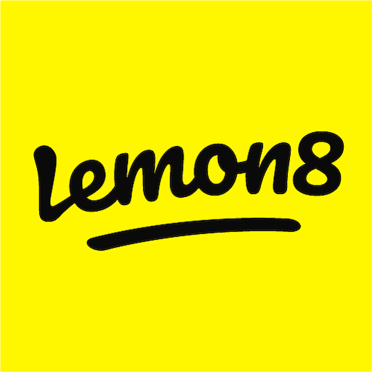



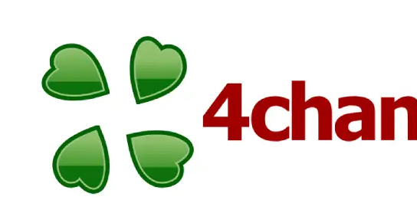









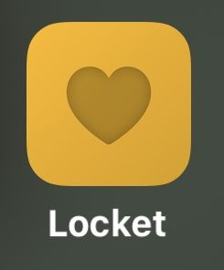
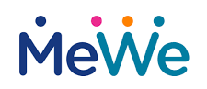




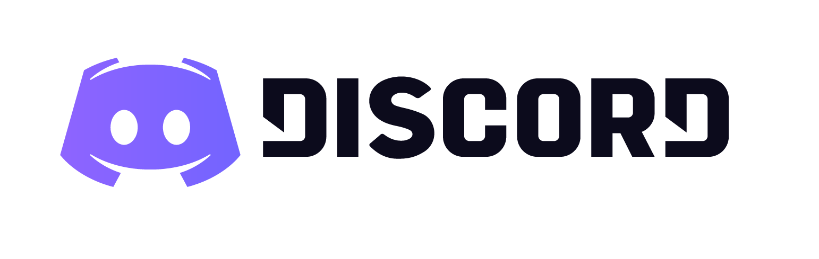


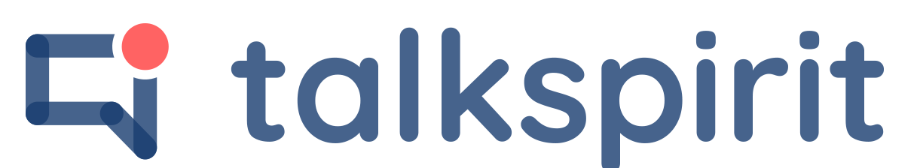



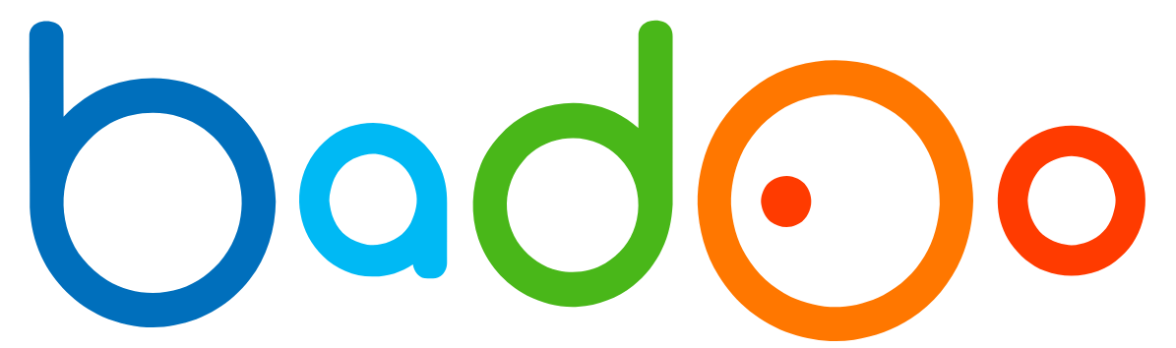

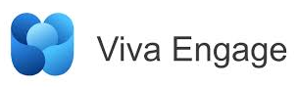
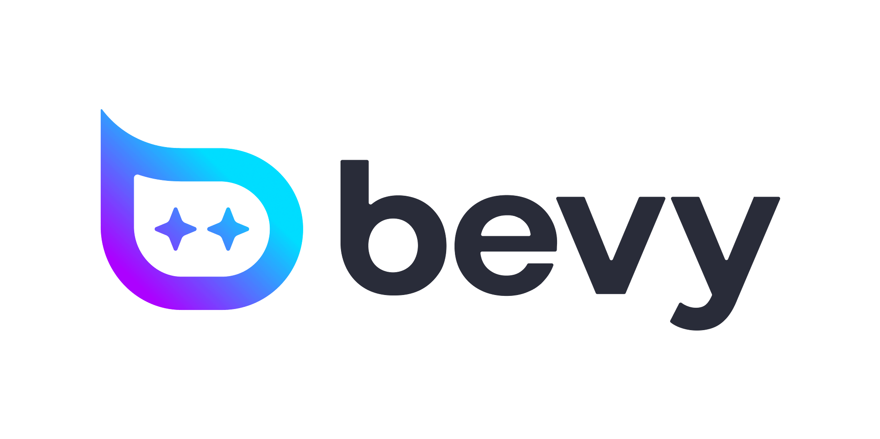
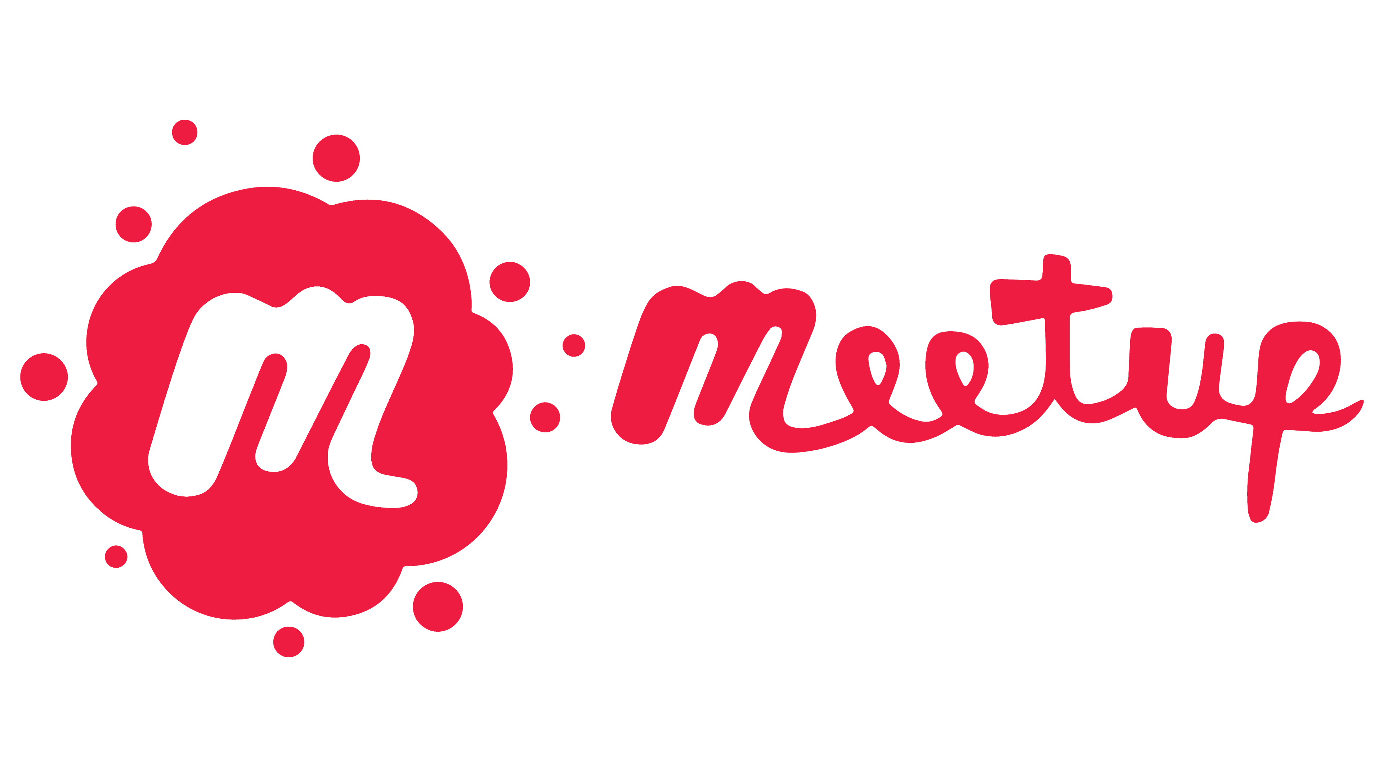
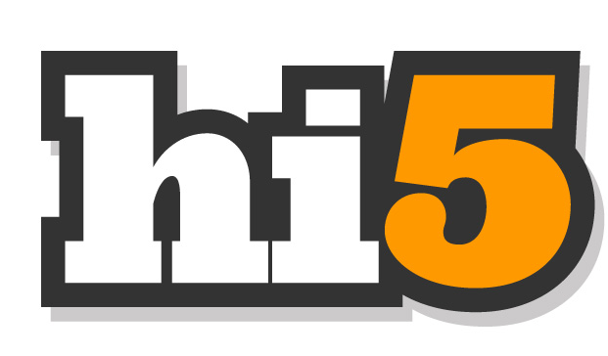


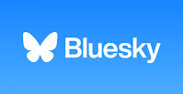






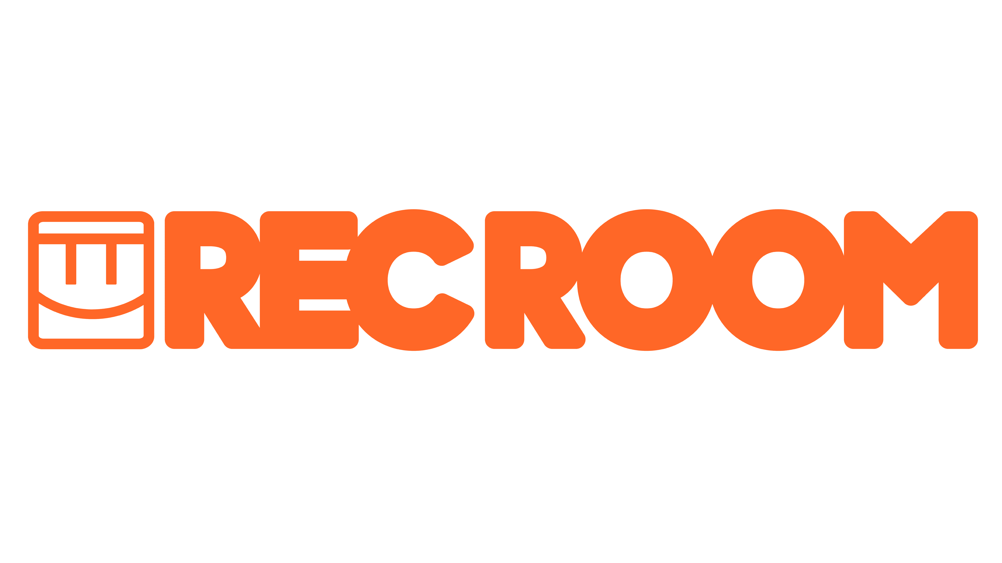









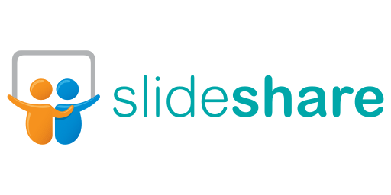




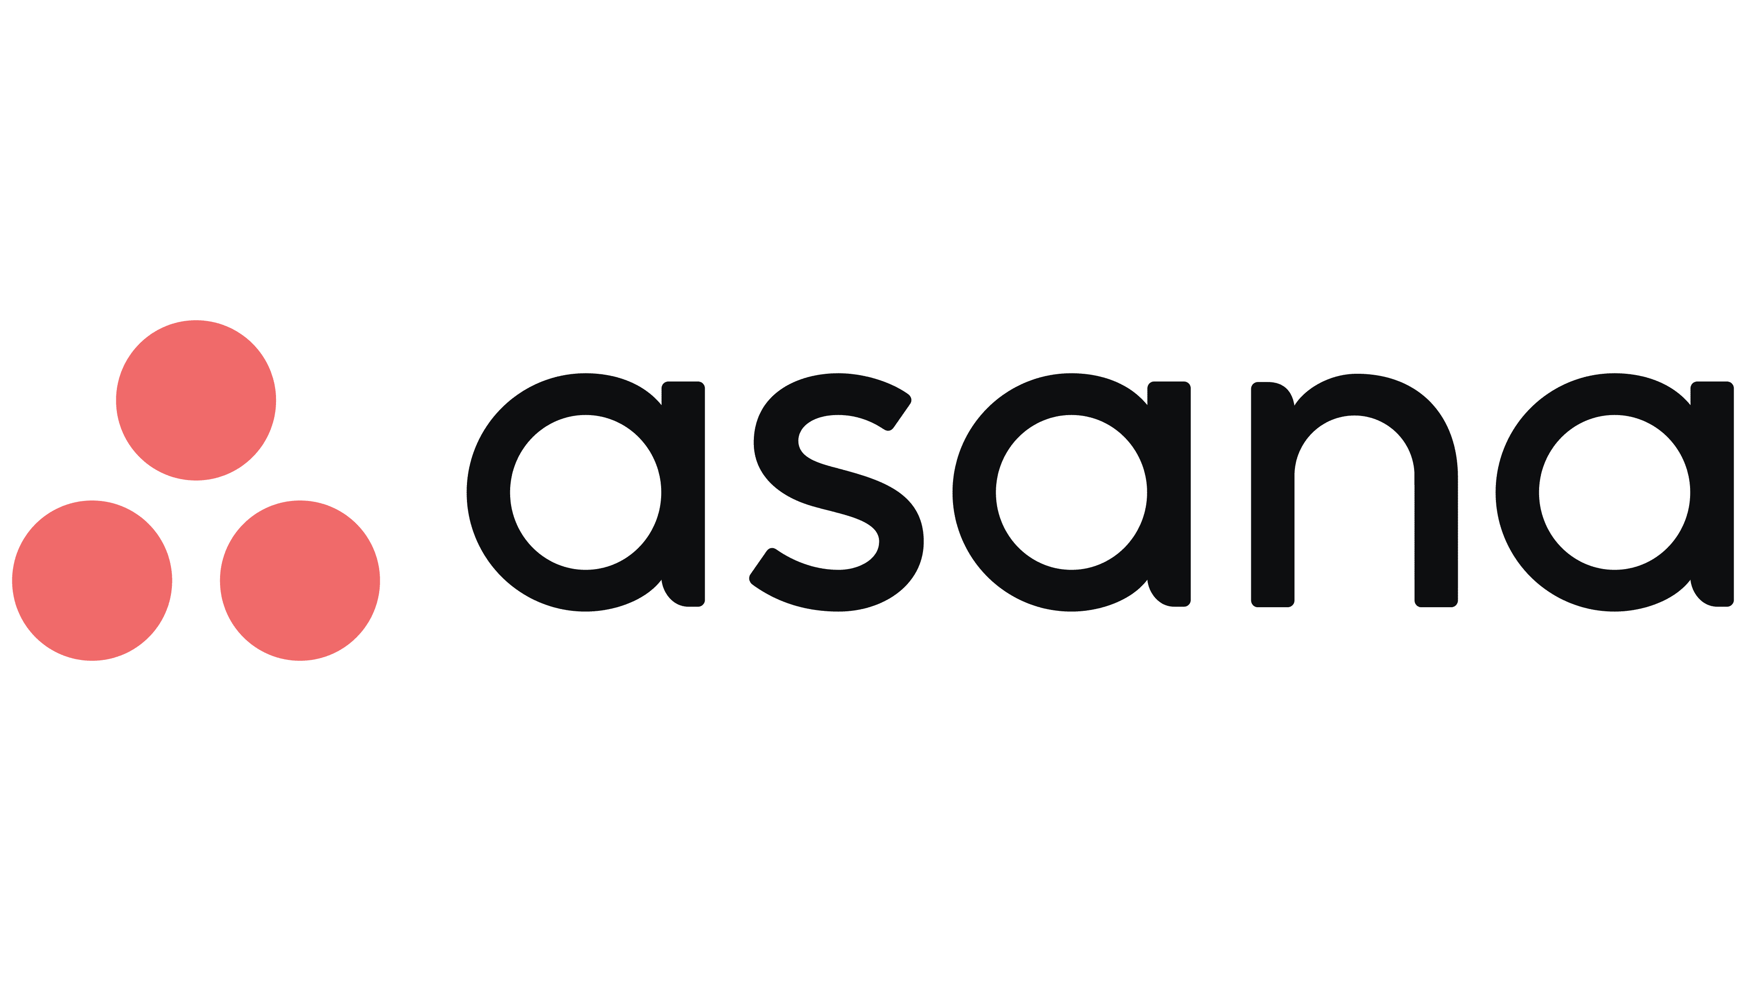



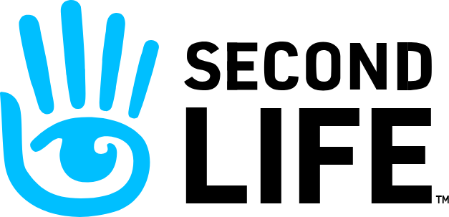




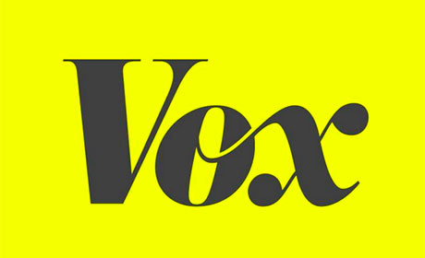

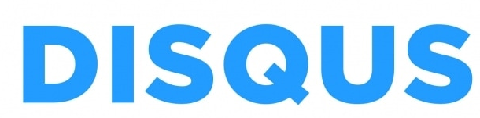
What Counts as Social Media
Community
Visual Sharing
Messaging & Communication
Discussions
Collaborations
Video & Live Streaming
Publishing & Blogging
Virtual Worlds

Slide 6

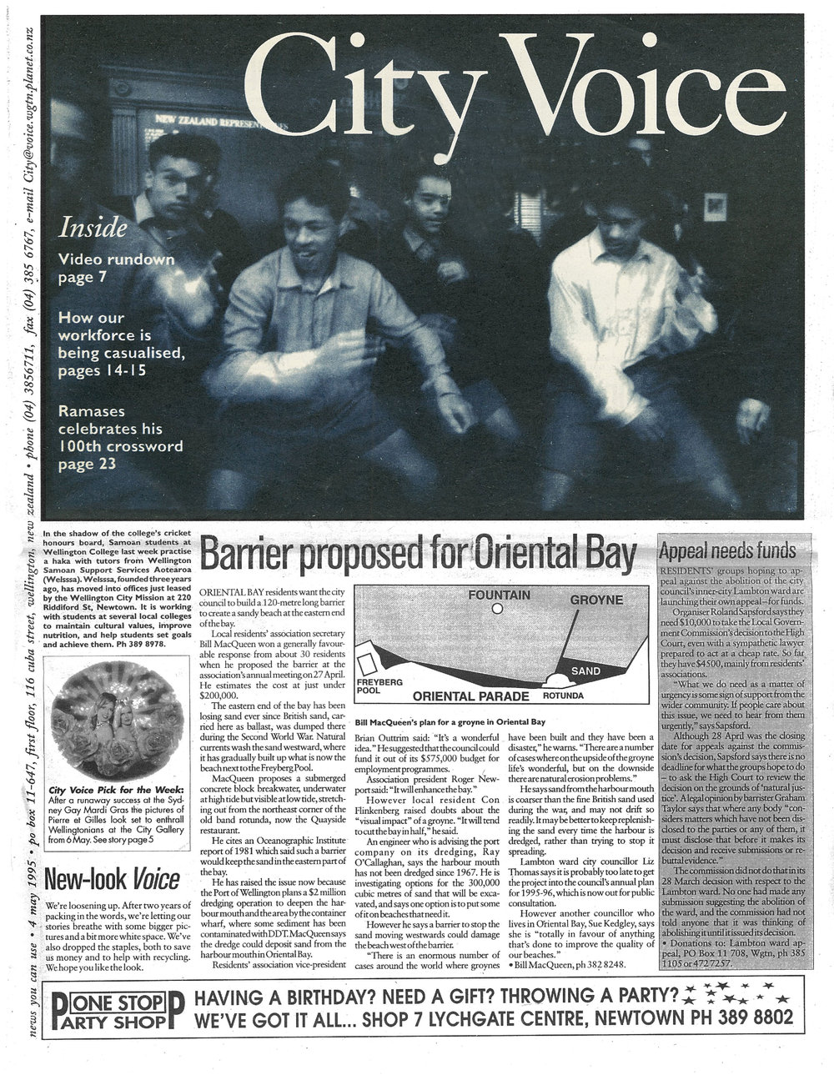
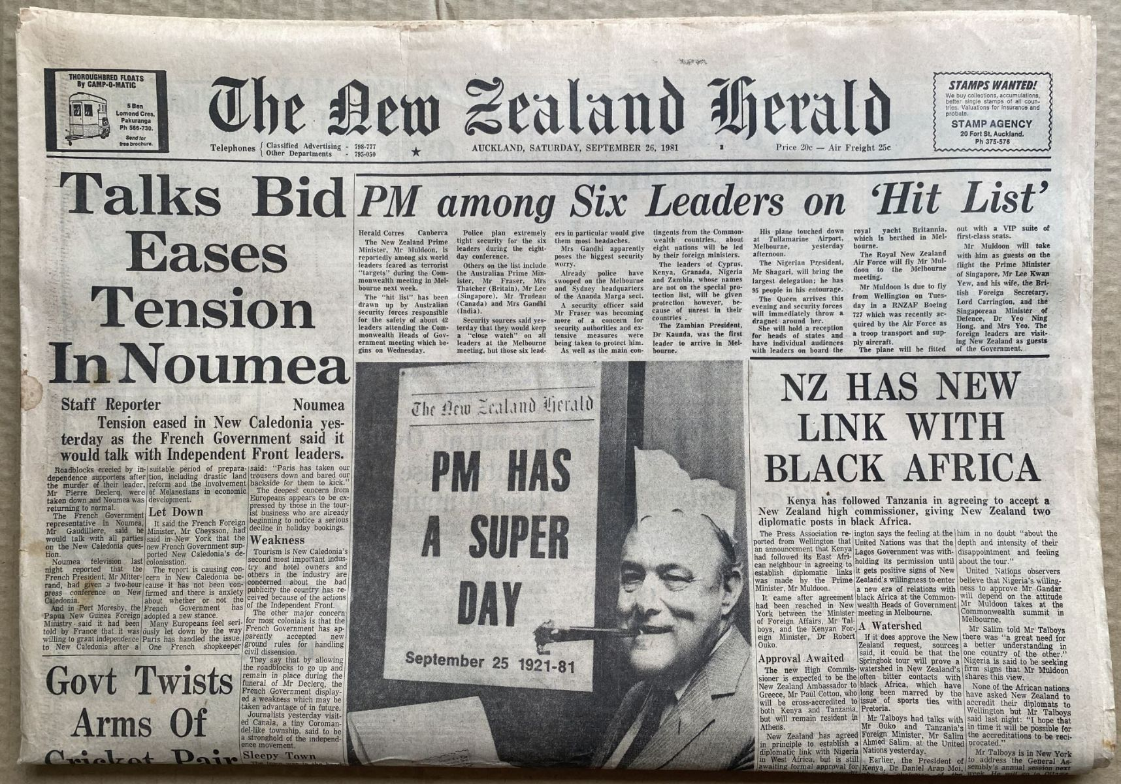
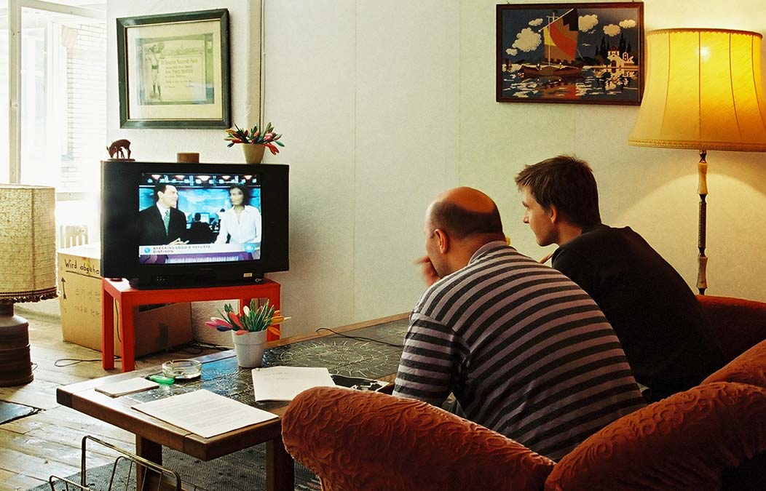
News Then and Now
30 years ago
Fixed daily editions: only the most important stories
Same news for everyone
Curated by professionals
Passive consumption

Slide 7


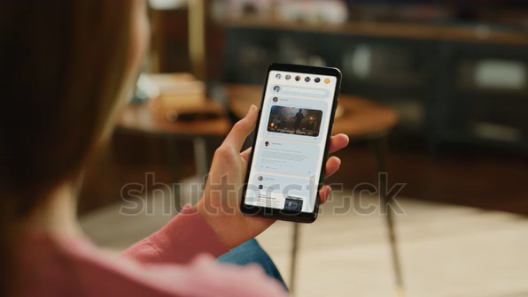
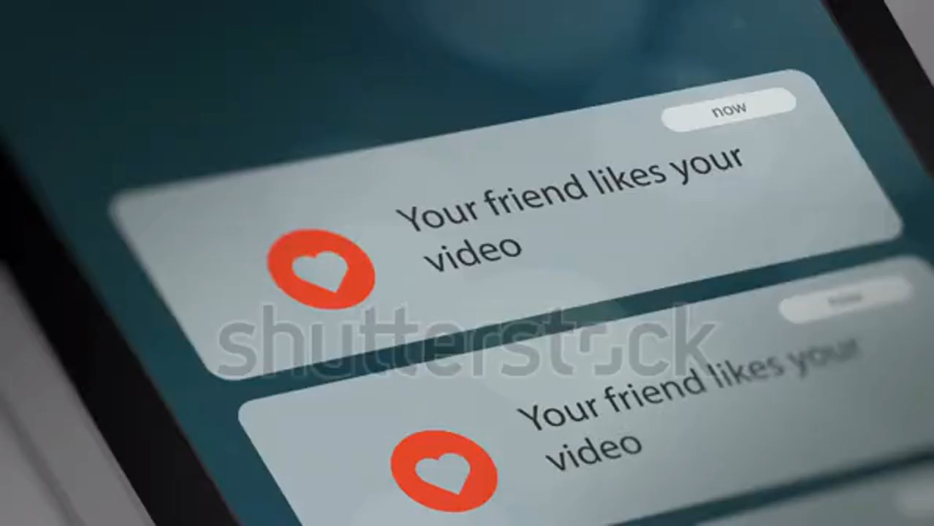
News Then and Now
Today
Endless Scrolling
Attention-grabbing content
Personalised by algorithms
Interactive: react instantly
Anyone can publish

Slide 8
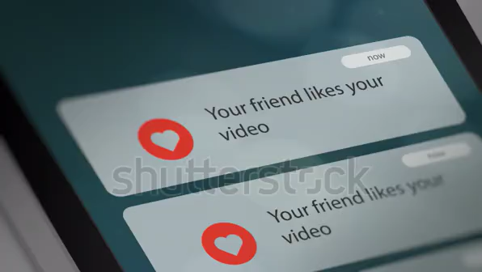
News Then and Now
Today
Endless Scrolling
Attention-grabbing content
Personalised by algorithms
Interactive: react instantly
Anyone can publish

Slide 9
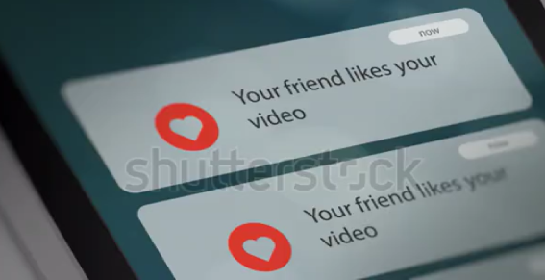
News Then and Now
Today
Endless Scrolling
Attention-grabbing content
Personalised by algorithms
Interactive: react instantly
Anyone can publish

Slide 10
News Then and Now
Today
30 years ago

Slide 11


Same Apps, Different Outcomes
Some people can easily put the phone down…
…while others keep scrolling —
even when it harms their well-being
Self-control is the ability to resist immediate impulses and act in line with long-term well-being (Tangney et al., 2004). Is it just about self-control?

Slide 12
How much is too much?
No universal “safe” time standards
(Galer, 2018; Ross et al., 2009; Thompson et al., 2012)
Time limits quickly become outdated as average use rises
Excessive use is defined by negative impact on well-being, not just time spent (Andreassen et al., 2016; Kuss et al., 2011)

Slide 13

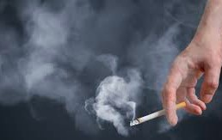






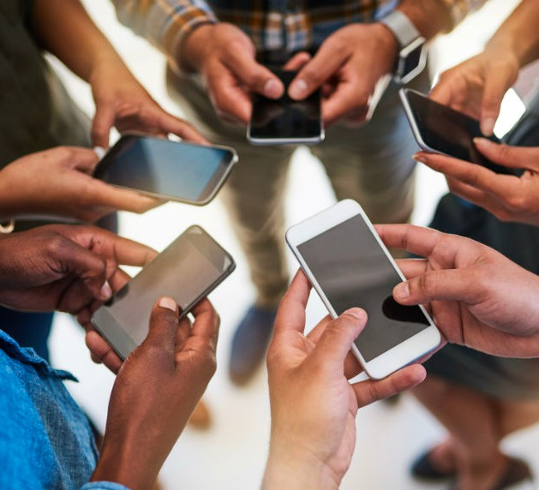
Nature of Excessive Behaviours
Non-Media Behaviours
Media Behaviours
Impulsivity
(non-conscious hard-to-control urges)
Self-reporting tools
(people describe what they think)

Slide 14
Research Questions
RQ1: How does impulsivity impact excessive social media use?
RQ2: What is the role of self-control in managing excessive use and its negative impact on daily life?

Slide 15
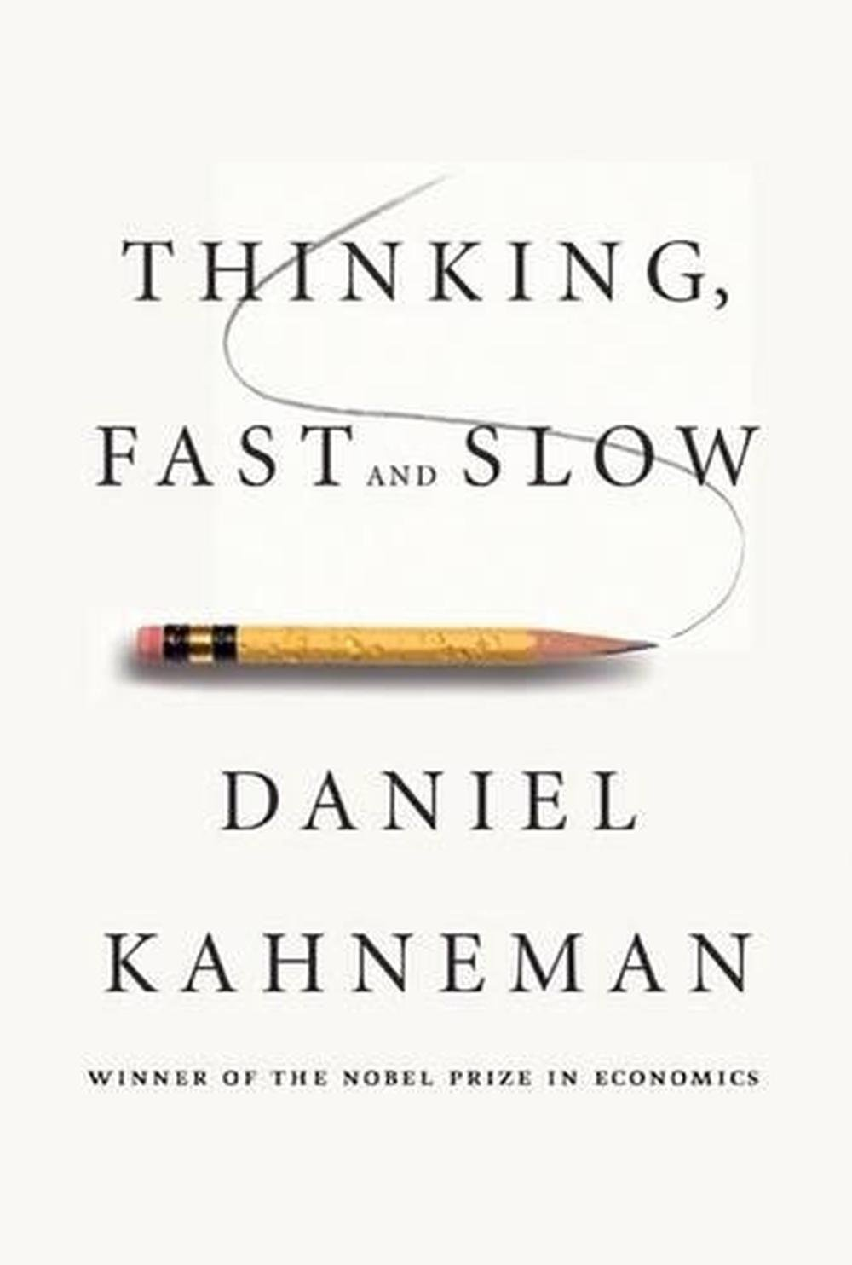
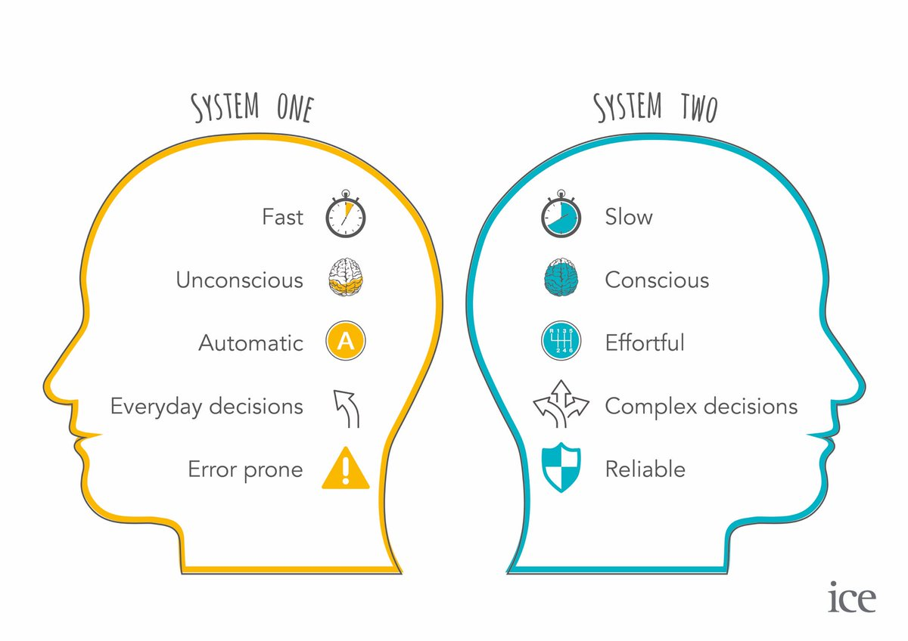
Dual-System Theory
Two Systems in Judgement and Decision-making (Kahneman, 2011)
S1 (impulsive):
fast and non-conscious
S2 (reflective):
slow and conscious
System 1 often wins the race

Slide 16
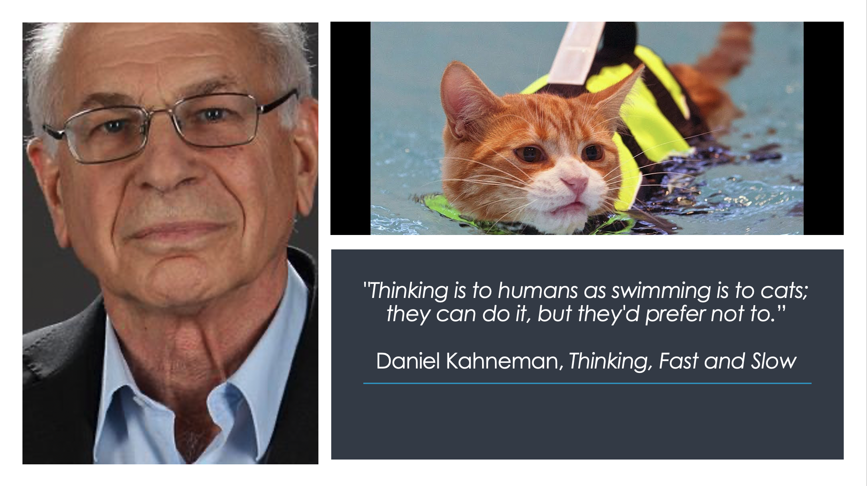
Dual-System Theory
Two Systems in Judgement and Decision-making (Kahneman, 2011)

Slide 17
Dual-System Theory
Two Systems in Judgement and Decision-making (Kahneman, 2011)
Associations = Implicit Attitude
Opinions = Explicit Attitude

Slide 18
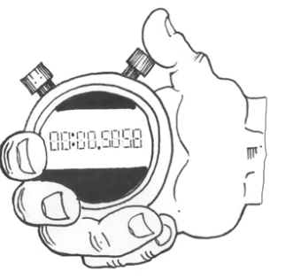

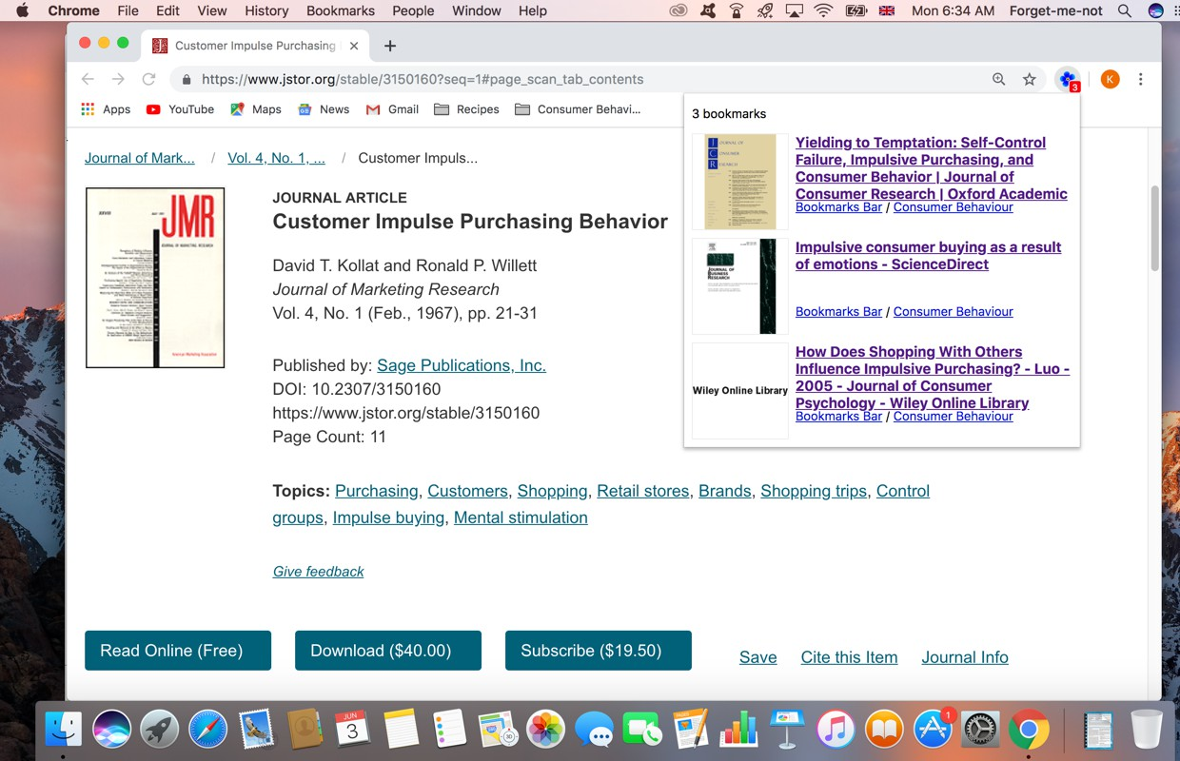
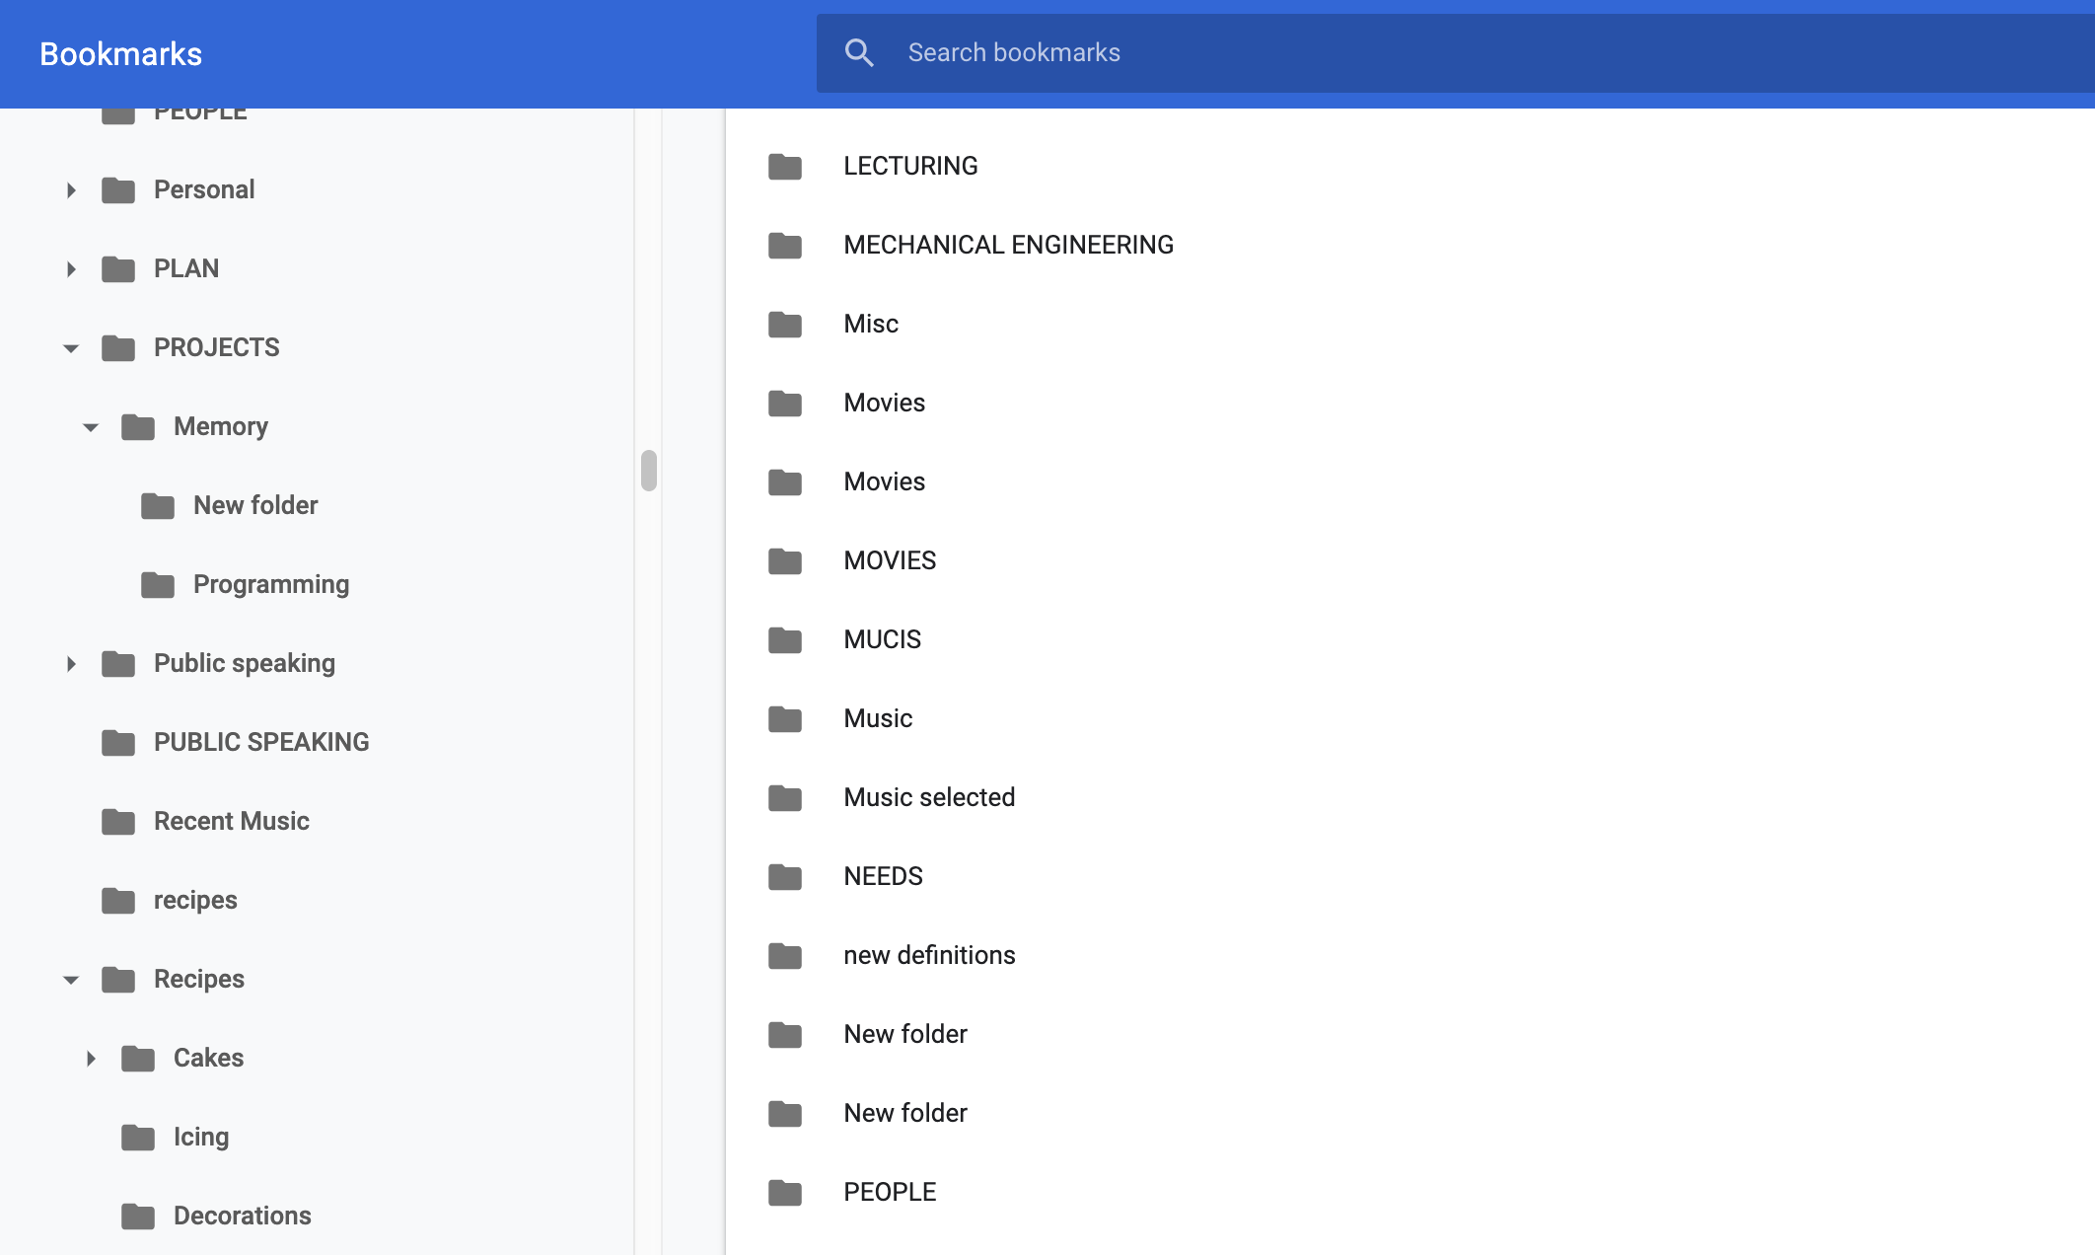

Implicit Association Test (IAT)
(Greenwald et al., 1998; Karpinski et al., 2006)
Pleasant
or
Social media
Unpleasant
reveals automatic, non-conscious attitudes
measures how quickly people associate social media with positive and negative feelings

Slide 19
Finding 1: Implicit Attitude as a Driver
389 participants, 18-44 y.o., more than 2 hours on social media daily
Implicit attitude drives impulsive and excessive use
What people consciously believe has little effect on their actual social media use
Implicit Attitude
Impulsive Use
Excessive Use
Explicit Attitude
Negative Impact on Daily Life
Zahrai, K., Veer, E., Ballantine, P. W., de Vries, H. P., & Prayag, G. (2022). Either you control social media or social media controls you: Understanding the impact of self‐control on excessive social media use from the dual‐system perspective. Journal of Consumer Affairs, 56(2), 806-848.

Slide 20
Finding 2:
Duality of Self-Control
Self-control
High initial self-control can reduce harmful use, but…
Self-control is limited when positive implicit attitudes are strong
Implicit Attitude
Impulsive Use
Excessive Use
It is something I do unconsciously and don’t think how it takes me away from the rest of my life
(Study participant)
Negative Impact on Daily Life
“
”
Zahrai, K., Veer, E., Ballantine, P. W., de Vries, H. P., & Prayag, G. (2022). Either you control social media or social media controls you: Understanding the impact of self‐control on excessive social media use from the dual‐system perspective. Journal of Consumer Affairs, 56(2), 806-848.

Slide 21
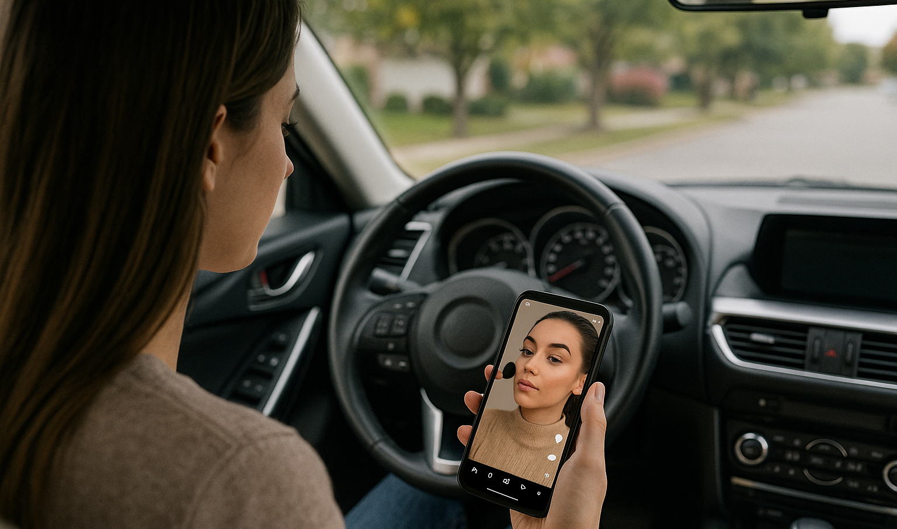

“I got into a bad car accident because I was watching Instagram makeup videos while driving. I didn’t notice a big animal crossing the road and swerved, flipped into a ditch, and broke my arm in 2 places. I'm still in physical therapy for it.
I never told my friends or family how it happened, instead saying I lost control on a slippery path. I'm trying to break the habit and am very grateful I didn't die that day.”
(Study participant)

Slide 22
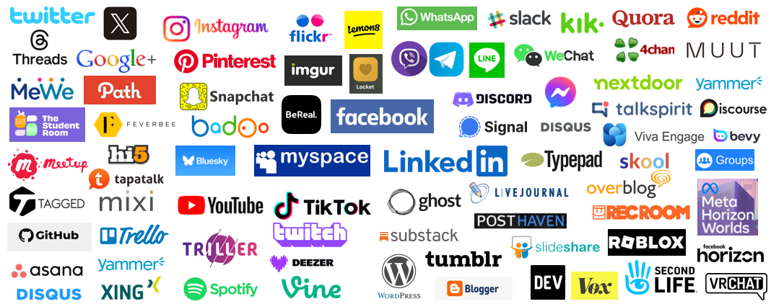
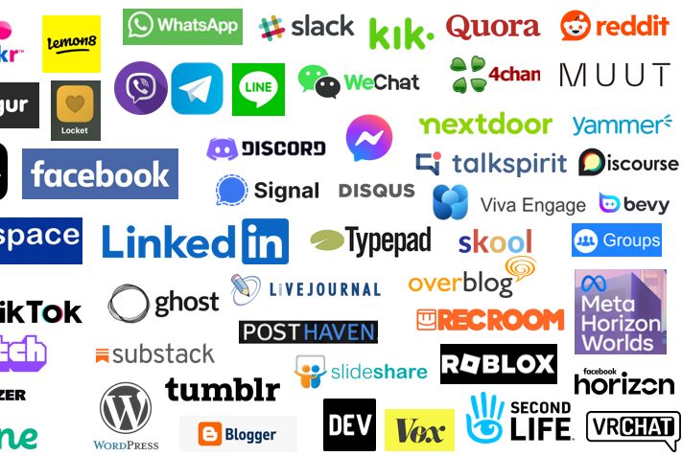
What Can Be Done?
Building Resilience
1. Users
Focus on meaningful use: time limits vs intention-based goals
Minimise social media triggers to reduce impulsive checks
Curate a feed to prioritise well-being

Slide 23

What Can Be Done?
Building Resilience
2. Public Policy Makers
Develop comprehensive digital literacy programs for all ages
Require platforms to disclose algorithms and prioritise transparency
Fund research on digital well-being

Slide 24
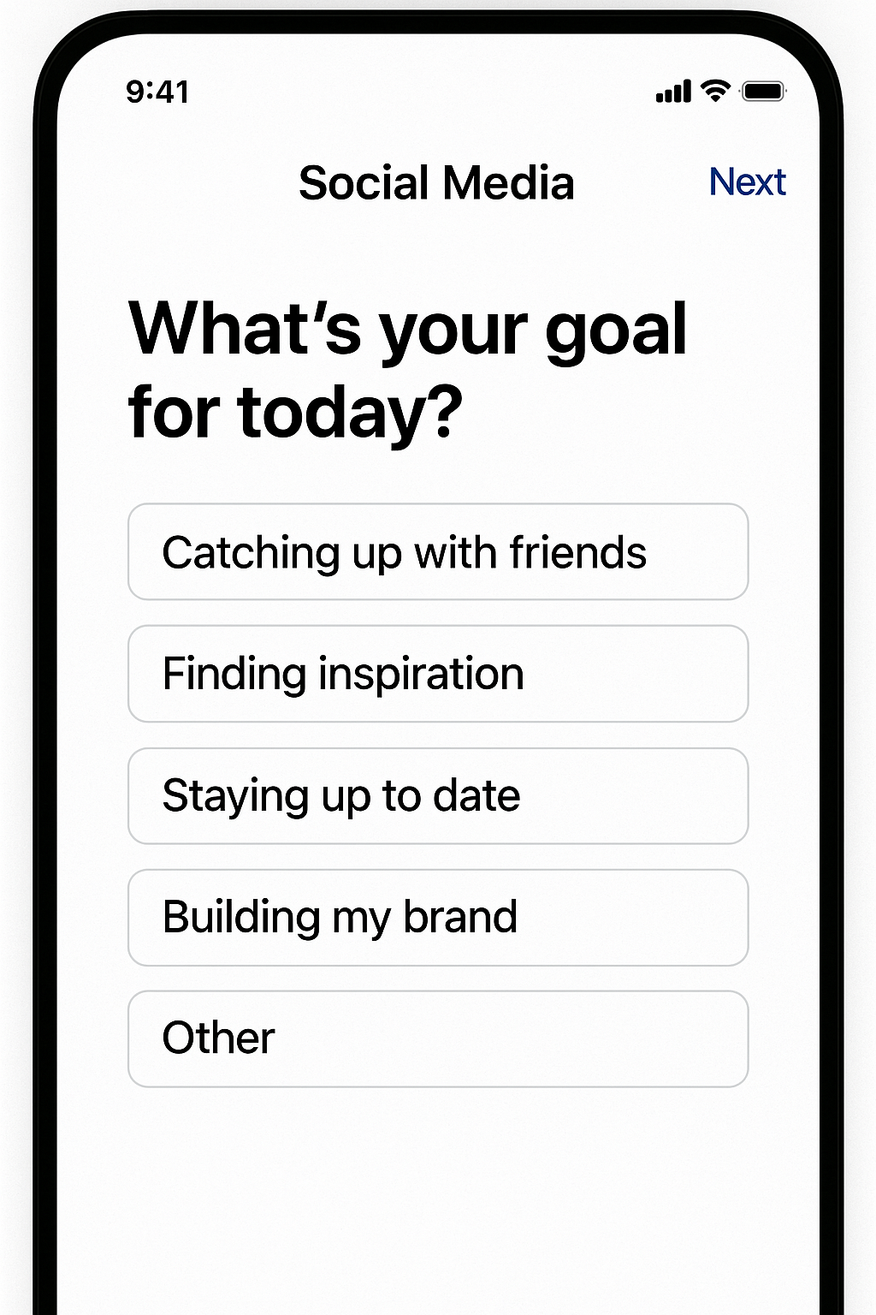
What Can Be Done?
Building Resilience
3. Social Media Companies
Promote conscious social media use
Display advanced personal statistics
Exploit Artificial Intelligence (AI) to
Identify vulnerable users
Offer personalised self-control strategies

Slide 25
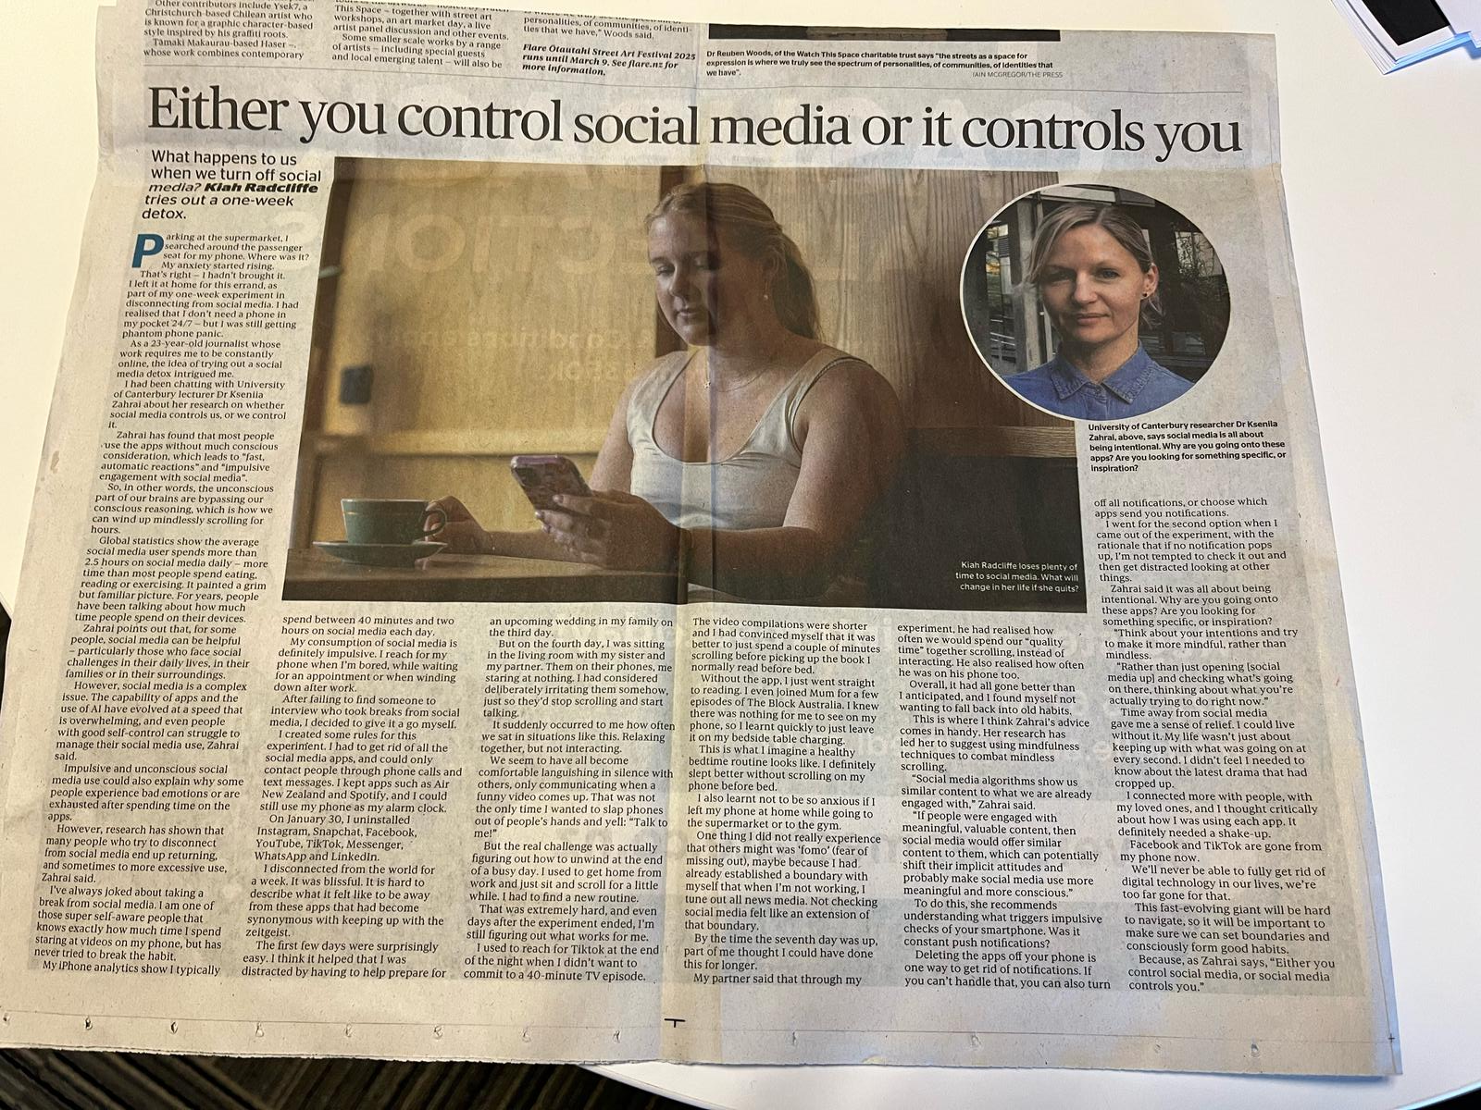
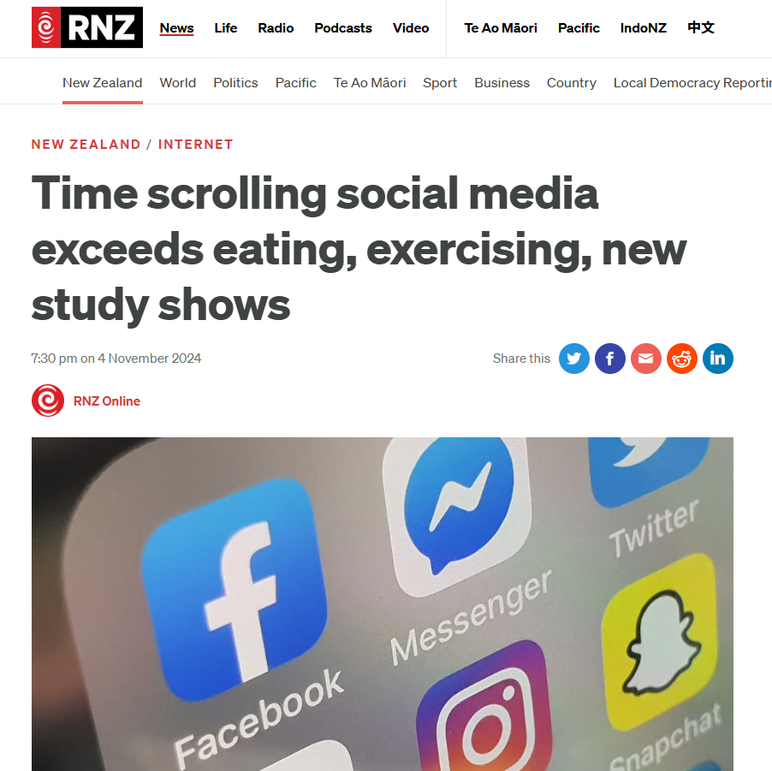

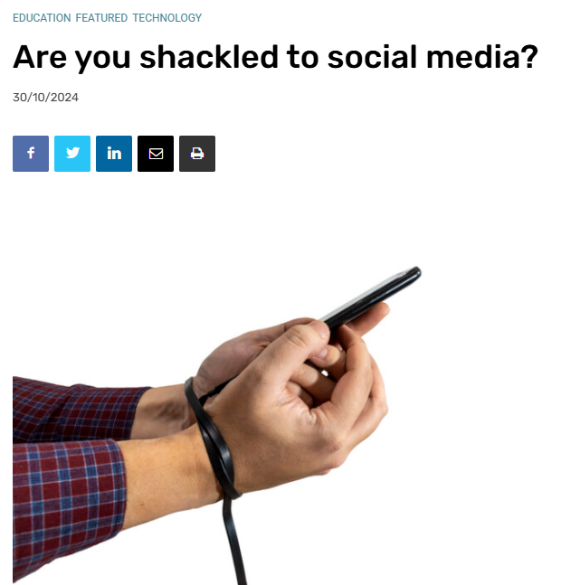
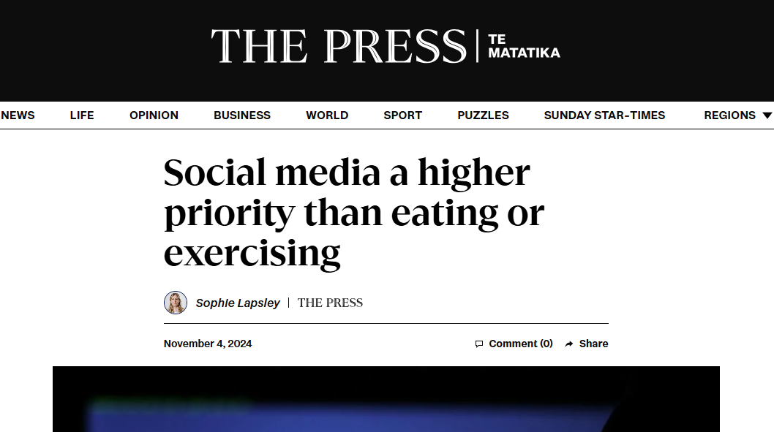
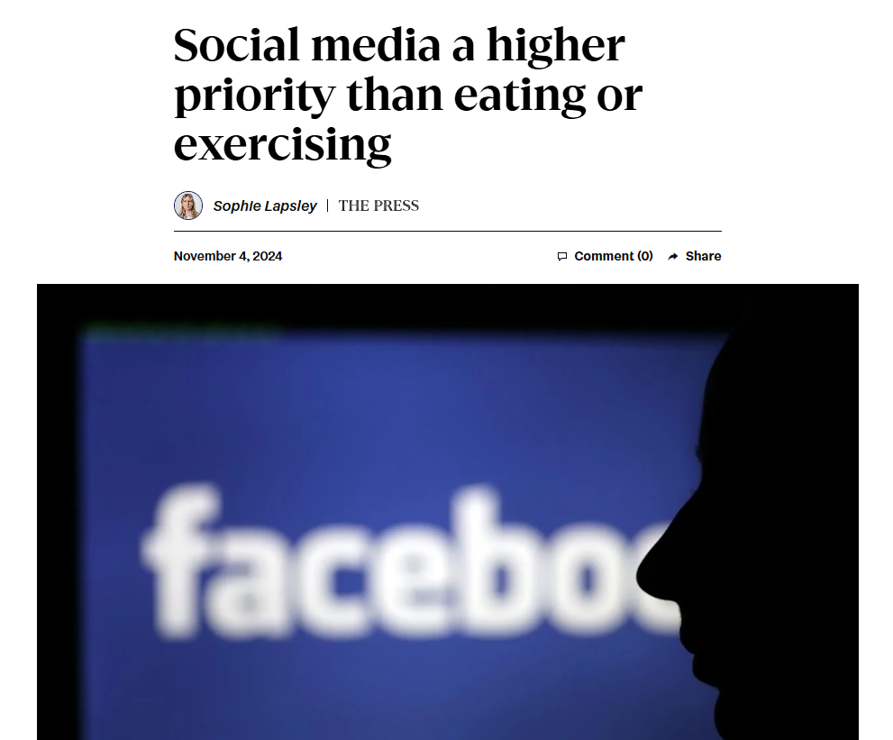

Community Response
The journalist’s experiment on social media ‘detox’: greater self-awareness can inspire positive, lasting changes.

Slide 26

Community Response
‘A Phone of the Artist as a Young Man’
by Pierce Day
A story about what it means to be human in the digital age — reminding us that behind every screen, there’s a real person searching for meaning and connection.

Slide 27

Either You Control Social Media, or Social Media Controls You

Slide 29


Social Media Restrictions
Lasting change requires more than bans, but building healthy digital habits
Social media can bring real benefits when used thoughtfully. The challenge is to find balance.
Education, open conversation and ethical design are key.

