Slide 1

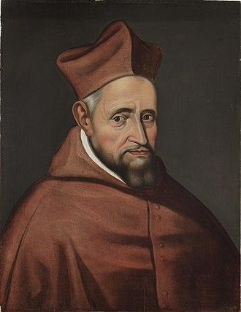
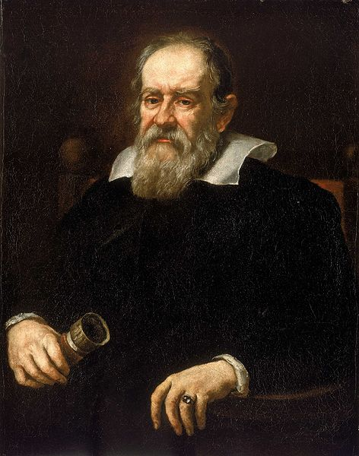
The Galileo Affair
Cardinal Robert Bellarmine
(1542–1621)
Galileo Galilei
(1564–1642)
Notes:
1

Slide 2
A Modern Myth
= that educated medieval people believed the earth was flat
‘In fourteen hundred and ninety-two,
Columbus sailed the ocean blue.
He took three ships with him, too,
And called aboard his faithful crew.
Mighty, strong and brave was he
As he sailed across the open sea.
Some people still thought the world was flat!
Can you even imagine that?’
(One version of the traditional children’s poem.)
Notes:
2

Slide 3
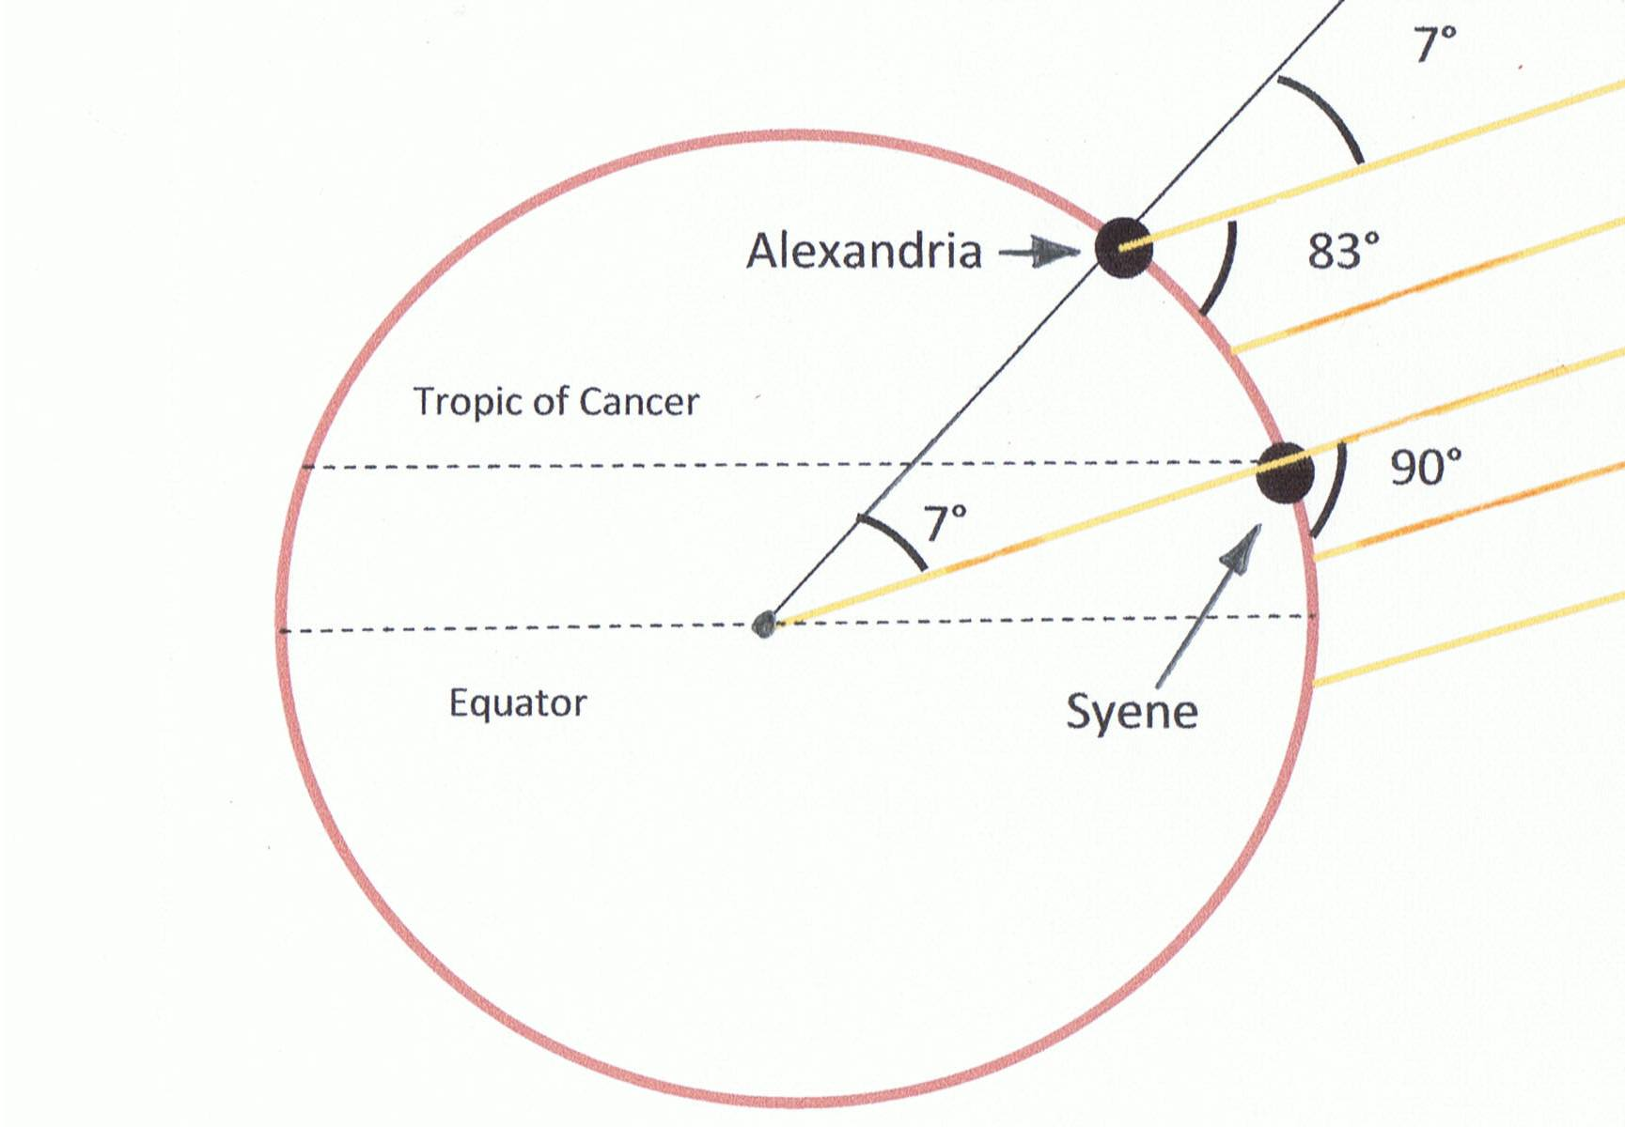
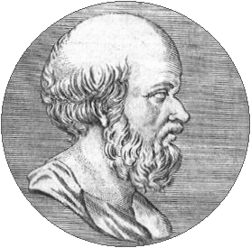
Ancient Greek Beliefs
An experiment to measure the earth’s circumference was undertaken by Eratosthenes (c. 276–c. 194 BC):
the result was either 39,690 or 46,620 km; today’s figure is 40,008 km.
Notes:
3

Slide 4
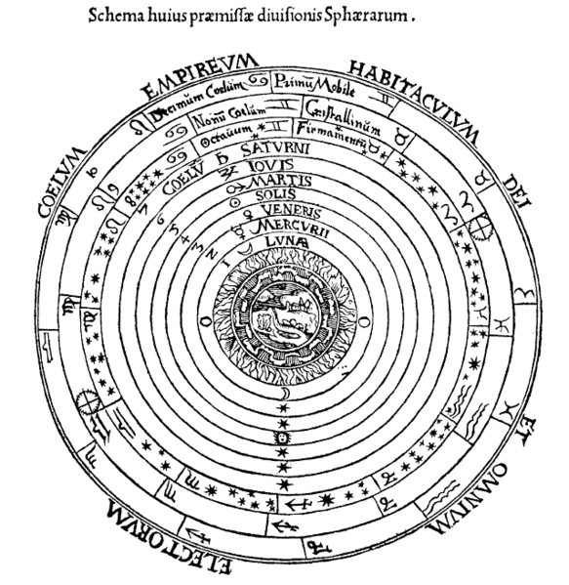
The Ptolemaic Cosmos
Popular Representations
Peter Apian, Cosmographia, Antwerp, 1524
Notes:
4

Slide 5
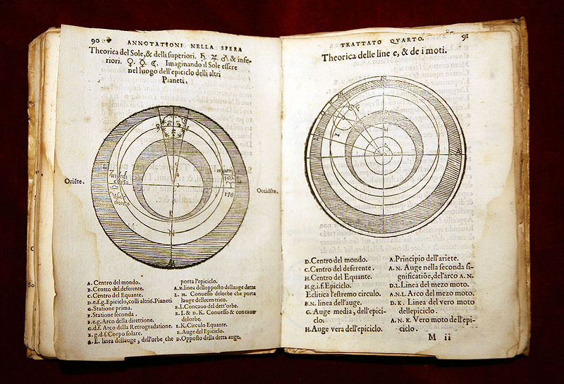
Sacrobosco’s De sphaera (ca. 1230) – A
An annotated edition of the Tractatus de Sphaera (On the Sphere)
by Ioannis de Sacro Bosco (ca. 1195–1256).
Notes:
5

Slide 6
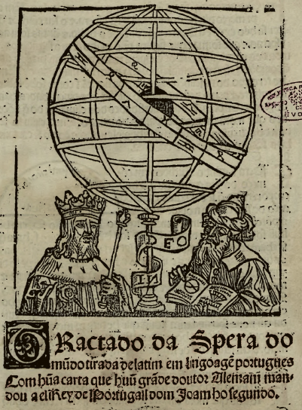
Sacrobosco’s De sphaera (ca. 1230) – B
The frontispiece of a Portuguese translation of Sacrobosco’s Tractatus de Sphaera
in a book for navigators,
published in Lisbon in 1509.
Notes:
6

Slide 7
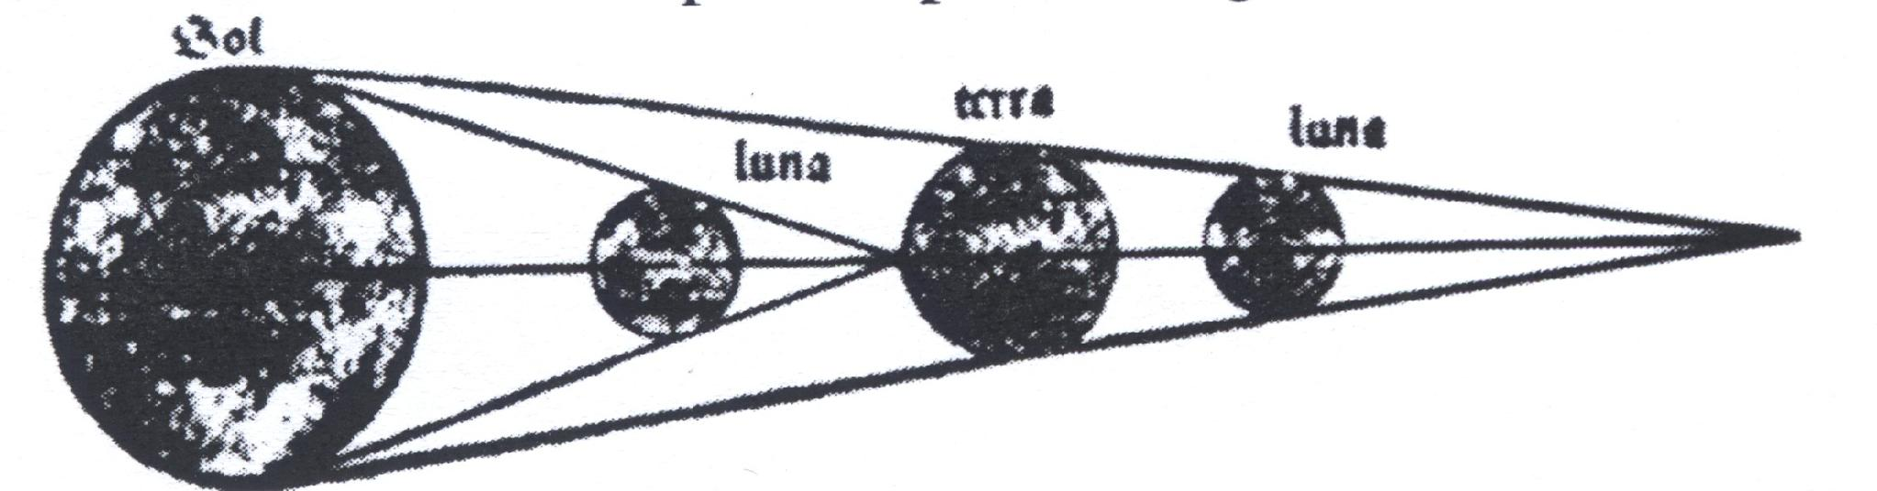
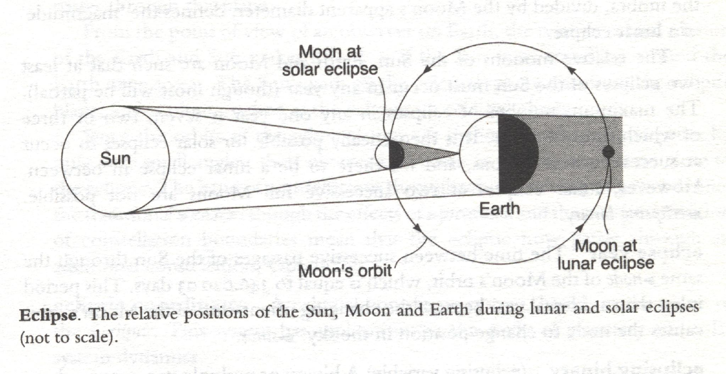
Ptolemaic Astronomy: e.g. Eclipses
Sacrobosco’s De Sphaera (1478 edition)
The Penguin Dictionary of Astronomy (1997)

Slide 8
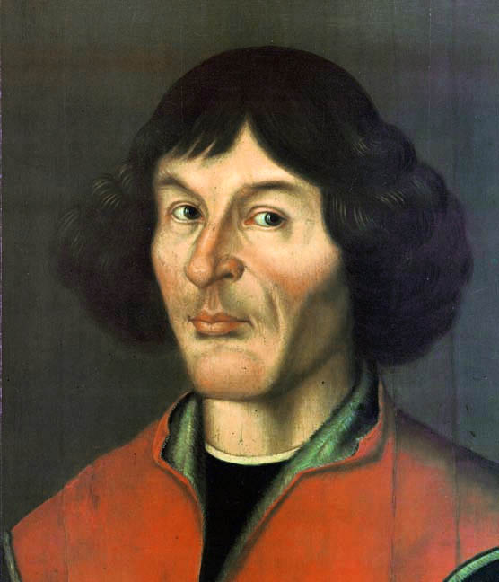
1543: A Revolution in Astronomy
Nicolaus Copernicus (1473–1543)
De revolutionibus orbium coelestium
(On the Revolutions of the Heavenly Spheres)
Notes:
8

Slide 9
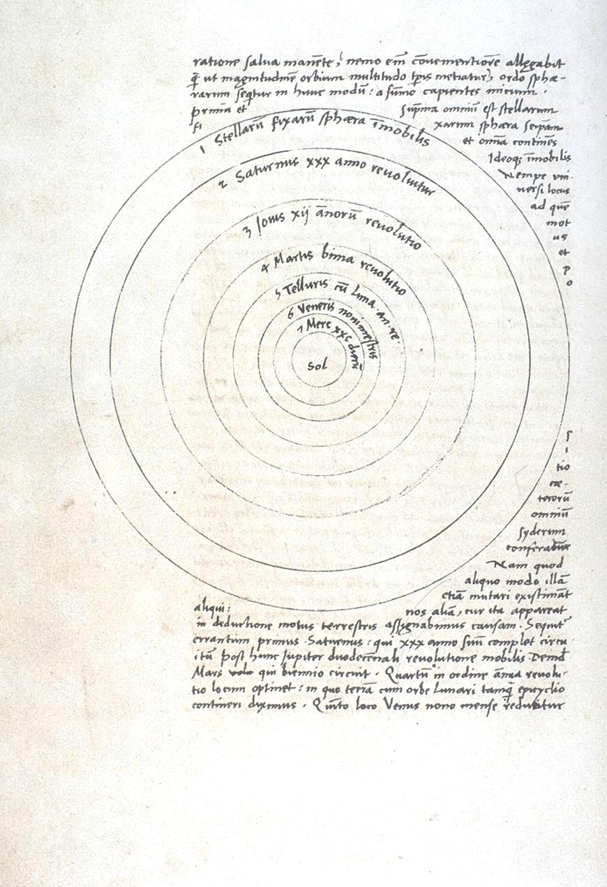
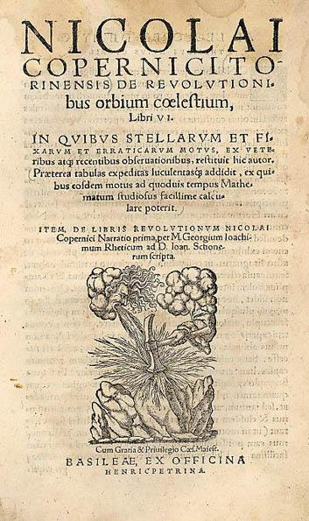
Notes:
9

Slide 10
Galileo Galilei – A
1564: Born in Pisa (Toscana / Tuscany), in Northern (N. Central) Italy.
1581–85: Studies Medicine (University of Pisa) & Mathematics (privately).
1589: Teaches Mathematics at University of Pisa.
Galileo Galilei
(1564–1642)
1592: Professor of Mathematics at University of Padua (Padova), N. Italy.
1609: Builds a telescope & begins astronomical observations.
1610: Philosopher & Chief Mathematician in Florence (Fiorenze), at the court of Cosimo de’ Medici, the Grand Duke of Tuscany.
Notes:
10

Slide 11
Galileo Galilei – B
1616: The consultors to the Inquisition condemn the Copernican view.
1616: Galileo is warned by Cardinal Bellarmine not to advocate it.
Galileo Galilei
(1564–1642)
1623: Maffeo Barberini from Florence, an admirer of Galileo, is elected Pope; in 1624 Galileo meets with the new Pope.
1632–33: Galileo, summoned to Rome, is formally examined ‘under threat of torture’, and renounces Copernicanism.
1633–42: Galileo lives under house arrest at his home in Arcetri near Florence.
Notes:
11

Slide 12
The Church’s Condemnation of Copernicanism
In 1616, the Consultants of the Roman Inquisition condemned these two propositions:
(1) ‘the sun is the centre of the world, and is completely devoid of local motion’, which is ‘foolish and absurd in philosophy’ and ‘formally heretical since it explicitly contradicts in many places the sense of Holy Scripture, according to the literal meaning of the words and according to the common interpretation and understanding of the Holy Fathers and doctors of theology’ and
(2) ‘the earth is not the centre of the world, nor motionless, but it moves as a whole and with diurnal motion’, which is ‘absurd in philosophy’ and ‘at least erroneous in faith’.

Slide 13
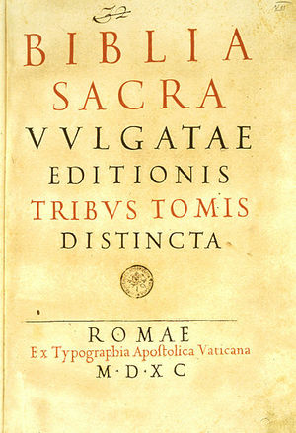
A Dispute about Biblical Authority
Qu: What were the theological issues at stake in the debate between Galileo and his ecclesiastical opponents?
Ans: Two issues
1. the scope of biblical authority
2. how to deal with apparent conflicts.

Slide 14
Issue 1: The Scope of Biblical Authority – A
Galileo suggests that the authority of Scripture is limited to matters directly related to salvation.
‘The authority of Holy Scripture aims chiefly [principalmente] at persuading men about those articles and propositions which, surpassing all human reason, could not be discovered by scientific research.’
Galileo Galilei
(1564–1642)
‘The authority of the Holy Writ has merely [solamente] the aim of persuading men of those articles and propositions which are necessary for their salvation and surpass all human reason, and so could not become credible through some other science.’

Slide 15
Issue 1: The Scope of Biblical Authority – B
Cardinal Bellarmine holds quite a different view:
‘In Scripture there are many things which of themselves do not pertain to the faith, that is, which were not written because it is necessary [for salvation] to believe them.
But it is necessary to believe them because they were written.’
Cardinal Bellarmine
(1542–1621)

Slide 16
Issue 2: What to do with apparent conflict – A
Galileo and Bellarmine agree on two principles.
1. The Priority of Demonstration: ‘When there is conflict between a proven truth about nature and a particular reading of Scripture, an alternative reading of Scripture must be sought.’
Cardinal Bellarmine
(1542–1621)
Galileo Galilei
(1564–1642)
2. The Priority of Scripture: ‘Where there is an apparent conflict between a Scripture passage and an assertion about the natural world grounded on sense or reason, the literal reading of the Scripture passage should prevail as long as the latter assertion lacks demonstration.’

Slide 17
Issue 2: What to do with apparent conflict – B
Scientific theory lacking proof | Literal sense of scripture to be followed
Proven scientific theory | Scripture to be reinterpreted (figurative sense)
Cardinal Bellarmine
(1542–1621)
Galileo Galilei
(1564–1642)

Slide 18
Issue 2: What to do with apparent conflict – C
The Problem: Galileo has no proof of the Copernican theory,
because there exists another theory that is
both
(a) consistent with the new (telescopic) evidence,
and
(b) consistent with a literal interpretation of Scripture.
Galileo Galilei
(1564–1642)

Slide 19
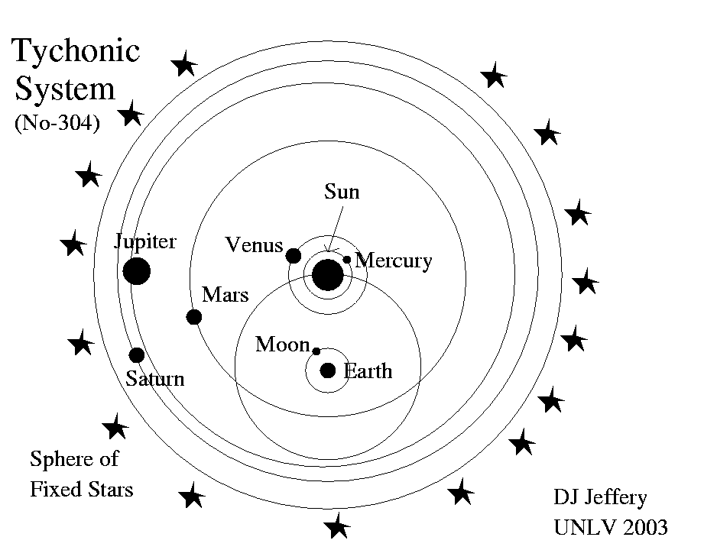
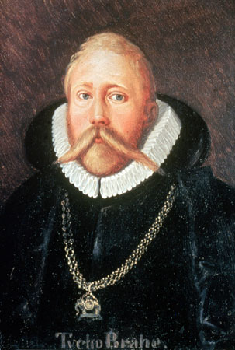
Issue 2: What to do with apparent conflict – D
Tycho Brahe
(1546–1601)

Slide 20
Issue 2: What to do with apparent conflict – D
So Galileo appeals to a further principle, a Principle of Prudence:
‘I should think it would be very prudent not to allow anyone to commit and in a way oblige scriptural passages to have to maintain the truth of any physical conclusions
whose contrary could ever be proven to us by the senses and demonstrative and necessary reasons.’
Galileo Galilei
(1564–1642)

Slide 21
Issue 2: What to do with apparent conflict – E
Scientific theory lacking proof | Literal sense of scripture to be followed
Proven scientific theory | Scripture to be reinterpreted (figurative sense)
Scientific theory that may one day be proven
Galileo Galilei
(1564–1642)

Slide 22
Qu: Is this a Conflict between Science and Religion?
Ans: On the one hand, it seems not: it looks like an argument among believers about how to interpret what they all agree is a divinely revealed text.
Cardinal Bellarmine
(1542–1621)
Galileo Galilei
(1564–1642)
On the other hand, it seems it is, because the authority of a divinely revealed text and its associated tradition
is being used to reject a theory that promises to be the best explanation of the phenomena.

Slide 23
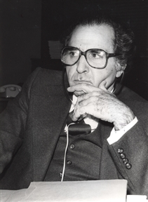
Religion and Science as Social Practices
A Social Practice is
‘a relatively coherent set of human actions, characterized by
[a] a commonly understood object, or good – i.e. a telos [goal]; ...
Marx Wartofsky (1928-1997)
[b] a ... commonly accepted repertoire of means, whether instruments or skills, ... understood as means to the end or the good of that practice – i.e. a techne; ...
[c] commonly understood norms.’
Notes:
23
23
23

Slide 24
(Transcendentalist) Religion | (Modern) Science
Goals = (a) the salvation of the individual (b) a society shaped by divine revelation | Goals = advancement of knowledge, by way of testable causal hypotheses.
Means = (a) correct living in accordance with authority (b) ritual practices | Means = (a) controlled experiment (b) collective criticism
Norm = Acceptance by faith of the authority of Scripture and (in the Roman Catholic case) the Church | Norm = Question authority e.g. Nullius in verba (‘Take no one’s word for it’)
Notes:
24
24
24

