Slide 1


Parkinson’s disease: where we’re at and challenges ahead
Dr Toni Pitcher
Senior Research Fellow
Dept. Medicine, University of Otago, Christchurch
New Zealand Brain Research Institute
25 May 2026

Slide 2
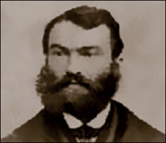
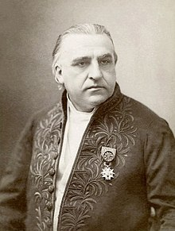
Parkinson’s – motor symptoms
Bradykinesia – slowed movements
Rigidity – stiffness
Tremor (resting)
Postural instability
Gait (walking)
Notes:
Over 200 years since the symptoms of what is now known as Parkinson’s disease were first described by Dr James Parkinson, a London-based surgeon.
He described the symptoms which he had observed across 6 people, some of which were patients of his and some were people he had observed in the street. He named this condition the ‘shaking palsy’.
Use of the term Parkinson’s disease was suggested by the renowned French Neurologist Jean-Martin Charcot in the late 1870s. He not only publicised Parkinson’s observations, but also added his own observations, which included bradykinesia (slow movements) and rigidity (stiff muscles) were key components of the disease. James Parkinson had noted that patients were involuntarily weakened, but had not recognised that this was in fact due to bradykinesia and rigidity. Charcot noted that although tremor was typical of the disease it was not essential for diagnosis
A diagnosis of Parkinson’s is made clinically, based on physical examination and medical history. Presence of the 3 core symtpoms of the disease, bradykinesia, rigidity and tremor are primarily considered, but postural instability and gail imapirments will also be assessed, as these are common symptoms.

Slide 3
Parkinson’s – non-motor symptoms
Sleep Disorders
  Fragmented sleep and insomnia
  REM behavioural disorder
  Daytime sleepiness
Autonomic Dysfunction
  Orthostatic hypotension
  Urogenital dysfunction
  Constipation
Sensory symptoms and pain
  Loss of sense of smell
  Abnormal sensations
  Pain
Neuropsychiatric
  Depression
  Anxiety
  Apathy and anhedonia
  Cognitive impairment and dementia
  Hallucinations and psychosis
  Impulse control
Notes:
History of a range of non-motor symptoms will also assessed as these are now considered part of the disease complex.
Despite some non-motor symptoms being recognised by James Parkinson’s – he described the need for the manual evacuation of the bowel in some individuals – our delay in realisation that others are related to or caused by the disease processes is that they are non-specific to Parkinson’s and commonly occur as part of normal life and ageing process.
The non-motor symptoms affecct a number of different body systems and can have significant impacts on quality of life, sometimes more so than the motor impairments. Some of these symptoms may present very early in the disease and even pre-date the presentation of the motor symptoms by 10 years or more.
The most common non-motor symptoms presenting early are, RBD, constipation, loss of smell, and depression.

Slide 4
Challenge #1
Why does an individual get Parkinson’s?

Slide 5
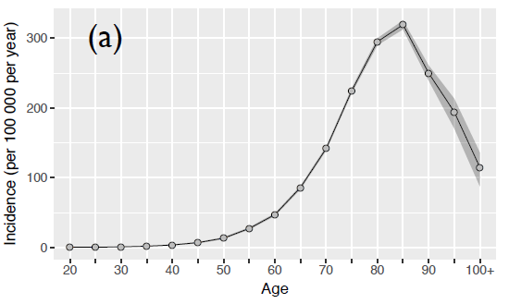
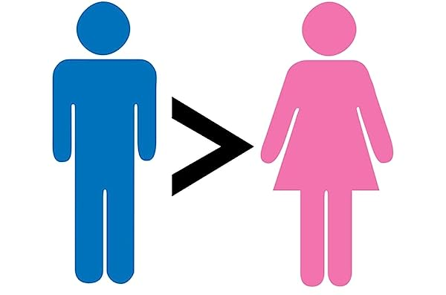
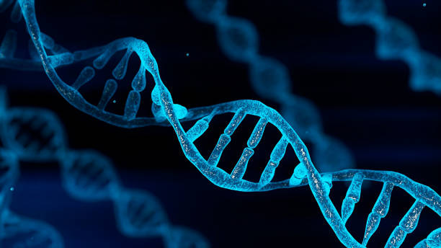

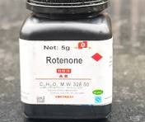
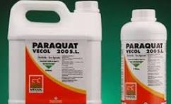


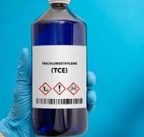
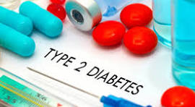
Parkinson’s – risk factors
Notes:
The majority of Parkinson’s cases are of an unknown cause, however there are a number of factors that have been identified as contributing to an increased risk of developing the disease.
Firstly, the most robust risk factor is age, where increasing age, up to a point, increases the chances of a diagnosis.
We also know that males are twice as likely to receive a diagnosis than females, although the exact mechanism of this is unknown. Not all countries report this sex difference
Genetics also play a role, there are genetic forms of Parkinson’s that arise from known mutations in specific genes, these however only account for around 10% of cases.
Outside of these genetic forms there are also a growing number of risk genes that have been identified as increasing a persons chance of getting Parkinson’s. These genes are small changes in the genetic code that occur at greater rates in Parkinson’s compared to the general population.
These risk genes alone are not able to cause Parkinson’s, but having one or more of these in combination with exposure to other risk factors will increase the chance of getting Parkinson’s.

Slide 6


Parkinson’s – risk mediation
Studies have indicated that Parkinson’s risk can be mediated by medications
  Salbutamol – asthma
  Glitazone – diabetes
  Calcium channel blockers – hypertension
  Ambroxol – cough syrup
Notes:
There are a few factors that have been identified that protect against Parkinson’s. However they are not necessarily things that people are generally encouraged to do…..
Cigarette smoking remains the most robust finding for factors that associated with reduced risk of Parkinson’s. The protective effect is greatest for current smokers, but ex-smokers do retain some benefit for a number of years after giving up. The mechanism for this protection is likely through increased dopamine levels due to chronic smoking.
The other factor that provides some protection against Parkinson’s is daily caffeine consumption. The mechanism of action is likely via caffeine's action on the adenosine receptors within the brain and specifically on the dopamine neurons. These effects are through reduction of inflammation, excitotoxicity, mitochondrial function.
A number of medications, already in use, have been shown, through epidemiological studies, to be associated with a reduced risk of developing Parkinson’s, these medications are used in the treatment of asthma and diabetes.
We have known for a number of years that the use of calcium channel blockers, which treat high blood pressure, also provide some protection against Parkinson’s. One type of CCB has been tested in a clinical trial, unfortunately the result was negative, however, given the trial was enrolling people at time of diagnosis, it may have missed to window of opportunity for the benefits to be observed. It is possible that people identified in the prodromal phase of the disorder are the ones that are most likely benefit from these types of medications.
Ambroxol is currently in a phase III trial in the UK. Ambroxol is interesting in that it increases the activity of the enzyme that is coded by the GBA gene. It should benefit everyone, not just people with mutations/variations in this gene.

Slide 7
Risk factors - What challenges remain
Very good at identifying the risk and ‘protective’ factors in isolation – not very good at combining them
  Difficult to collect all relevant information from individuals
  Difficult to get enough numbers to do meaningful analyses
  Fancy statistics needed to ensure robust analyses
Movement Disorders Society – Parkinson’s Exposome Taskforce

Slide 8
Challenge #2
Can we identify who is going to get Parkinson’s?

Slide 9
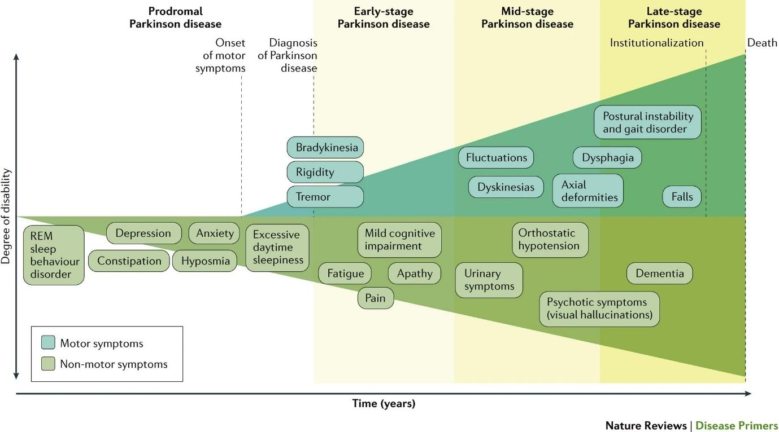
Parkinson’s - timeline
Notes:
Poewe et al. 2017. Nature Rev Dis Primer

Slide 10
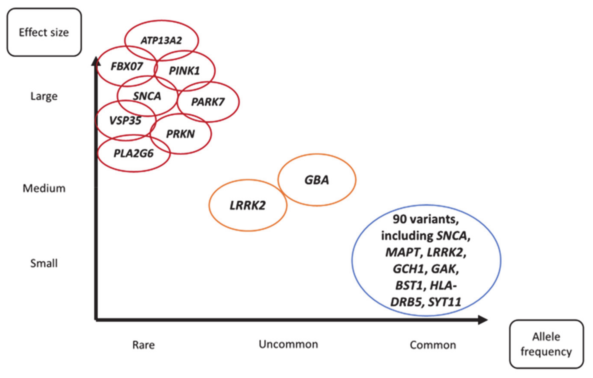
Notes:
Day & Mullin 2021. Genes

Slide 11
Early detection - What challenges remain
Some of the strongest predictors of future Parkinson’s are not specific to Parkinson’s
  Loss of sense of smell – can also be related to Alzheimer’s
  REM sleep behaviour disorder – strongly related to α-synuclein pathology
      Parkinson’s
      Dementia with Lewy Bodies
      Multiple System Atrophy

Slide 12
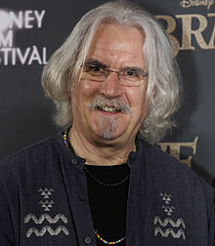
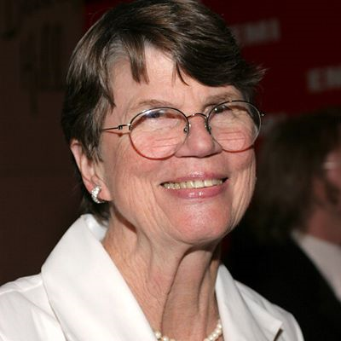
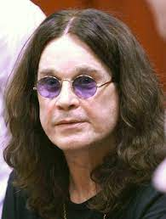

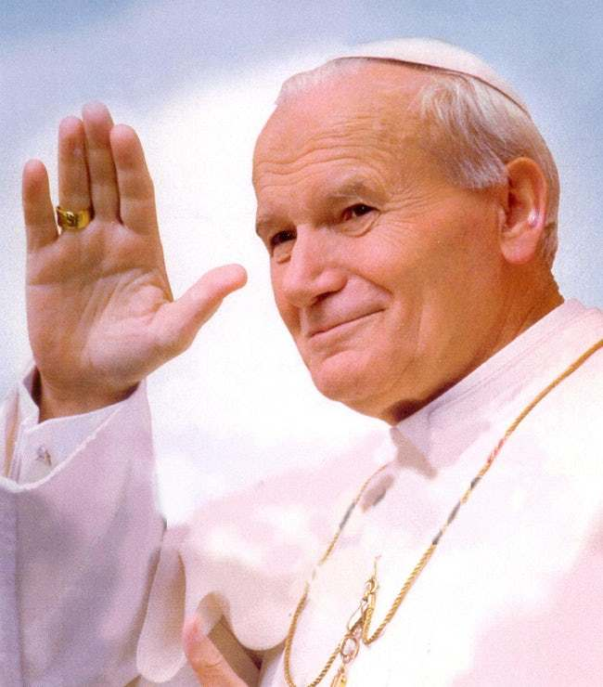
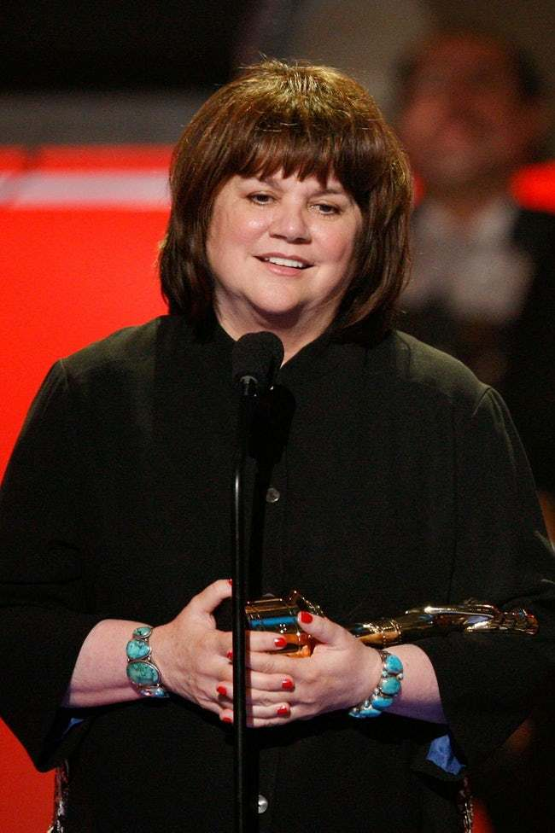


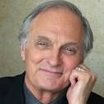
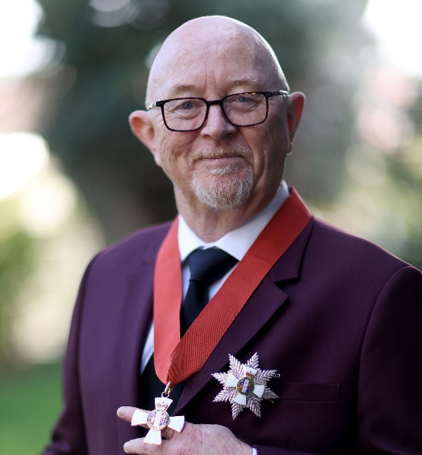

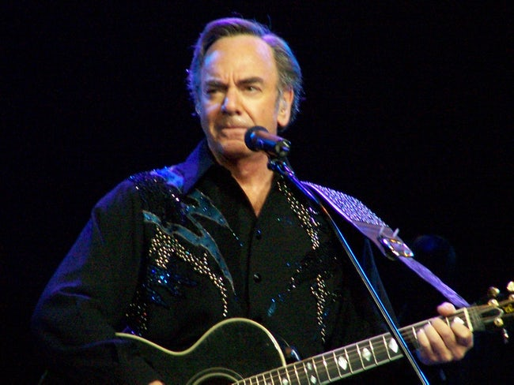
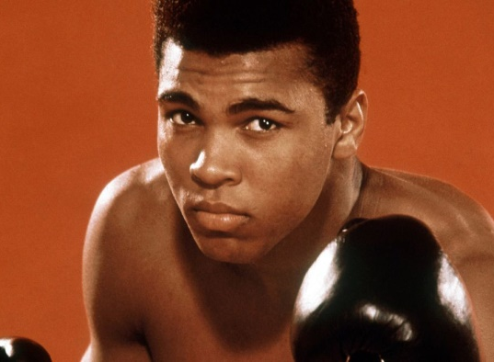
Billy Connolly
Janet Reno
Ozzy Osbourne
Pope John Paul II
Michael J Fox
Linda Ronstadt
John Walker
Allan Border
Alan Alda
Dave Dobbin
Toa Fraser
Muhammed Ali
Neil Diamond
Notes:
This slide shows some famous faces who have been afflicted by Parkinson’s.

Slide 13
Challenge #3
No diagnostic test available, there is a need for a ‘biomarker’

Slide 14

Parkinson’s smell
“Parkinson’s smell”
Joy Milne
Dogs have been trained to identify the “Parkinson’s smell”
Scientists established the molecular signature of the scent - ~4 compounds have been identified
Notes:
This line of research stems of observations made by Joy Milne from Scotland, her husband was diagnosed with Parkinson’s at age 45, she had notice a change in his ‘smell’ some 12 years prior to his diagnosis. When they started attending Parkinson’s UK events she realised that other people with Parkinson’s had a similar ‘woody musty smell’ as her husband.
It was some years later and not until after the death of her husband, that she asked, at a public lecture, ‘why do people with Parkinson’s smell different?’
The presenter of the lecture had no answer, as he did not realise there was a distinct smell associated with the disease. A few months later the scientists, got together with Joy and tested her ability to smell the disease by presenting her with 12 t-shirts, 6 having been worn by people with Parkinson’s and 6 worn by people without. She correctly identified all the Parkinson’s t-shirts and even labelled one of the control shirts as having Parkinson’s – remarkably this person was diagnosed with the disease 8 months later.
They have also trained sniffer dogs to identify the Parkinson’s smell and scientists. This year they have published findings on the molecular signature of the scent. The hope is that they will be able to develop a test to identify this scent on people, not only at the time of diagnosis but also prior to motor symptom onset.

Slide 15
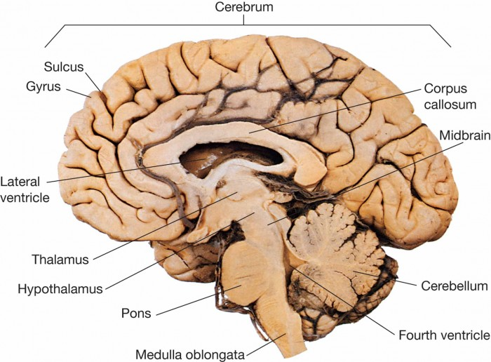
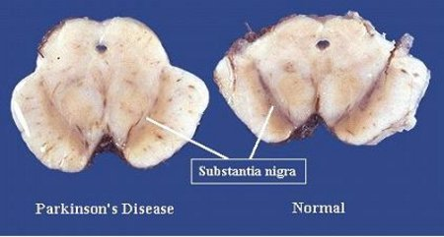
Parkinson’s – pathology
  Death of dopamine producing neurons in substantia nigra
Notes:
This figure shows the midline view of the brain after the two hemispheres have been separated. This section is the brainstem which connects the brain above to the spinal cord below. At the top of the brain stem is the midbrain and its here that the dopamine neurons are found.
If you cut through a healthy midbrain you would see two dark bands which show the location of the substantia nigra, which means ‘black substance’. If you did the same to a midbrain from someone who had Parkinson’s there would be a distinct absence of the dark bands, indicating the loss of the dopamine neurons. It is worth noting that by the time a diagnosis is made, over 50% of the dopamine neurons have already died.
Black due to the presence of neuromelanin

Slide 16
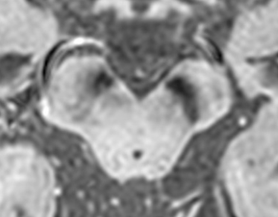
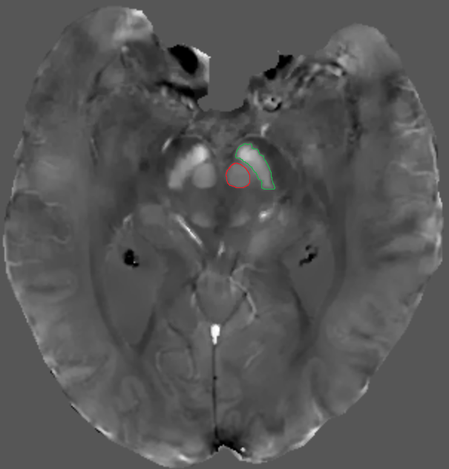
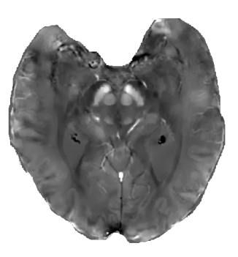
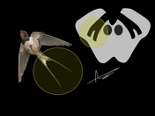
Substantia nigra MR imaging
Swallow tail sign
Radiopaedia.org
Notes:
Visualising the substantia nigra in a living person is difficult because of its location deep in the brain.
There have been many attempts to use MR imaging to identify the substantia nigra and illustrate the loss of the dopamine neurons.
This image shows the so called swallow tail sign – whereby a normal SN looks a litttle like a swallow’s tail – as shown on the left of the image, whereas the SN on the right is a much more uniform in width across its length.
It hasn’t really taken off. But in the future if there is development of more refined sequences for capturing images that show the SN more clearly this could be used to help with diagnosis.
These images have been provided by my colleague Tracy Melzer. This is another type of MR imaging – QSM or quantitative susceptibility mapping. This type if imagin aims to identify the deposition of iron in the brain. On the left is a non-Parkinson’s brain with the SN outlined in green and the round struture – the red nucleus outlined in red are showing as being much brighter than the other parts of the brain – that is because they have higher levels of iron than surrounding tissue. The image on the right is from someone with Parkinson’s and you can see the both the SN and red nucleus are showing as being brighter than those in the left image.

Slide 17
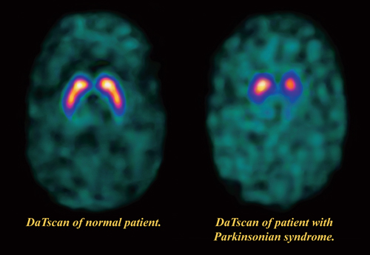
Dopaminergic nuclear imaging
DaTscan will help to differentiate between Parkinsonism and;
  Essential tremor
  Drug-induced Parkinsonism
Notes:
There is one type of nuclear brain imaging, which is used – to varying degrees across countries to support a diagnosis.
It is called a DaTscan, whereby a radioactively labelled tracer is injected into the blood stream and binds to the dopamine reuptake transporter (or DAT) which is located at the ends of the axons of the dopamine neurons from the SN.
The ‘normal’ DaTscan shows the full shape of the putamen which receives a large amount of dopamine from the SN. The DaTscan from a parkinsonian disorder is missing the tail of the putamen, These scans are especially good at differentiating between Parkinsonism, which might be tremor dominant, and essential tremor, and drug-induced Parkinson’s, particularly in those with a history of antipsychotic medication use.
These scans are expensive, and not widely available in NZ.
https://www.cedars-sinai.edu/Patients/Programs-and-Services/Imaging-Center/For-Patients/Exams-by-Procedure/Nuclear-Medicine/DatScan/DaTscan-Procedure-Information.aspx

Slide 18
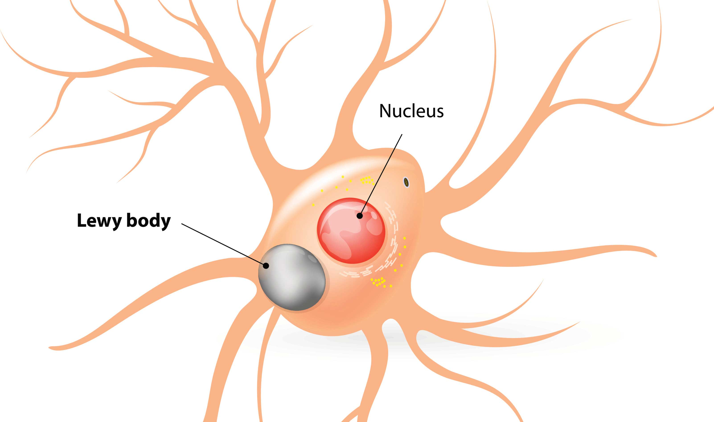
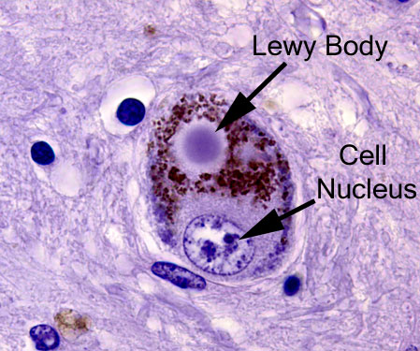
Parkinson’s – pathology
  Lewy bodies within neurons – α-synuclein protein

Slide 19
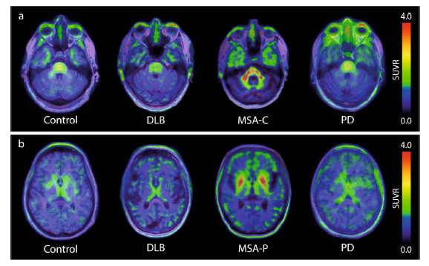
α-synuclein protein – PET imaging
Massive effort to develop a viable tracer – $10M from MJFF
Notes:
One of the biggest challenges in the development of a PET tracer has been that alpha-synuclein is at much lower concentrations that other protiens associated with other disorders such as the b-amyloid and tau proteins that are associated with alzheimer’s and both have PET tracers that are regularly used.
α-synuclein PET tracer [18F] ACI-12589. predominately Swedish group

Slide 20
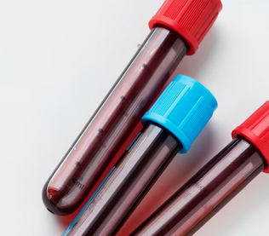
α-synuclein protein – blood
Blood tests are simple
α-synuclein concentration is low
Red blood cells have α-synuclein
Notes:
Why can’t we just do a blood test – these are familair to most of us and well tolerated by the majority of the population.
It’s been tried. The main problem is that 99% of the alpha-synuclein in blood is thought to come from red blood cells – this alone has led to an almost abandonment investigations into this as a diganostic test.
Us, along with others, have looked at an alternate way of using blood, and that is to utilise the EVs, which are in the blood.

Slide 21
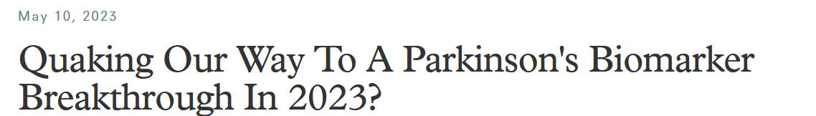
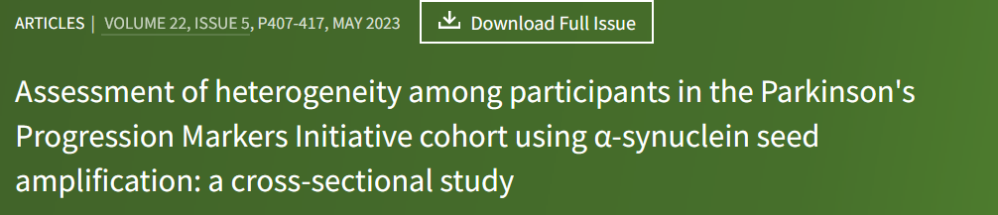
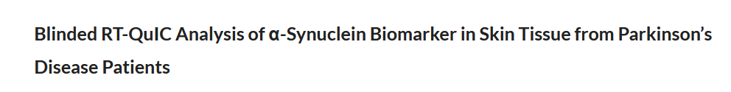
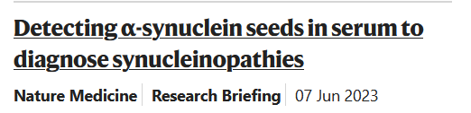
α-synuclein protein – new assay
Notes:
Real time Quaking-induced conversion
Key difference to earlier assays – not measuring protein quantity but measuring samples ability to induce mis-folding

Slide 22
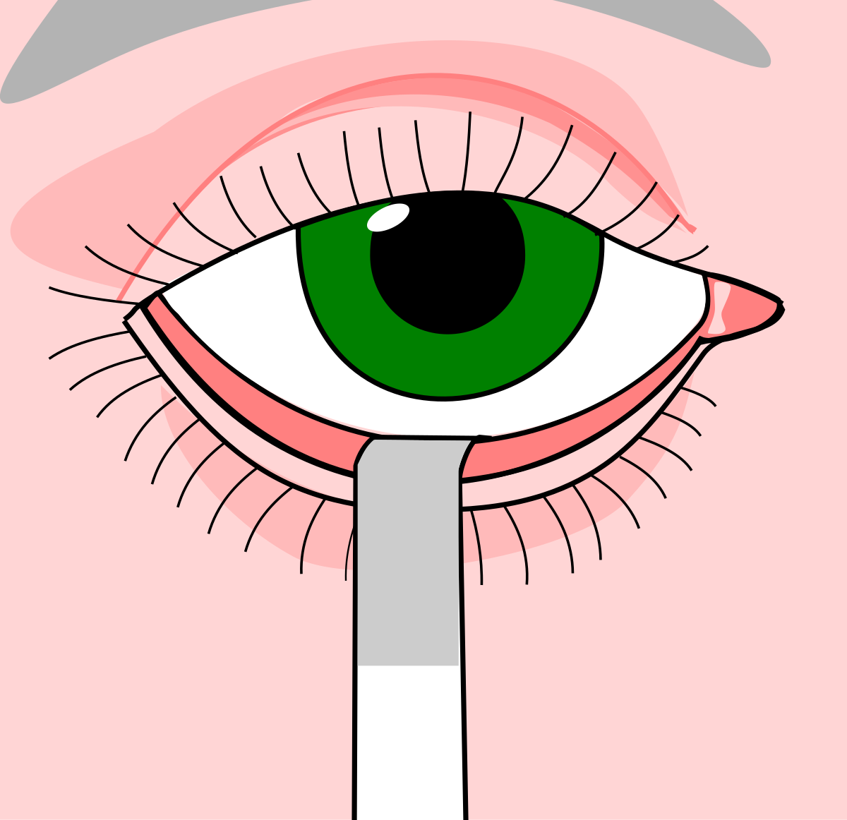
α-synuclein protein – tears
Alternate to blood – eliminates the red blood cell problem
Easier to collect, more suitable for regular collection

Slide 23
Biomarkers – challenges that remain
Massive global effort to find a ‘biomarker’ of Parkinson’s
  Diagnosis
  Change with progression – testing of new therapies
Somes challenges overcome
    α-synuclein ‘behaviour’ rather than concentration
Some challenges remain
    Parkinsonian disorders – not just Parkinson’s

Slide 24
