Slide 1
After the WHY
“Movement is Medicine” now the
What, When, Where and How
U3A TIMARU
Sharon Peck, physiotherapist
Notes:
Anecdote on my clumsiness; talk on back care to x200 5th and 6th form students, exs ball, kneeler chair, me falling over , silence except me snorting

Slide 2
JOY
IN
MOVEMENT

Slide 3
Exercise, “A subset of physical activity that is planned, structured and repetitive and has the objective of improvement or maintenance of physical fitness”
Exercise cures, improves or prevents EVERYTHING from halitosis and hair loss to warts and ingrowing toenails ??????
Exercising has become a separate entity to movement, as we have evolved more and more sedentary lives.

Slide 4
Movement, “ the change in the position of a body part with respect to the whole body”
MOVEMENT is what we do intuitively, naturally, functionally
Cave men moved to protect, feed and shelter themselves
Notes:
Movement of organs/viscera with limb movement & visa/versa in newly deceased rabbit Movement of the skeleton is essential for function of the viscera

Slide 5
We don’t sleep, eat, breathe, urinate for a single 30 minute session everyday, or for an hour 3 times a week.
So, why do we think that MOVEMENT is a particular function of the body that requires specific scheduling?
Exercise should be a pleasure, a hobby that we timetable into our lives but
MOVEMENT MUST be a HABIT,
performed regularly throughout the day

Slide 6
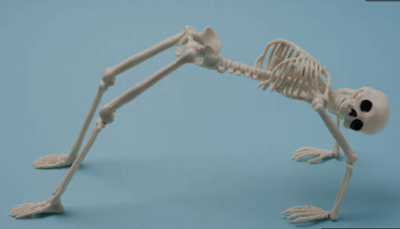
POSTURE AND MUSCLE SYNCHRONISATION
Deep stability muscles
Superficial muscles
Joint stability
Weakness of deep muscles leads to:
hyper- vigilance of superficial muscles
Strain of ligaments
Micro trauma to joints
Notes:
15 mins max in 1 position
Ligament creep after 20 mins sustained posture
If you want to learn more about the importance of posture, ask my husband as I give him this lecture daily!!

Slide 7
HEALTHY LONGEVITY to maintain whatever level of independence you desire
Not about living longer but living healthier and fitter
To be motivated to move or do exercise the activity needs to make you feel good
Movement releases beta endorphin which reduces pain and increases a sense of happiness

Slide 8
Contributors to healthy longevity
POSTURE
MOVEMENT AS A HABIT
DIET
FINDING JOY/ HAPPINESS IN SMALL THINGS
PERSONAL CONNECTIVITY-PETS/ANIMALS/HUMANS/wildlife/the land
PURPOSE
EXERCISE AS A HOBBY

Slide 9
UNATTAINABLE GOALS biggest risk of failure and defeat
ONE repetition of an exercise is better than NONE
"A journey of a thousand miles begins with a single step”
THINK BINARY
COMPUTERS ACHIEVE AMAZING THINGS WORKING ON JUST I AND II
Do 1 or 2 repetitions many times a day
Notes:
Recent research says that longer walks improve fitness more than several short walks. Longer = 15 mins or more. But if you don’t have that capacity do what you can-little and often and gradually increase the time.

Slide 10
Who in the audience today does these?
? 10,000 steps a day
? 30 minutes of exercise a day
? 30 reps of lifting 40kg
? Swimming 50 lengths
? Intensity- running fast for 5 minutes/Running up 3 flights of stairs
? Stamina- cycle 60km in a morning
INTEGRATE MOVEMENT AND EXERCISE INTO YOUR DAY
Notes:
Some research stopping, short rests and then restarting increases fitness more—time for blood to circulate overcoming inertia burns more energy
As we age, feel disheartened can not achieve same level exercise so reduce movement overall. Something is better than nothing
Tell about George at 94. Unable to stand unaided 3 months ago. Now walks without aid, can stand on 1 leg for 90 seconds and performs 30 squats daily. All achieved by incremental increases from 1 repetition several times a day.

Slide 11
MOTIVATION
Physical activity needs to FEEL better than inactivity
Performance of activity is influenced by environment, social situation, gender, the individual’s previous experiences and BMI
Motivation from CHOICE NOT PRESSURE results in better long term engagement and outcomes

Slide 12
Successful Physical Activity Engagement
Choice of actions
To feel successful
To feel connected and supported by others
Participation with like minded people with a common goal
The activity does not need to be community, group based. Self directed can be just as successful as long as you feel supported by family/work/friends and that you ENJOY it.

Slide 13
RECAP
Weak muscles & bones and poor posture -> increase risk of falls, hunched posture and respiratory illness
Vertebral and hip fractures increase risk of death
No. 1 cause of death in over 60 yo is falls
WHO: av lifespan in USA is 79, av living health is 64 = 15 years of poor health before death
24 hours of bedrest -> muscle mass loss. Takes 7 days to recover it.
Bone density and muscle mass decrease with age (especially over 65)
NEVER TOO LATE TO IMPROVE
Notes:
Research on men in late 80s. Exs prog x3 weekly led to improved function and 175% increase in muscle mass.

Slide 14
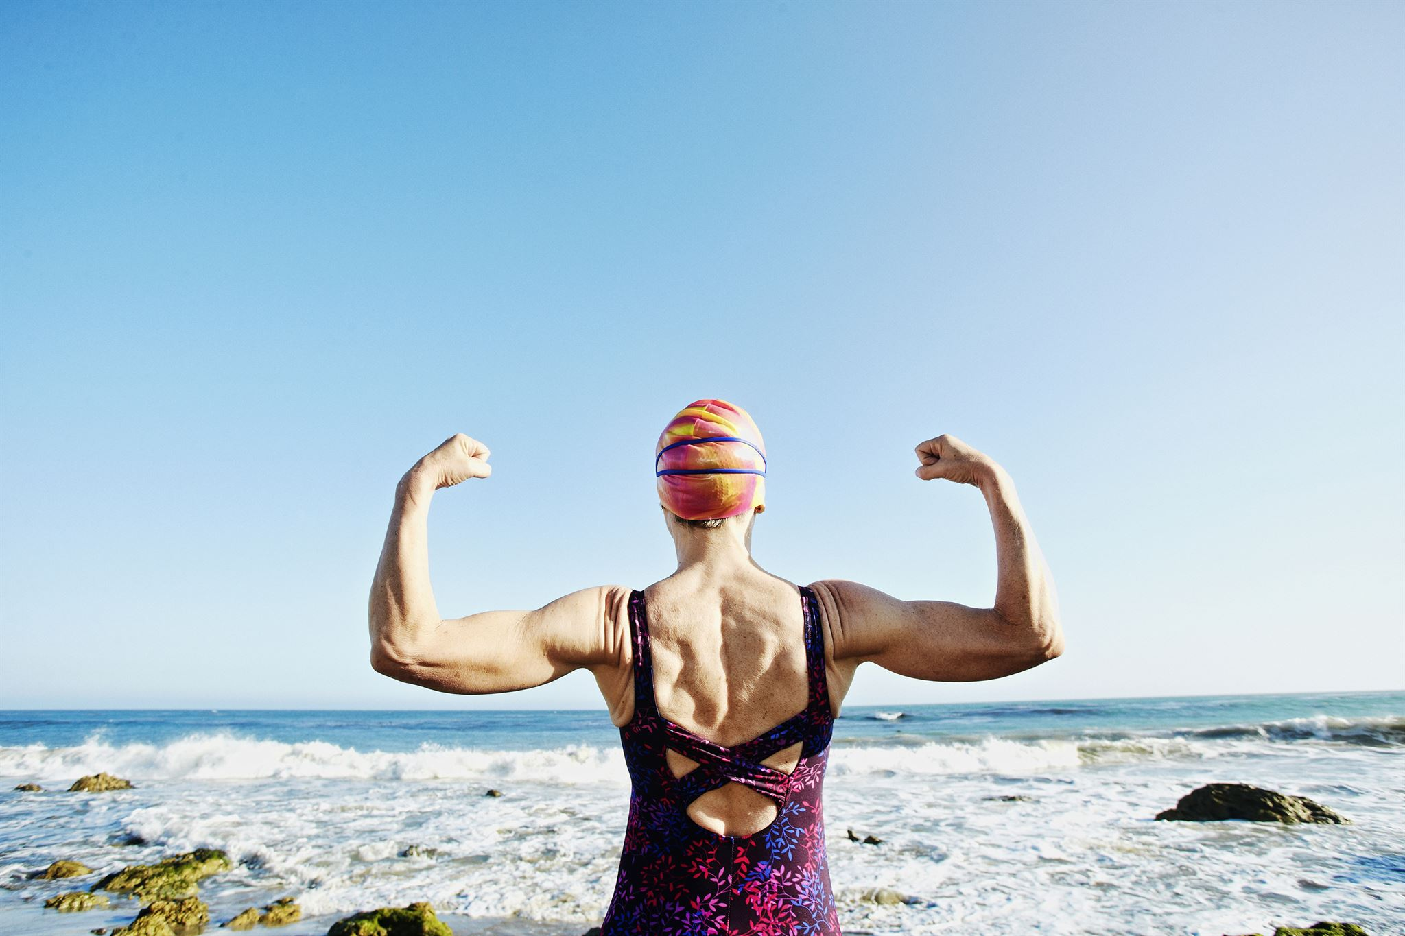
PHYSIOLOGY
30% blood flow reduction with muscle contraction followed by refill with relaxation
Movement of joints stimulates phagocytic cell action to “clean” the joint - important for arthritic joints
Bone density, Vit D, sunshine and weight bearing exercise

Slide 15
SIMPLE BIOMARKERS
FOR PHYSICAL FITNESS
Ability to stand on one leg (finger tip support to help balance)
Grip strength for over 65 yo:
Men > 28kg, Women > 15kg

Slide 16
DIET
Protein 45-60g per day women, 65-85g men. Eaten throughout the day
Green veges and fruit
Vit C (muscles), B12 (nerves) and Vit D (bones) (also from exposure to sunshine)
Source of Calcium
Notes:
This is not my scope but simple advice is a/a
Meds: Bisphosonate/Alendrenate for older men and post menopausal women

Slide 17
PREPARATION
Good POSTURE
Efficient BREATHING
Comfortable and supportive FOOTWEAR
PAIN management
PACING
HYDRATION
Notes:
Demo good posture, breathing, pacing, pain management
Our nervous system uses 40% of our O2—brain is very O2 hungry
Pain control- 1 rep, pain free, mirroring movements, using assistance and graduating with positive successful outcomes

Slide 18
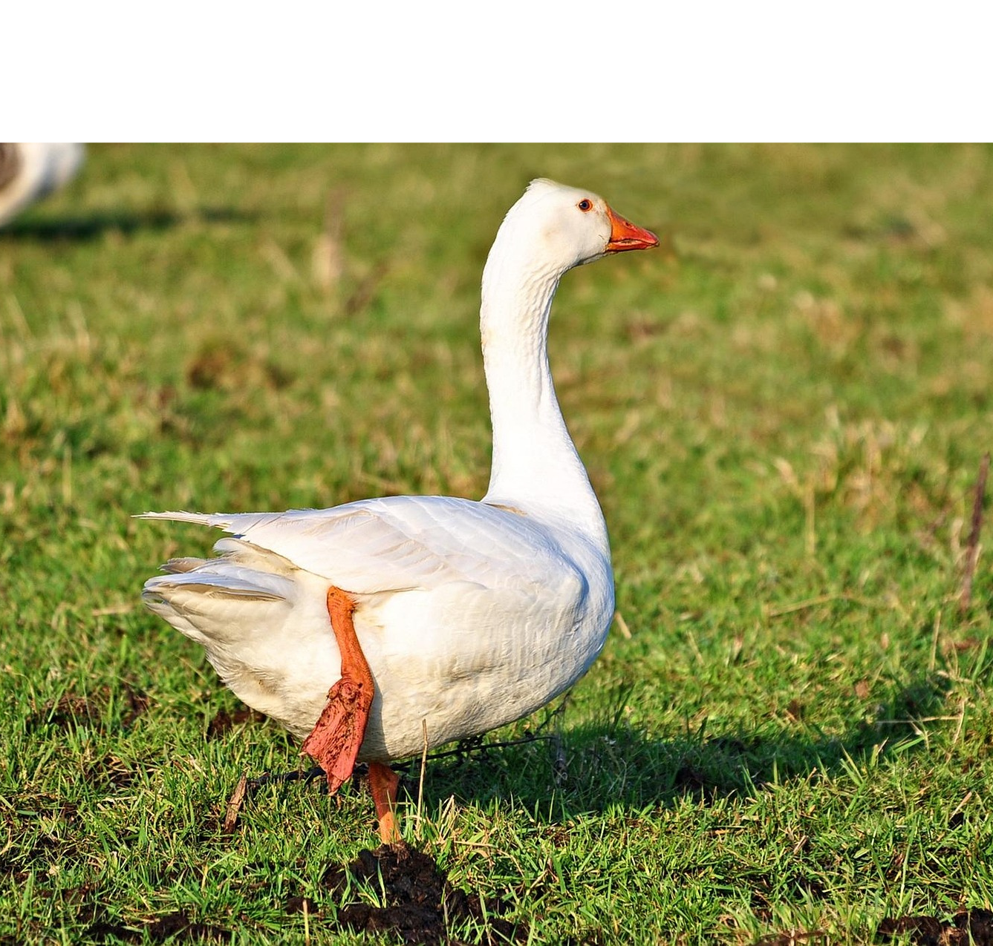
ESSENTIAL DAILY EXERCISES
Squats (with ball between knees)
Sit to stand
Single leg stand
Integrate several exs into 1
Move/exercise whilst performing daily functions
Little and often
Notes:
Suggest integration of exs into function and several exs in 1

Slide 19
Correct performance of an exercise is important to minimise the risk of injury and maximise effect
Strengthening the deep muscles is essential and is achieved by GENTLE exercises
Standing on 1 leg
Make sure that you feel stable (finger tip support)
The pelvis of the lifted leg should be higher than the weight bearing leg
Increase complexity by standing on a soft surface (cushion) orby moving your arms
Squats/ step ups /sit to stand
These do not need to be deep
Always keep feet hip distance apart
As you move ensure that your knees do not move towards each other
Keep your hips and knees over your toes

Slide 20
DEEP HIP STABILISER EXERCISE
Sit on a chair or ball with your feet hip-width apart and place your hands on your thighs.
Try to sit up by firstly rolling your pelvis forward leading from the bottom of your spine so that you are sitting in neutral spine position.
Imagine gently drawing your thigh bones back into the hip sockets and drawing in the muscles across the front of your pelvis.
Keep imagining “thighs back and hips together”.
Repeat x3, several times a day. This exercise also helps with bladder control

Slide 21
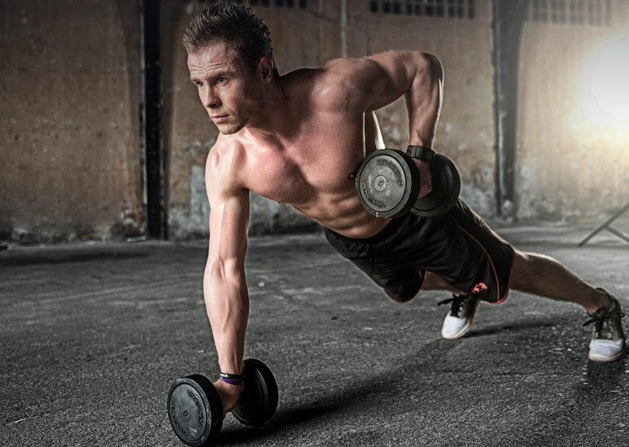
WHOLE..ISTIC
Concentric, eccentric, isometric, isotonic, inner/middle and outer range
Range of movement
Aerobic
Strengthening
Balance
Co-ordination
Notes:
first muscle to contract when we move shoulder in standing—gastroc/calf

Slide 22
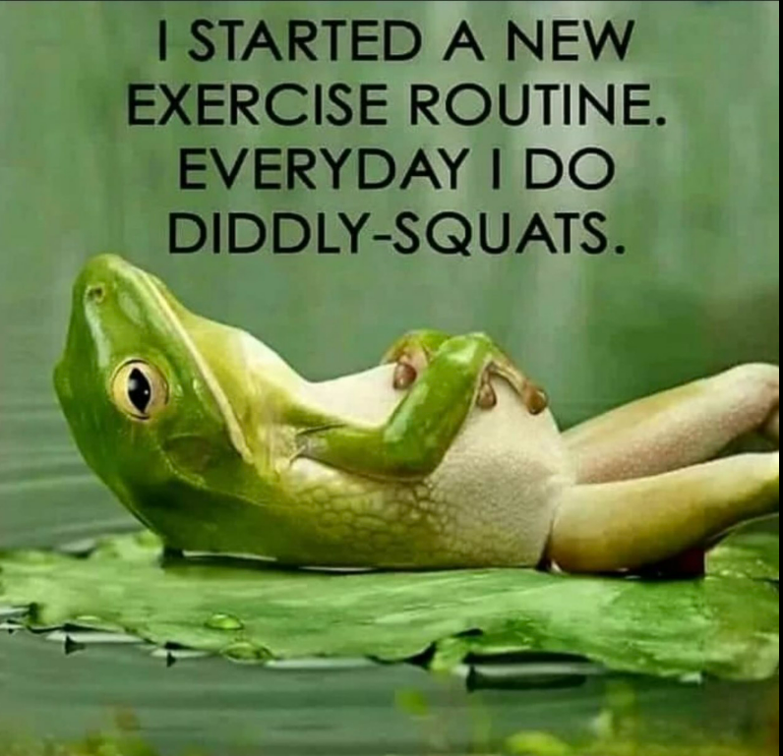
PROGRESSION
Reps and sets, increase complexity
Pacing—10% increase rule, 20% decrease rule, 15 mins max then rest, ( ligament creep) repeat
No 2 consecutive days without exs/movement
Weight bearing exs
Non WB exs
Notes:
Suggest Piddly Squats instead
Exercise can be housework, gardening, going for a walk, playing with grandkids as long as it is movement

Slide 23
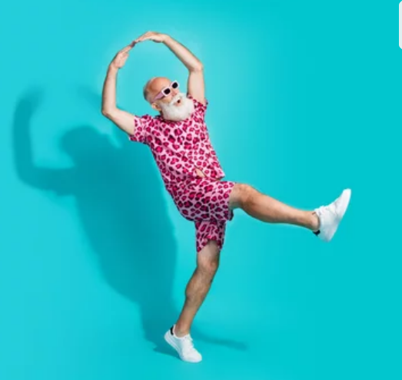
FIND JOY
Enjoyable exs
Sociable exs
Music and other parts of the brain

Slide 24
Weight bearing exercise: walking-use a stick/tramping pole, tennis, golf, gardening, T’ai Chi, Pilates, yoga, table tennis, badminton, gym
Sports South Canterbury, Aorangi Stadium, Morgans Road for ideas, advice and groups to join

Slide 25
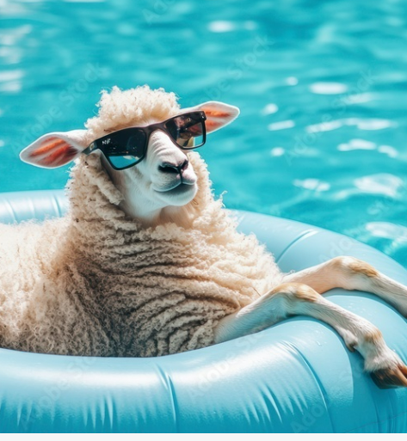
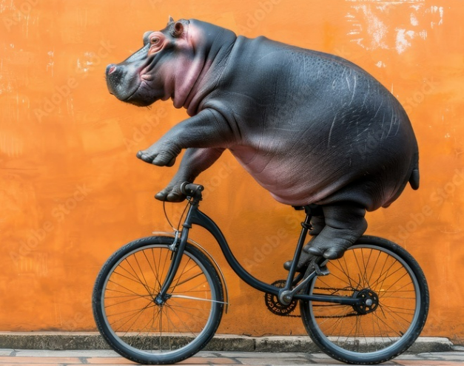
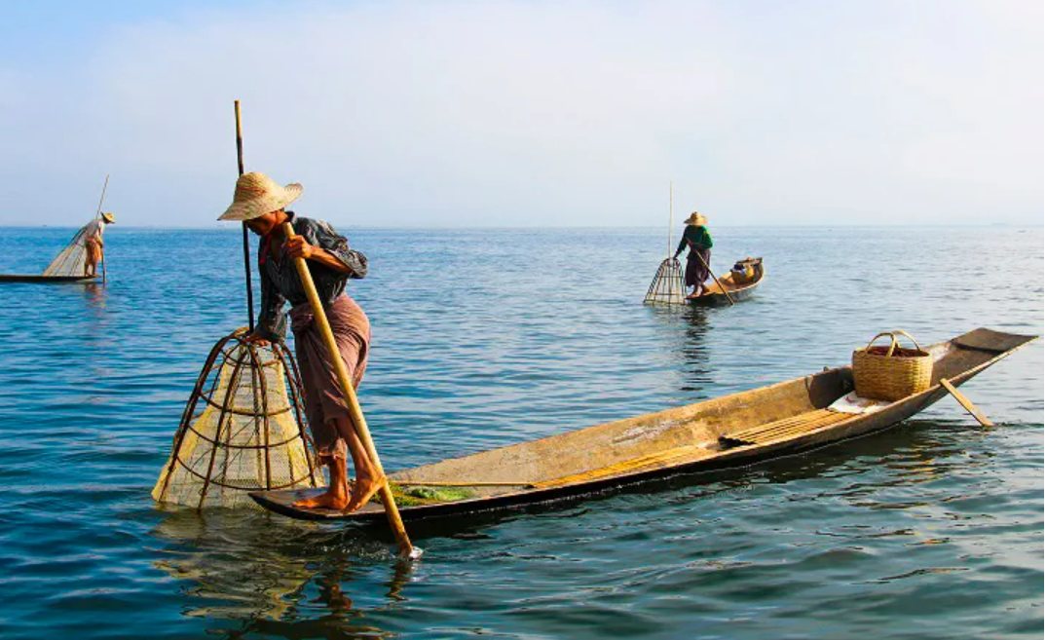
Do what you enjoy what you are good at or learn a new skill
Swimming and Deep Water Walking
Rowing
Exercycles, Cycling and Ebikes

Slide 26
Some condition specific exercises
Rowing machine/recumbent bike
Toe rises, calf stretches, squats
Weight bearing and resistance training in sunlight
Toe curls, heel/toe raises, knee bend and straighten, walking on the spot
POTS- recumbent position
Restless legs syndrome
Osteoporosis
Prolonged sitting—DVT prevention

Slide 27
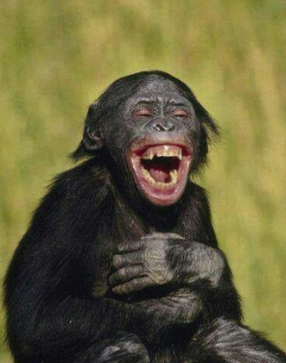
POINTS TO REMEMBER
It takes 14 muscles to open a bottle of wine
It takes 25 muscles to laugh
It takes 50 muscles to frown
SO …LAUGHING YOUR WAY THROUGH TWO BOTTLES OF WINE IS MORE OF A WORKOUT THAN BEING MISERABLE!!

Slide 28
THANK YOU

